Slide 1
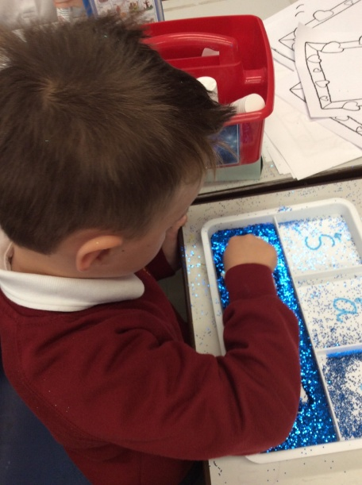
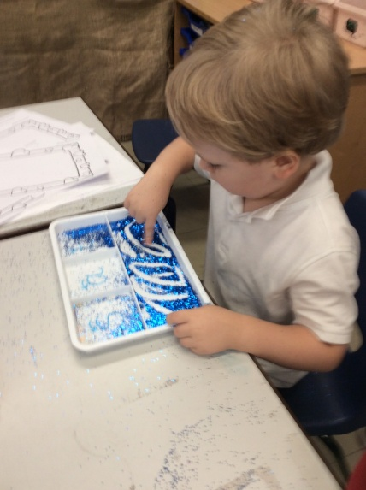
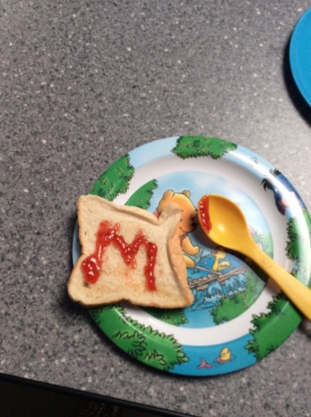
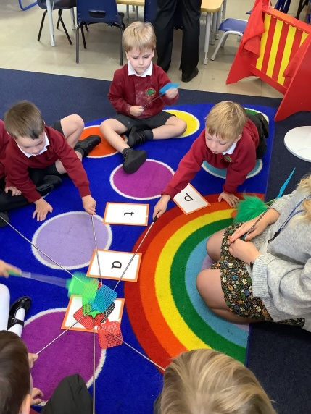
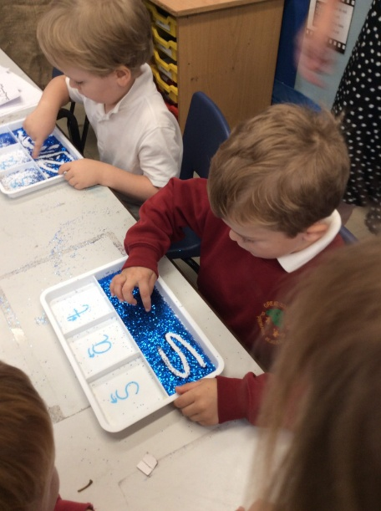
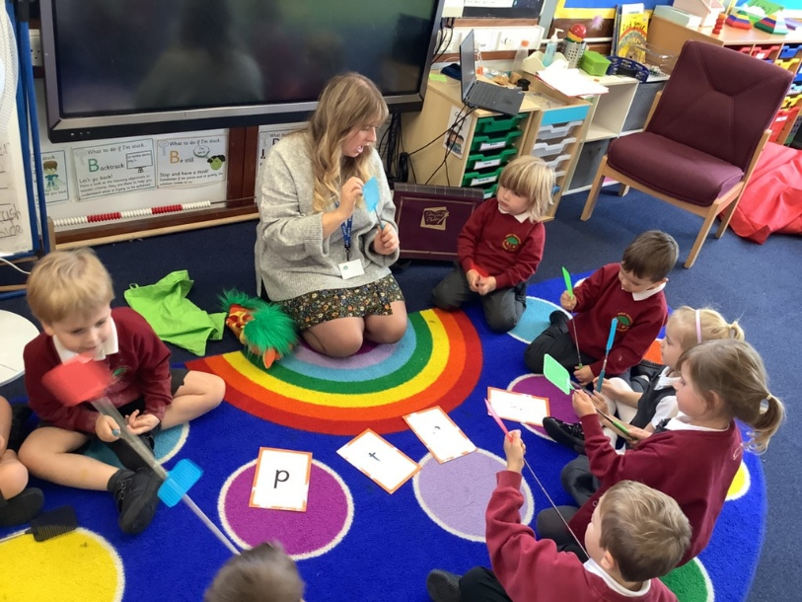
Early Reading and Phonics Workshop

Slide 2
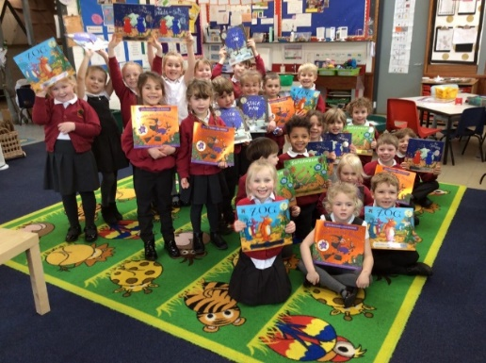
What is Phonics?
‘Phonics refers to a method for teaching speakers of English to read and write their language’
The National Literacy Trust
Notes:
EK Children are taught to read through phonics. Phonics is a method of teaching the 44 different sounds in the English language and identifying them in words to read them. However phonics is only one strategy the children use when reading. They are also encourage to look at the pictures, listen to the rest of the sentence to work out words they cannot read and think about whether the sentence makes sense in the context.

Slide 3
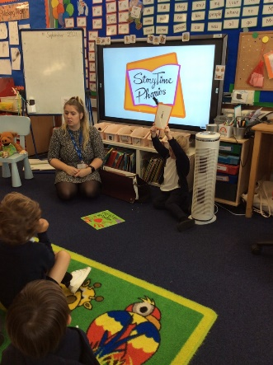
Phonics
30 mins daily focussed lessons, and is also referred to throughout the day in a variety of activities.
Recap, Teach, Practise, Apply.
At Great Staughton, we use Storytime Phonics which follows the Government Letters and Sounds programme.
Notes:
Ek We recap previous learning, teach a new sound, practise using the new sound and then the children have the opportunity to apply it. Chn are taught in their year groups and the lessons move at an appropriate pace for the children. Anyone struggling gets booster sessions as necessary.
We use Storytime phonics it is designed to help promote a love of reading and to teach phonics in a more meaningful way. The concept helps put the sounds into context through books.

Slide 4
Terminology
Children are taught from the beginning to use phonic terminology that may be new to you.
A phoneme is the smallest unit of sound in a word. (e.g. s, a, p)
A grapheme is the letter, or letters, representing a phoneme (e.g. t, ai and igh).
Digraphs have two letters (e.g. sh, ck, th and ll).
A vowel digraph contains at least one vowel (e.g. ai, ee, ar and oy).
Trigraphs have three letters (e.g. igh).
A split digraph (e.g. slide and like).
Notes:
GB
Children are taught to use the correct terminology from the beginning and we encourage them to do so. Some words you may now have heard before…..

Slide 5
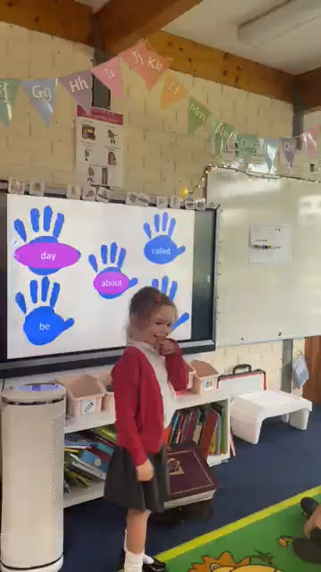
What does a phonics lesson look like?
revisit
reveal our new sound
engaging
activities
develop a love of reading

Slide 6
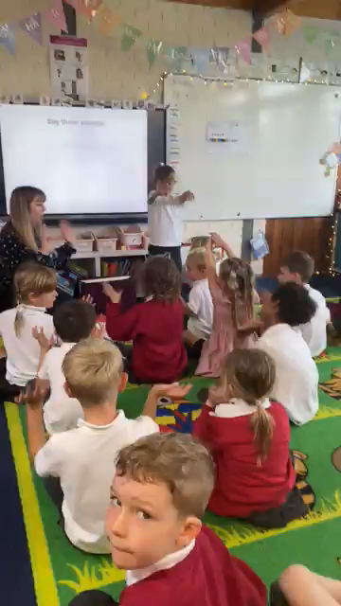
What does a phonics lesson look like?
revisit
reveal our new sound
engaging
activities
develop a love of reading

Slide 7
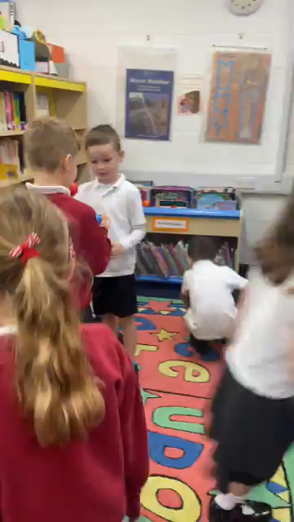
What does a phonics lesson look like?
revisit
reveal our new sound
engaging
activities
develop a love of reading

Slide 8
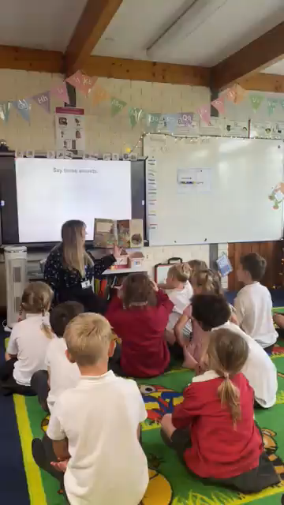
What does a phonics lesson look like?
revisit
reveal our new sound
engaging
activities
develop a love of reading

Slide 9
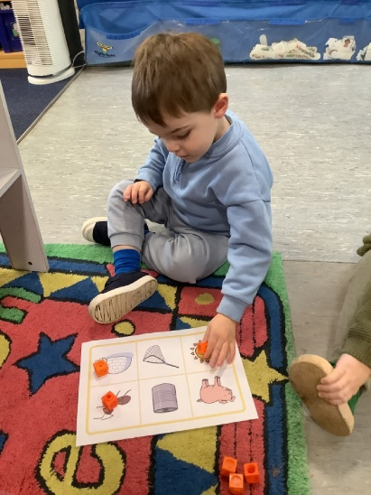
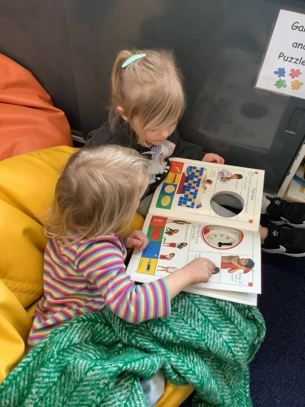
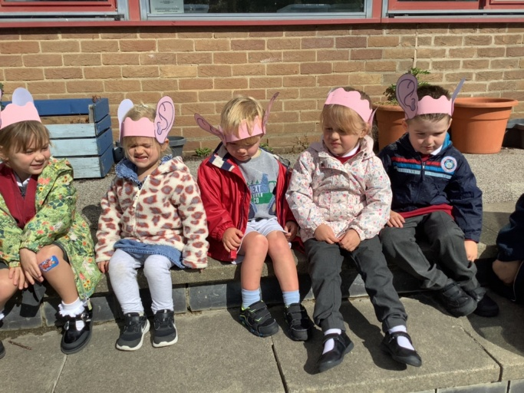
Phonics- phase 1
Listening and spoken language skills continue alongside all other phases of learning to read.
Your child has been learning to:
  Have fun with sounds
  Listen carefully
  Develop their vocabulary
  Speak confidently to you, other adults and children
  Tune into sounds
  Listen and remember sounds
  Understand that spoken words are made up of different sounds.
Notes:
GB
Phase one is the first building block to learning to read and really builds on many of the games and activities that you may already do at home with your child such as singing nursery rhymes and listening to environmental sounds. We play lots of listening games such as recognising rhyming, initial sounds, natural sounds etc. We continue this phase alongside all other phases.

Slide 10

Phonics- phase 2 and 3
Phase 2
Set 1: s, a, t, p
Set 2: i, n, m, d
Set 3: g, o, c, k
Set 4: ck, e, u, r
Set 5: h, b, f, ff, l, ll, ss
Phase 3
Set 6: j, v, w, x
Set 7: y, z, zz, qu
Consonant digraphs: ch, sh, th, ng
Vowel digraphs: ai, ee, igh, oa, oo, ar, or, ur, ow, oi, ear, air, ure, er
Pronunciation is key!
Segmenting and blending
Notes:
EK
In phase 2 we teach the children to recognise single letter sounds. We teach them to segment words into their individual sounds and then blend them together to read them- this is why it is so important to pronounce each sound correctly. We are in the process of providing videos on the school website- will add to them as the children learn each sound. In phase 3 the children are taught digraphs and trigraphs- 2 or 3 letters making one sound. By phase 3 children are expected to be reading and writing simple words in sentences. Always use lowercase letters unless except the start of names. The call the uppercase letters by their name (like the alphabet) and lowercase letters make the sounds.

Slide 11
s

Slide 12
a

Slide 13
t

Slide 14
Segment and blend
sat

Slide 15


Sound buttons
We use sound buttons as a visual aid to support segmenting and blending.
cat
tap
church
ship
Notes:
EK
Model this on a whiteboard!!
Tricky words and some of the words on the word walls cannot be segmented and blended- this is why the children learn them by sight.

Slide 16
Phonics- Phase 4
In Phase 4-
No new graphemes.
Aim is to consolidate the children's knowledge.
Focus on reading adjacent consonants, such as trap, string and milk.
In phase 3 they learn to read CVC words. Now they are taught to read and write CVCC words.
Tricky Words:
  said
  have
  like
  so
  do
  some
  come
  were
  there
  little
  one
  when
  out
  what
Notes:
EK
This is a short phase- use for consolidation and some new tricky words are introduced.

Slide 17
Phonics- Phase 5
In phase 5 new graphemes are taught:
ay, ou, ie, ea
oy, ir, ue, aw
wh, ph, ew, oe, au, ey
a_e, e_e, i_e, o_e, u_e
Phase 5 teaches more graphemes and phonemes but also teaches alternative pronunciations.
Notes:
EK
The next phase of phonics is phase 5. The children learn some new, more challenging sounds but it is often with these sounds their reading really takes off. With practice, speed at recognising and blending graphemes will improve. Word and spelling knowledge will be worked on extensively.
In this phase we look at alternative ways of making the same sound. For example, ai, a-e, ay, etc.

Slide 18

Year 1 Phonics Screening Check
The Phonics Screening Check takes place at the end of year 1.
The phonics screening check assesses children’s ability to decode words.
The children will read 40 words. Some of these words will be alien or nonsense words.
Notes:
GB
The phonics screening check takes place at the end of year 1. The children read 40 words, some of which are nonsense words. We practise nonsense words through each phase of phonics so it becomes normal. The screening assesses the children’s ability to decode words. It purely assess their phonics knowledge, not their reading ability.
It’s nothing to worry about and the children are very used to doing them through the year within lessons.

Slide 19
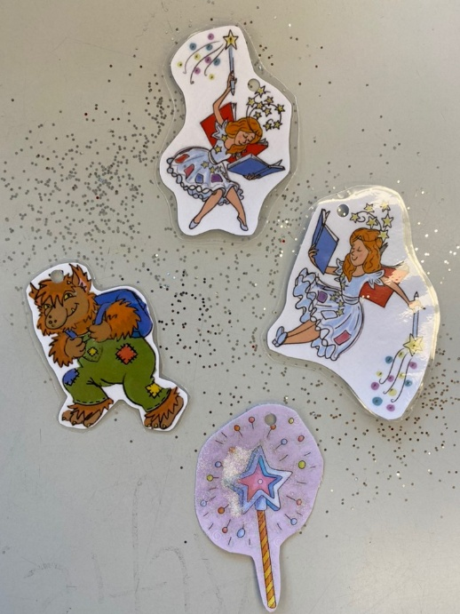
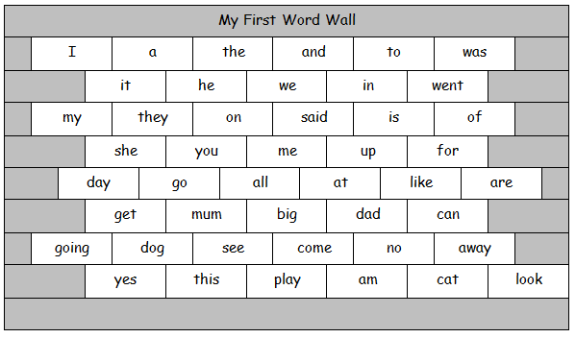
Phonics packs and word walls
Word walls 1-3 contain high frequency words and some tricky words.
Learning these words by sight will improve reading fluency.
Notes:
EK
Your child will receive a phonics pack with all the sounds they have learnt so far. It is useful for you to practise these at home to help consolidate learning. At school we play games such as SPLAT!, pairs and snap. These are games you can also play at home.
Model each game using cards.

Slide 20
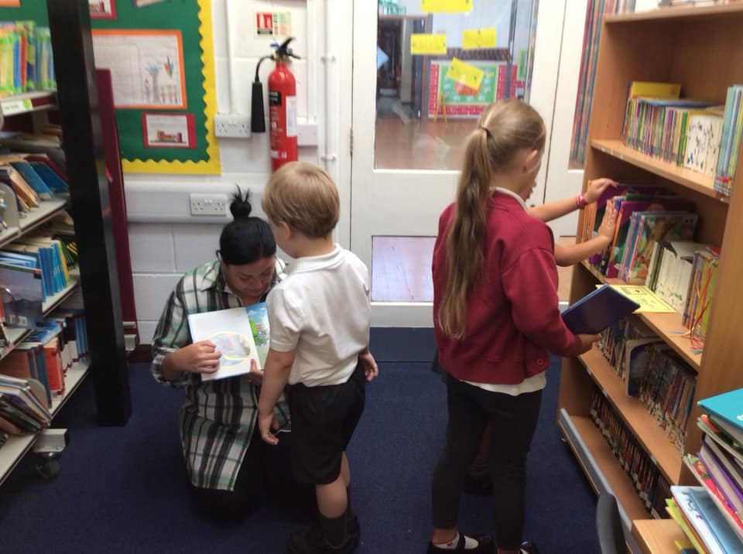
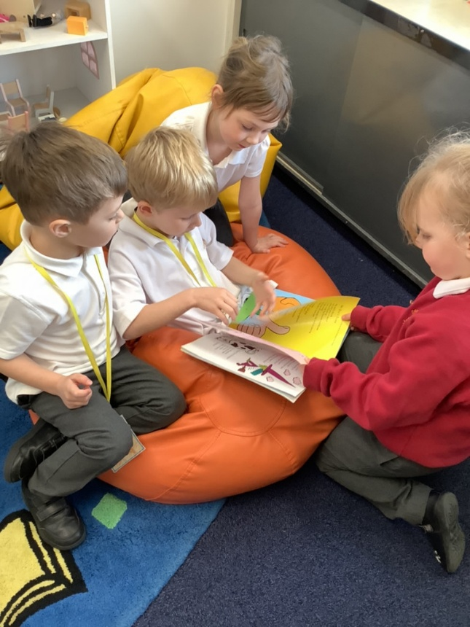
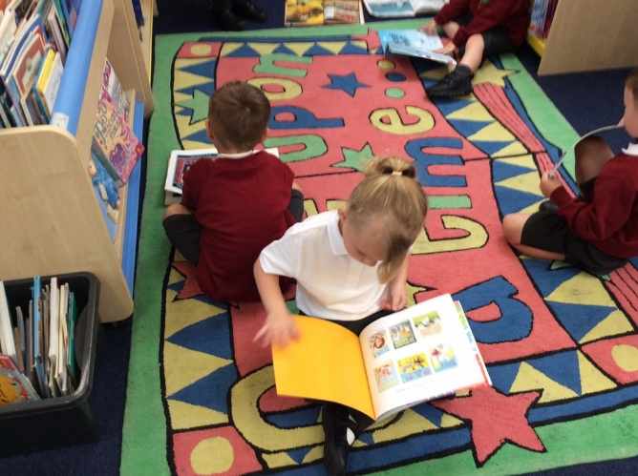
Reading at GS
1:1 reading
Guided Reading
Shared Reading
Independent Reading
Notes:
GB
At our schools we provide opportunities for the children to read 1:1 with an adult almost every day. This may be with teachers, teaching assistants or one of our volunteers. Sometimes the children also read to other class children which they absolutely love! We also do guided reading every week where the children take part in a group discussion about a book. We share books as a whole class and the children also have opportunities for independent reading within the classroom. They enjoy choosing their own library books, which they often cannot read yet themselves- this is a great opportunity for discussions and to broaden their vocabulary. Discussing the meaning of next words is a fantastic opportunity to move their reading skills on!
At home you can share books for pleasure- this is probably the most important thing you can do! Enjoy bedtime stories, but also books at any time of day. Share recipe books, newspapers, magazines, instruction manuals- anything with text in it is a great things to share with your child as they explore reading for different purposes! They took home books without words in this week and we encourage you to spend time discussing the title, pictures and events. When the children are ready they will receive a book with words in that matches their phonics ability.

Slide 21
Book bands/ phonics books
Your child will receive 3 books.
Phonics books
Relate to current sounds your child is learning or one they need to practise.
Decodable words e.g. cvc words
Develops using phonics knowledge to break and blend words
Coloured band book
Relate to the stage your child is on their reading journey
Read with at least 90% accuracy
Develops segmenting and blending skills, understanding of what they have read, expanding vocabulary
Library book
Purely for joy
Access to wide range of books
Develops their imagination
Reading:
Expands vocabulary
Develops imagination
Encourages concentration and focus
Promotes empathy
Provides a chance to access the whole curriculum
Develops expression
Teaches us about the world around us
Notes:
EK
Phonics books, these books relate to the current sounds your child has learnt/learning. These books will contain words that your child can decode. Reading these books helps your child use their phonics knowledge to break down the words and blend them to read.
Coloured band book, these books relate to the stage your child is on their reading journey. Every half term your child will be benchmarked (assessed) on their segmenting and blending skills and understanding of what they have read. These books help develop pleasure for reading, expanding vocabulary and blending skills.
Library book, these books are purely for joy. We want our children to access a wide range of book, develop their imagination and to share their books with you!

Slide 22
Reading Bands
This book is too easy for my child!
My child’s friend is on the next colour.
My child has read this book already.
When can my child move up?
Notes:
EK
I really do not want parents to compare the colour band their child is on with other children. Each child is on their own journey. It is not a race! Lots of factors affect when we choose for a child to change colour book band. Most of all we want the children to enjoy the books they read at home- the books that get sent home should be readable with at least 90% accuracy- we do the hard work at school in guided reading sessions and when we read 1:1.
Sometimes we ask a child to read a book again or sometimes they choose the same book again. There is nothing wrong with this. It helps to consolidate the sounds and words they know and is a great opportunity for discussion.
You can challenge your child by asking them questions about the text. Can they retell the main events accurately or with details. Can they predict what might happen next if you pause part way through? Can they discuss characters, their feelings and their actions? Can they talk about why they like or dislike a certain book? Can they compare it to other texts? You can do this with any book- bedtimes stories, reading books, books from the library.

Slide 23
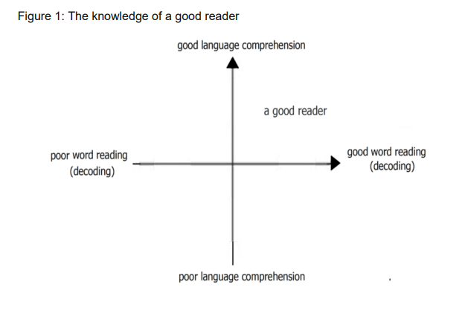
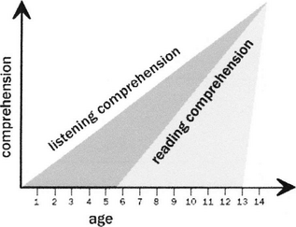
Links between decoding and comprehension
Comprehension: the understanding of the text by connecting ideas within and between sentences.
Decoding: applying phonics knowledge to correctly read written words.
Developing secure decoding skills, and in turn fluency and comprehension, opens a world of opportunities.
Notes:
GB
Decoding is a key skill to reading comprehension. Word reading and language comprehension require different sorts of teaching. When children start learning to read, the number of words they can decode accurately is too limited to broaden their vocabulary. Their understanding of language should therefore be developed through their listening and speaking, while they are taught to decode through phonics. This skill is developed through the phonics phases. However, when they can read most words ‘at a glance’ and can decode unfamiliar words easily, they are free to think about the meaning of what they read. They can then begin to develop their understanding of language through their reading. (p17)
In contrast to spoken language, written language is a cultural invention. Most children do not develop the ability to read without direct teaching. For children who begin school with a poor understanding of language, being able to decode words is essential for equality, because their understanding of language, their vocabulary and their knowledge of the world will expand rapidly when they can read for themselves. Children need both good language comprehension and good word reading to become good readers.
Graph 2: Decades of research, not to mention personal experiences, confirm that listening comprehension outpaces reading comprehension from early childhood through at least middle school. Based on their review of research, Stricht and James (1984) analyzed the gap between listening and reading comprehension by age of learner (see Figure 1). What is obvious from this figure is the fact that access to complex ideas, for many years of the learner's life, requires oral rather than written input.
Simply stated, children can listen to and talk about much more complex ideas than they can read (and probably write) about. In addition to the research, anyone who has ever read a bedtime story to a preschooler knows that listening comprehension is more sophisticated than reading comprehension. The proof comes from nights when you're tired and you skip a page while reading a bedtime story. That 3-, 4-, or 5-year-old's eyes pop open. You are accused of skipping some of the story, and the punishment is that now you must start over. Yes, in fact, the child is listening, understanding, and comparing the text with his or her expectations.
What is less obvious from personal experience is the persistence of this gap. According to Stricht and James (1984), the gap extends well into middle school. This gap has implications for high-quality instruction across the learner's elementary and middle school experience, and oral language development should not be considered solely the role and responsibility of early childhood educators.

Slide 24
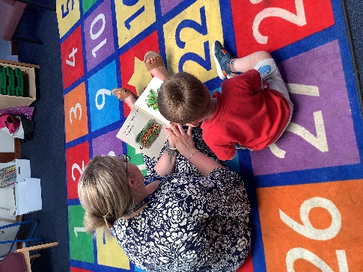
The Importance of Book Talk
Book talk refers to the discussion you might have about a book.
Look at the front cover, the title, the pictures. Discuss what you think the book might be about.
Who are the character?
What might happen? How do you know?
Retell the story in your own words.
It’s vital to develop children’s listening and speaking skills alongside reading
Notes:
GB
Book talk is vital for children to gain an understanding of what they have read, to improve their comprehension skills and inferential skills. Book talk gives the children a chance to use some of the words in the book in advance of reading the book.
We really encourage you to try lots of book talk at home before you ask your child to start reading the words- look at the front cover, the pictures, discuss what they think the story is going to be about.
Oral language development facilitates print literacy.

Slide 25
Reading at Home
Readers are made on the knees of their parents.
Sharing books for pleasure.
Bedtime Stories.
1:1 reading of school reading book.
Sharing newspapers, magazines and non-fiction texts.
Notes:
EK
At home you can share books for pleasure- this is probably the most important thing you can do! Enjoy bedtime stories, but also books at any time of day. Share recipe books, newspapers, magazines, instruction manuals- anything with text in it is a great things to share with your child as they explore reading for different purposes! They took home books without words in this week and we encourage you to spend time discussing the title, pictures and events. When the children are ready they will receive a book with words in that matches their phonics ability.

Slide 26
Top Tips
Practise little and often.
Practise phonics flash cards and games.
Discuss the world and children’s experiences to gain new vocabulary.
Sharing books with your child often. Look at the pictures and talk about the book.
Encouraging your child to form their letters correctly.
Model correct speech and correct your child’s speech if they say something incorrectly.
Play reading and writing games.
Come and chat if you are worried or have questions!
Promote a love of reading!
Notes:
EK

Slide 27
What can I do if my child is stuck?
Don’t let them struggle for too long- count to three and then help them by:
  Encouraging your child to look at the pictures.
  Ask what sound the word starts with?
  Re-read the sentence up to the point your child is stuck.
  Write the word down and ask your child to add sound buttons.
  Give the child the word.
  Write any words your child struggles with and needs to learn in their reading diary.
Notes:
EK

Slide 28
Useful Resources
Our School Website
Phonics Play- www.phonicsplay.co.uk
Letters and Sounds- http://www.letters-and-sounds.com/
Mr Thorne Does Phonics/ Geraldine the Giraffe Learns… (Youtube)
Espresso
Teach Your Monster to Read – Your child has a login!
Notes:
GB
Some useful websites to practise phonics at home in a fun way!

Slide 29

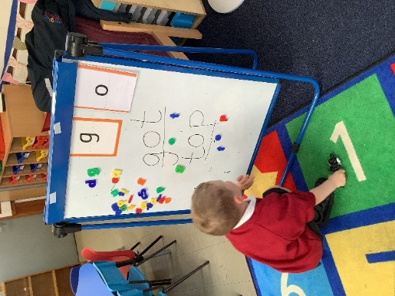
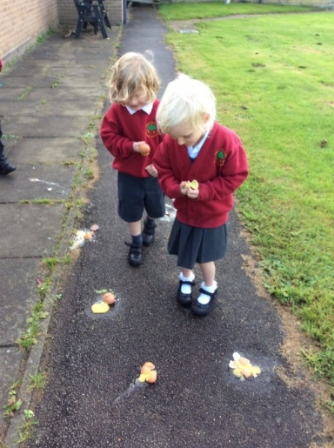
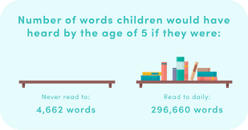
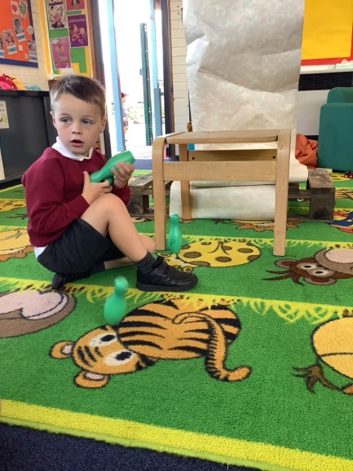
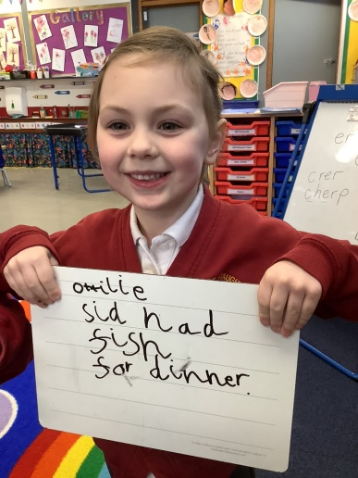



Any Questions?
Notes:
GB
As you are all here I’m sure you will agree with the quotes on this slide. The impact of parental support and engagement is huge. We see it everyday. Education doesn’t just happen at school and I hope that together we can form a partnership which will support and guide your child to become a successful reader.
Strong home-school partnership, if you need help or are unsure please ask.

