Slide 1





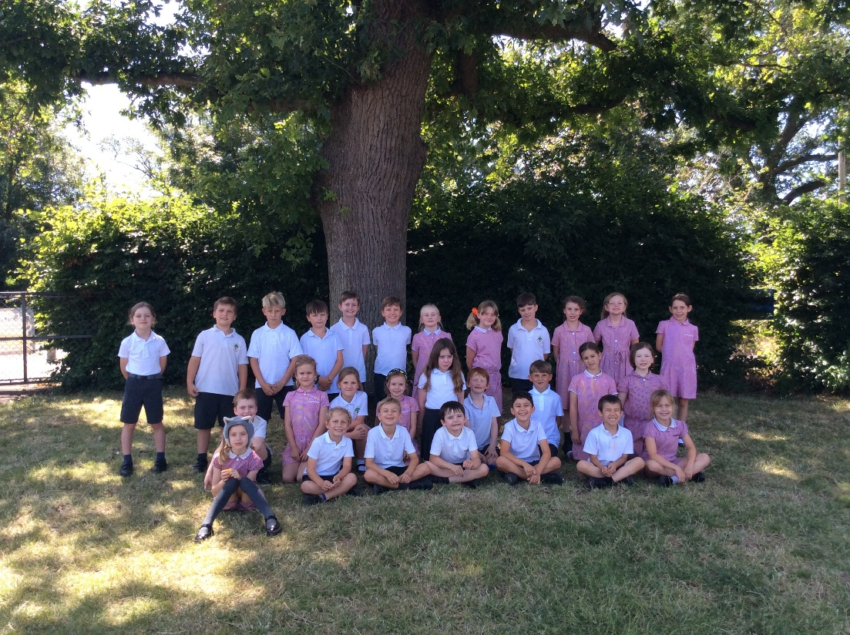


Jupiter Class 2025-2026
Class Teacher: Miss Smith
Teaching Assistant: Mrs Bendon

Slide 2


Key info
Our spelling tests are on Monday.
Outdoor learning is on a Thursday.
Mrs Passan teaches all day Wednesday.
Communicate
- Private facebook group
- letters/ emails
- reading diary
- face to face
PE is every Friday this half term. Next half term it will be Wednesday.
Name everything!
All login details are in your child's reading record.
We visit the library every Friday.

Slide 3
Uniform reminders
•Collared shirt or polo shirt- white (foundation-Y5) and blue (Y6)
•Sweatshirt or cardigan– burgundy (foundation-Y5) and blue (Y6)
•Grey long trousers, tailored shorts, skirt or pinafore dress
•Red checked dress (foundation- Y5) and blue (Y6)
•White or grey socks and grey tights.
•Black shoes, no trainers
PE uniform:
Indoor PE- navy shorts/white logo t-shirt
Outdoor PE- navy shorts/white logo t-shirt/navy sweatshirt/navy jogging bottoms
White trainers

Slide 4
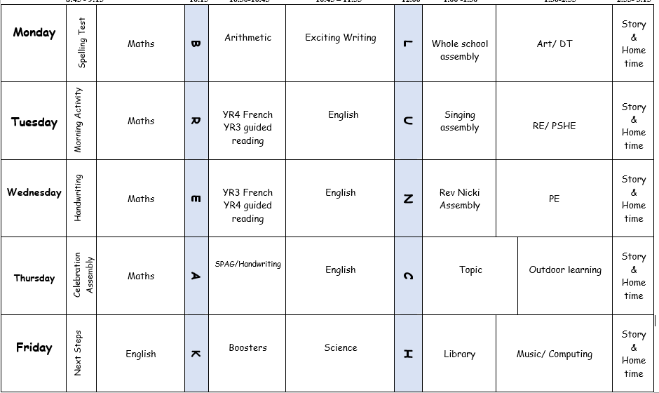
Typical Timetable

Slide 5
Daily/Weekly routines
Accelerated Reading- children complete quizzes when needed at school.
Maths Whizz- 60 minutes a week running from Monday-Sunday
TTRockstars- We encourage children to practice times tables when they can.
Outdoor Learning (every Thursday).
Homework- this could be flip learning, research or consolidation of any foundation subject and will usually be set each fortnight.

Slide 6
Expectations
  Arrive to school on time each day prepared to learn
  Follow agreed classroom rules
  Follow school behaviour system
  Work towards house point certificates
  Apply independent learning
  Implementing Growth Mindset
  What to do if I’m stuck..... (strategies)

Slide 7

What to expect from me and our team
Child-centred teaching. High quality and engaging lessons tailored to the children’s needs.
Extra support when necessary.
Guidance on things you can do at home to support your child.
Regular updates e.g. facebook and website.
Work is shared across a 2/3 year cycle.
Teachers work with colleagues across trust.
Core subjects taught throughout the week.
Implementation of skills and foundation subjects through week/term.
Specialist teachers for some subjects.

Slide 8
Support from home
  Regular reading
  Promoting independence at home
  Assistance with homework
  Maths Whizz and English based tasks
  Regular times table practice (especially YR4)
  Communication with teachers and staff
  Any additional knowledge or expertise

Slide 9
How to contact us
  On the playground for a quick chat or message (quickest for small queries)
  In written messages through the Reading Record
  Email via the office: office@greatstaughton.cambs.sch.uk
  (quickest for longer queries/messages)

