Slide 1
Saturn Class
Ms Smith – class teacher
Miss Preston – class TA Mondays and Tuesdays
Miss Anderson – class TA Wednesdays, Thursdays and Fridays
Mrs King – 1:1 TA

Slide 2


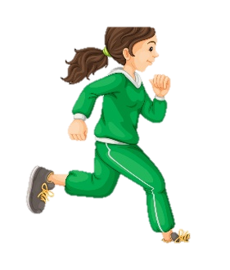
Look out for emails from the office relating to trips and events.
Key info
Outdoor learning will usually be on Fridays.
Breaktime snacks should be healthy.
Communicate
- letters / emails
- face to face
We visit the library every Wednesday, although children can change their library and colour banded books whenever needed.
Login details for Maths Whizz and TTRS are in your child's reading record.
PE is every Friday.

Slide 3



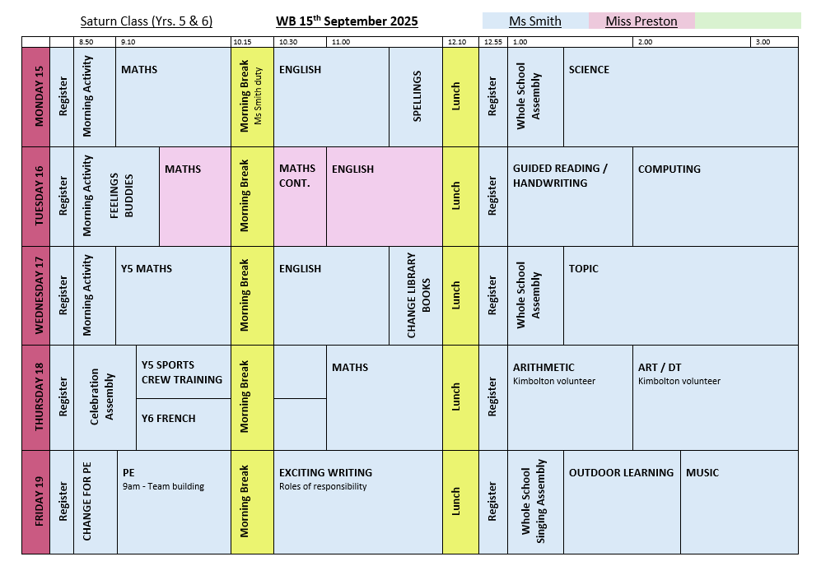
A typical day in Saturn
Routines:
Reading / changing books (AR quizzes)
Daily and weekly arithmetic practise
Year 6 buddies
Roles of responsibility

Slide 4


Arrive to school each day prepared to learn
Follow agreed classroom rules
Follow school behavior system
Earn house points
Be independent learners
Implement a growth mindset
Use taught strategies when stuck (The 6 Bs)
Expectations

Slide 5
Homework
Daily reading
Written homework set on Thursdays
Half-termly projects
Spellings due Monday
Maths Whizz due Sunday

Slide 6





Questions?

