Slide 1


Maths
Position and Direction
Year One
Maths | Year 6 | Position and Direction | Describe Coordinates in All Four Quadrants | Lesson 1 of 4: Olympic Coordinates

Slide 3
I can read coordinates in all four quadrants.
I can extend the x-axis and y-axis backwards into negative numbers to create the four quadrants.
I can read coordinates using positive and negative numbers.

Slide 4

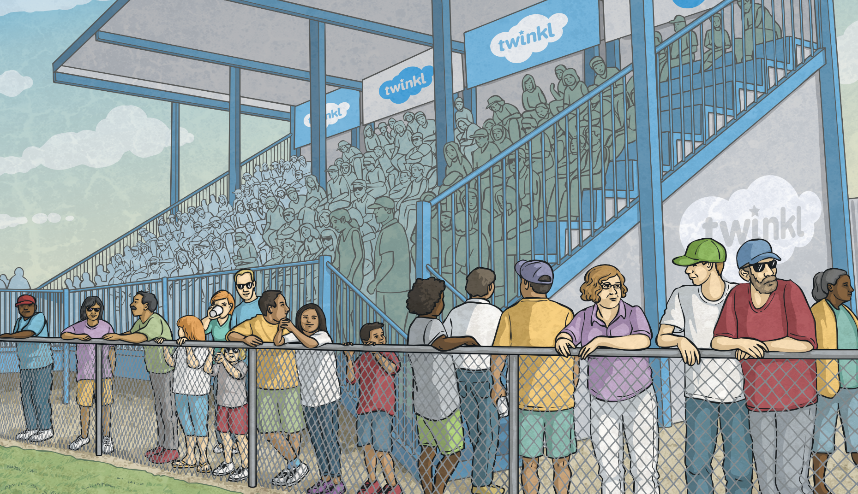

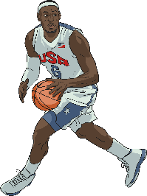
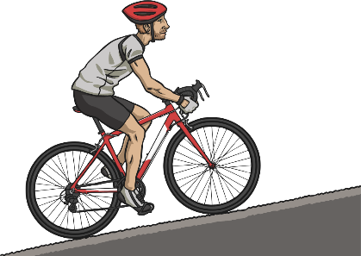
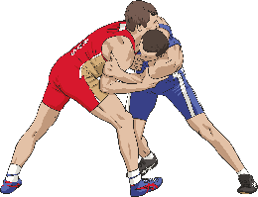
Olympic Sports Coordinates
6
My favourite sports to watch are (5,3), (2,5) and (0,1).
?
?
?
?
?
?
?
5
?
?
?
?
?
?
?
4
?
?
?
?
?
?
?
3
?
?
?
?
?
?
?
2
?
?
?
?
?
?
?
1
?
?
?
?
?
?
?
?
?
?
?
?
?
?
0
?
?
?
1
2
3
4
5
6
Click the correct coordinates to
find Joe’s favourite Olympic sports:

Slide 5
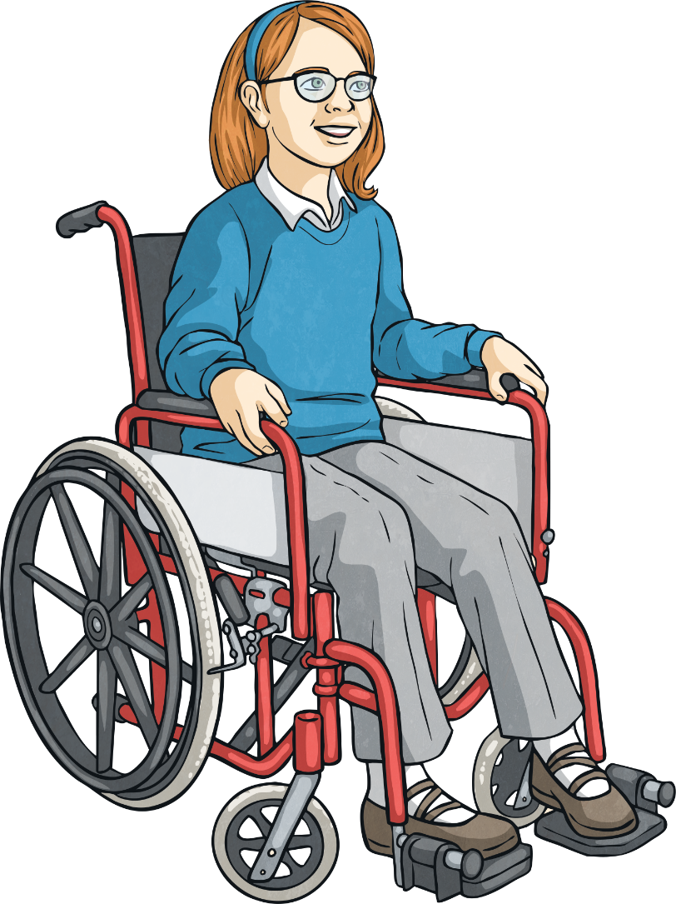
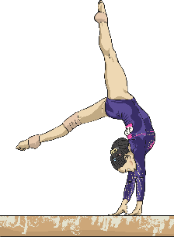
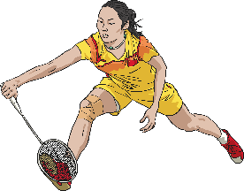
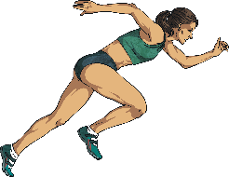
Olympic Sports Coordinates
6
My favourite sports to watch are (6,2), (1,6) and (3,3).
?
?
?
?
?
?
?
5
?
?
?
?
?
?
?
4
?
?
?
?
?
?
?
3
?
?
?
?
?
?
?
2
?
?
?
?
?
?
?
1
?
?
?
?
?
?
?
?
?
?
?
?
?
?
0
?
?
?
1
2
3
4
5
6
Click the correct coordinates to find
Anika’s favourite Olympic sports:

Slide 6

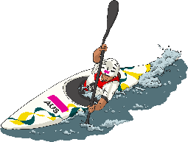
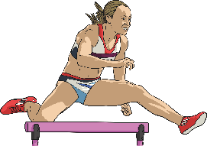
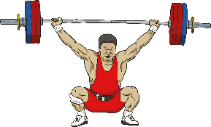
Olympic Sports Coordinates
6
My favourite sports to watch are (4,1), (2,4) and (5,0).
?
?
?
?
?
?
?
5
?
?
?
?
?
?
?
4
?
?
?
?
?
?
?
3
?
?
?
?
?
?
?
2
?
?
?
?
?
?
?
1
?
?
?
?
?
?
?
?
?
?
?
?
?
?
0
?
?
?
1
2
3
4
5
6
Click the correct coordinates to find
Grace’s favourite Olympic sports:

Slide 7

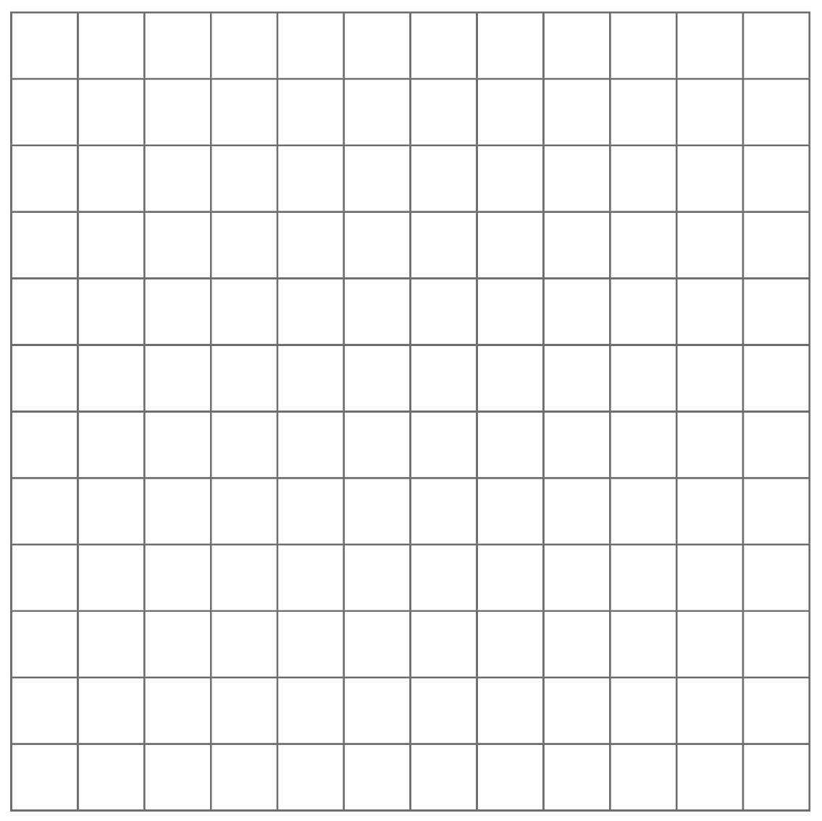
The Four Quadrants
6
In the first activity, you were identifying coordinates in the first quadrant, using the horizontal x-axis and vertical y-axis.
5
4
second
quadrant
3
first
quadrant
2
The point where the horizontal and vertical axes intersect is at (0,0). This is called the origin.
1
-6
-5
-4
-3
-2
-1
0
1
2
3
4
5
6
-1
When the x-axis and y-axis number lines are extended beyond the origin, into negative numbers, a much larger coordinate grid is created, made of four areas called quadrants.
-2
third
quadrant
-3
fourth
quadrant
-4
-5
-6

Slide 8
The Four Quadrants
6
Positions in the second quadrant always have a negative x-axis coordinate and a positive y-axis coordinate.
5
Positions in the first quadrant always have a positive x-axis coordinate and a positive y-axis coordinate.
4
second
quadrant
3
first
quadrant
2
1
-6
-5
-4
-3
-2
-1
0
1
2
3
4
5
6
Positions in the third quadrant always have a negative x-axis coordinate and a negative y-axis coordinate.
-1
Positions in the fourth quadrant always have a positive x-axis coordinate and a negative y-axis coordinate.
-2
third
quadrant
-3
fourth
quadrant
-4
-5
-6

Slide 9





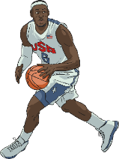
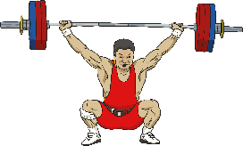



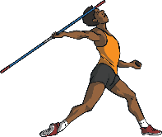
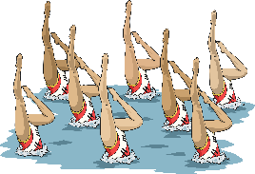
The Four Quadrants
6
5
Which quadrant should each Olympic sport be positioned in?
4
3
(-1,6)
first quadrant
(-3,4)
2
second quadrant
1
third quadrant
-6
-5
-4
-3
-2
-1
0
1
2
3
4
5
6
(5,-2)
-1
(6,1)
fourth quadrant
-2
-3
(-4,-1)
-4
(2,-2)
-5
-6

Slide 10


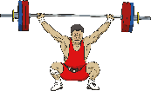



Describing Positions
6
Identify the Olympic sports positioned on a positive x-axis.
1.
5
4
3
first quadrant
2
second quadrant
1
third quadrant
0
Identify the Olympic sports positioned on a positive y-axis.
-6
-5
-4
-3
-2
-1
1
2
3
4
5
6
2.
-1
fourth quadrant
-2
-3
-4
-5
-6

Slide 11

Describing Positions
6
3.
Identify the Olympic sports positioned on a negative x-axis.
5
4
3
2
1
-6
-5
-4
-3
-2
-1
0
1
2
3
4
5
6
4.
Identify the Olympic sports positioned on a negative y-axis.
-1
-2
-3
-4
-5
-6

Slide 12

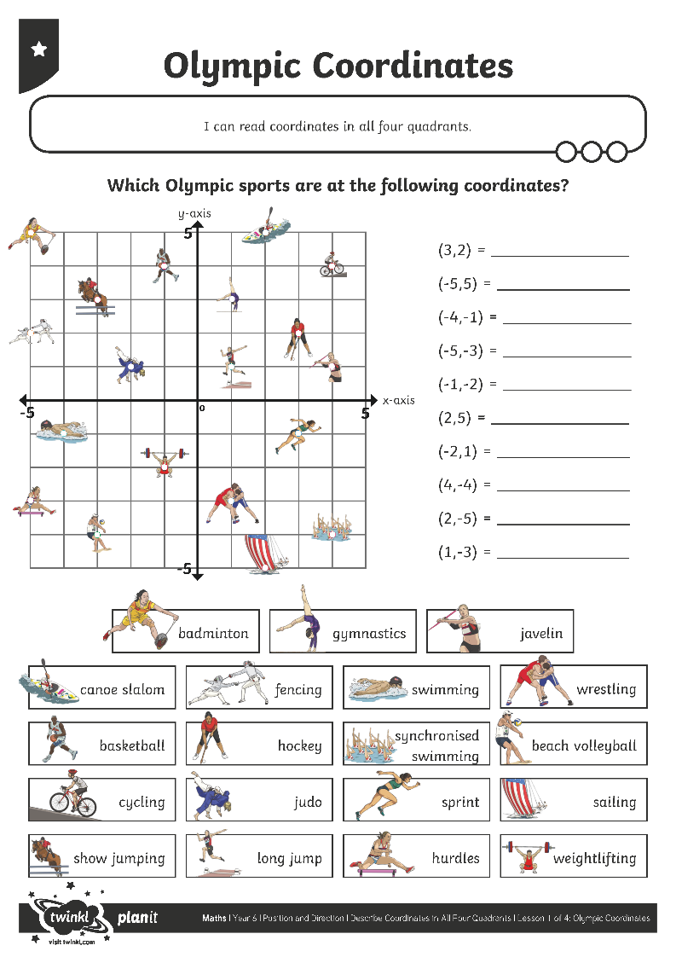
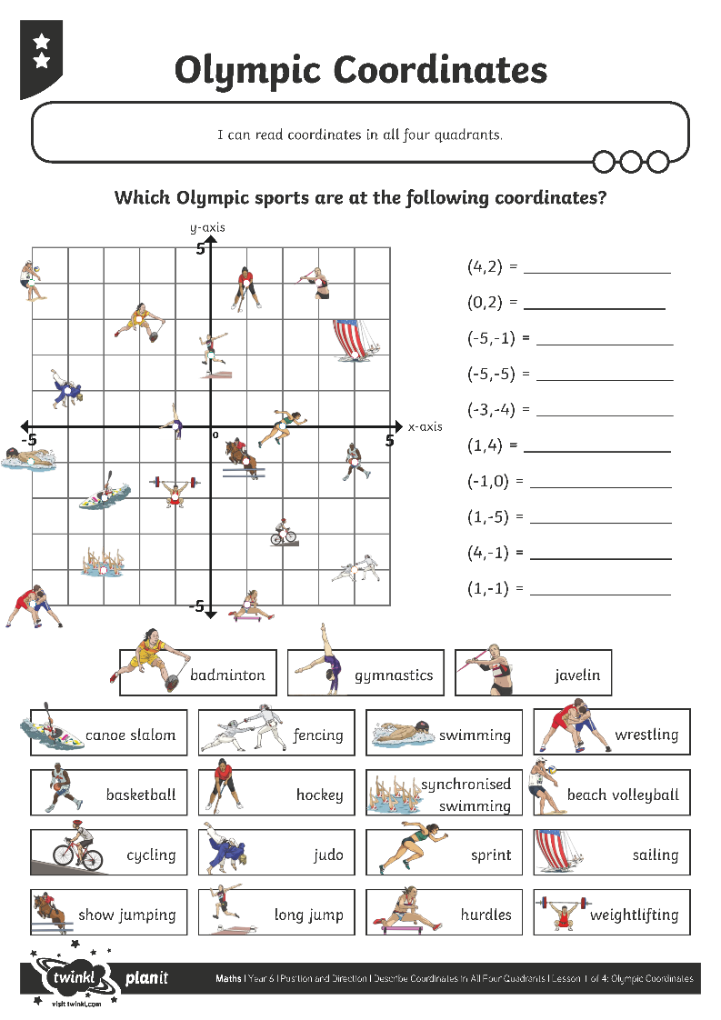
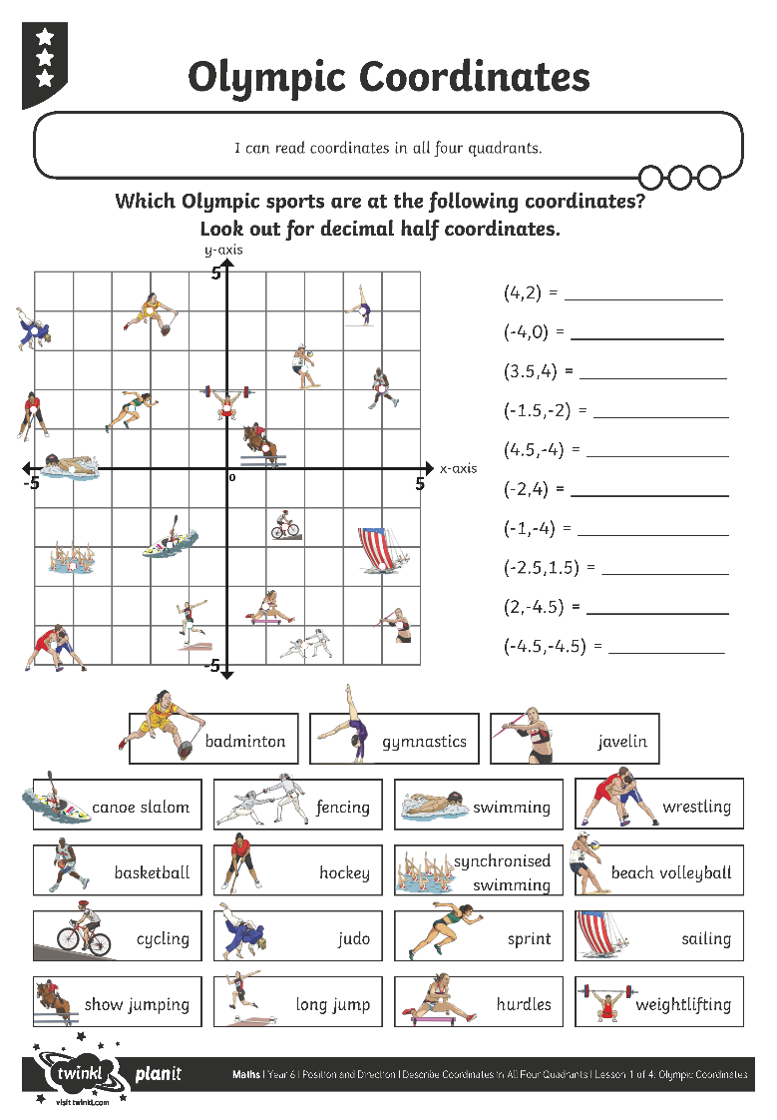
Olympic Coordinates

Slide 13
Missing Coordinates
6
5
Identify the missing coordinate for each Olympic sport:
4
3
(-2,-4)
?
2
(4,5)
1
?
-6
-5
-4
-3
-2
-1
0
1
2
3
4
5
6
(-3,-2)
-1
?
-2
(2,-4)
?
-3
-4
(-5,4)
?
-5
-6

Slide 14

I can read coordinates in all four quadrants.
I can extend the x-axis and y-axis backwards into negative numbers to create the four quadrants.
I can read coordinates using positive and negative numbers.

