Slide 1


To read, write, order and compare numbers up to ten million
© Classroom Secrets Limited 2018

Slide 2
Introduction
Use these digit cards to make the number with the greatest value.
Use these digit cards to make the number with the smallest value.
What is the value of 8 in each number?
6
8
9
1
4
3
© Classroom Secrets Limited 2018

Slide 3
Introduction
Use these digit cards to make the number with the greatest value.
Use these digit cards to make the number with the smallest value.
What is the value of 8 in each number?
6
8
9
1
4
3
986,431
134,689
8 ten thousands (80,000) and 8 tens (80)
© Classroom Secrets Limited 2018

Slide 4
Varied Fluency 1
Complete the statements using <, > or = to make them correct.
103,440 |  | 130,400
135,560 |  | 153,506
354,550 |  | 354,055
© Classroom Secrets Limited 2018

Slide 5
Varied Fluency 1
Complete the statements using <, > or = to make them correct.
103,440 | < | 130,400
135,560 | < | 153,506
354,550 | > | 354,055
© Classroom Secrets Limited 2018

Slide 6
Varied Fluency 2
Order the numbers from smallest to largest.
a. 902,346 |  | d. 920,546
b. 902,436 |  | e. 902,634
c. 920,643 |  | f. 920,463
© Classroom Secrets Limited 2018

Slide 7
Varied Fluency 2
Order the numbers from smallest to largest.
a, b, e, f, d, c
a. 902,346 |  | d. 920,546
b. 902,436 |  | e. 902,634
c. 920,643 |  | f. 920,463
© Classroom Secrets Limited 2018

Slide 8
Varied Fluency 3
Order the numbers from largest to smallest.
a.
b.
c.
100,000s | 10,000s | 1,000s | 100s | 10s | 1s
232,760
Two hundred and forty-one thousand and fifteen
© Classroom Secrets Limited 2018

Slide 9
Varied Fluency 3
Order the numbers from largest to smallest.
a.
b.
c.
a, c, b
100,000s | 10,000s | 1,000s | 100s | 10s | 1s
241,202
232,760
231,760
Two hundred and forty-one thousand and fifteen
241,015
© Classroom Secrets Limited 2018

Slide 10
Varied Fluency 4
The table shows the attendance at football matches last weekend. Write <, > or = to make the statement correct.
The attendance at Sheffield United FC was than the attendance at Leicester City FC.
Sheffield United FC | 23,445
Leicester City FC | 35,665
Aston Villa FC | 29,898
© Classroom Secrets Limited 2018

Slide 11
Varied Fluency 4
The table shows the attendance at football matches last weekend. Write <, > or = to make the statement correct.
The attendance at Sheffield United FC was than the attendance at Leicester City FC.
Sheffield United FC | 23,445
Leicester City FC | 35,665
Aston Villa FC | 29,898
<
© Classroom Secrets Limited 2018

Slide 12
Reasoning 1
True or false? Give reasons for your answer.
five hundred and twenty-six thousand, two hundred and fifty-one
 | < | 562,215
© Classroom Secrets Limited 2018

Slide 13
Reasoning 1
True or false? Give reasons for your answer.
True, it is less than…
five hundred and twenty-six thousand, two hundred and fifty-one
 | < | 562,215
© Classroom Secrets Limited 2018

Slide 14
Reasoning 1
True or false? Give reasons for your answer.
True, it is less than. The digit in the hundred thousands column is the same so we look at the digit in the next column and 6 is greater than 2.
five hundred and twenty-six thousand, two hundred and fifty-one
 | < | 562,215
© Classroom Secrets Limited 2018

Slide 15
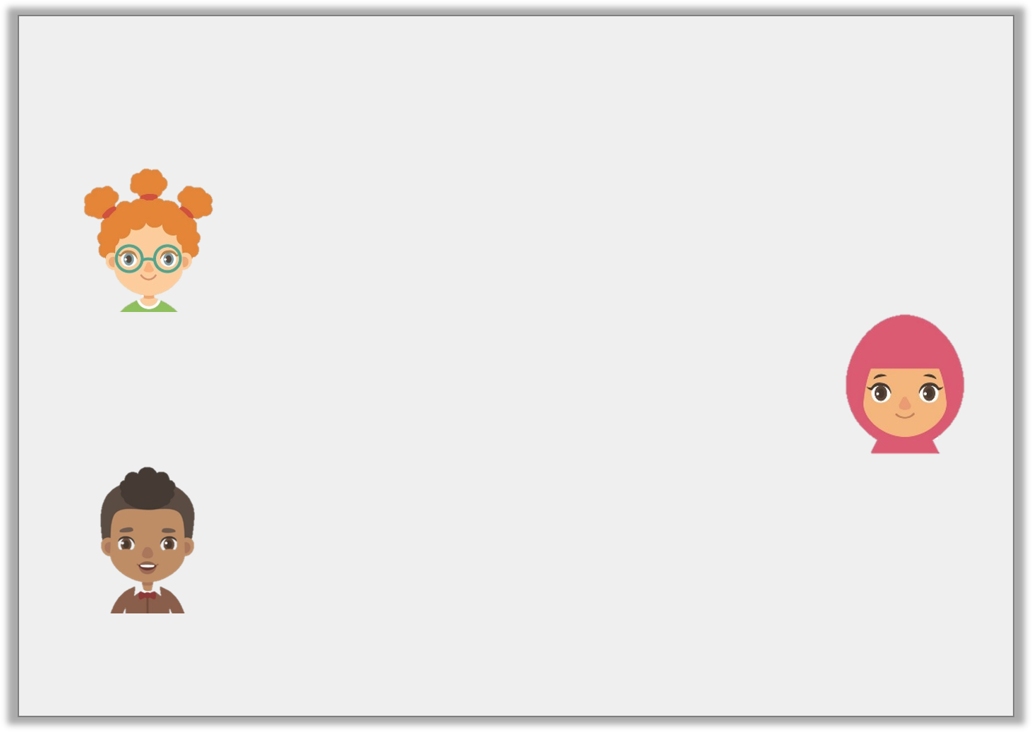
Problem Solving 1
Work out which child has the number card according to their statements.
742,039
My number has 7 hundreds and rounds to 740,000.
Lynn
My number has 9 ones and is less than 740,000.
Aleeza
My number rounds to 740,000 and has 0 hundreds.
Tyler
© Classroom Secrets Limited 2018

Slide 16
Problem Solving 1
Work out which child has the number card according to their statements.
Tyler
742,039
My number has 7 hundreds and rounds to 740,000.
Lynn
My number has 9 ones and is less than 740,000.
Aleeza
My number rounds to 740,000 and has 0 hundreds.
Tyler
© Classroom Secrets Limited 2018

Slide 17
Problem Solving 2
Use the digit cards to make the statement correct.
Is there more than one possible solution?
1
3
2
78 ___ ,20 ___ > 782,201
© Classroom Secrets Limited 2018

Slide 18
Problem Solving 2
Use the digit cards to make the statement correct.
Is there more than one possible solution?
Three solutions: 782,203, 783,201, 783,202
1
3
2
78 ___ ,20 ___ > 782,201
© Classroom Secrets Limited 2018

