Slide 1
Year 6 Maths 02.02.2021
LO: To solve missing number problems (algebra)

Slide 2
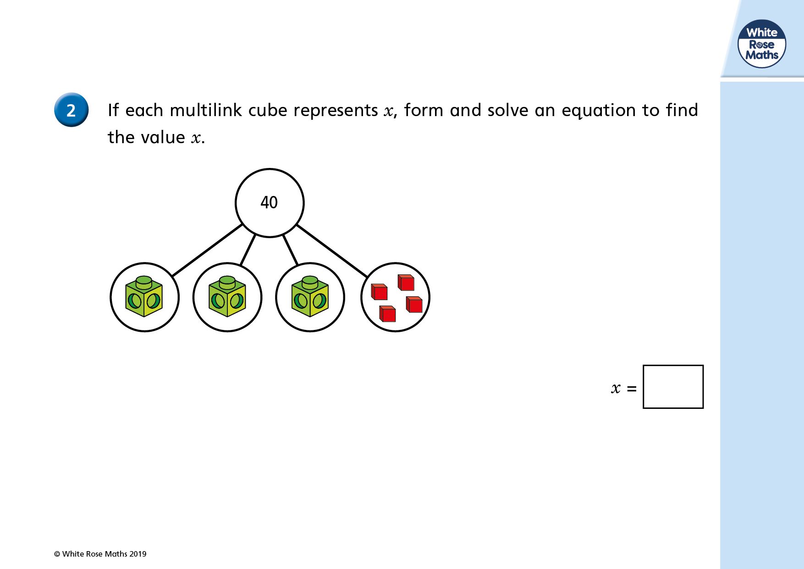


Slide 4
3 + 4 = 40

Slide 5
3 + 4 = 40
3 = 40 - 4

Slide 6
3 + 4 = 40
3 = 36
3 = 40 - 4

Slide 7
3 + 4 = 40
3 = 36
3 = 40 - 4
= 36 ÷ 3

Slide 8
12
3 + 4 = 40
3 = 36
3 = 40 - 4
= 36 ÷ 3

Slide 9
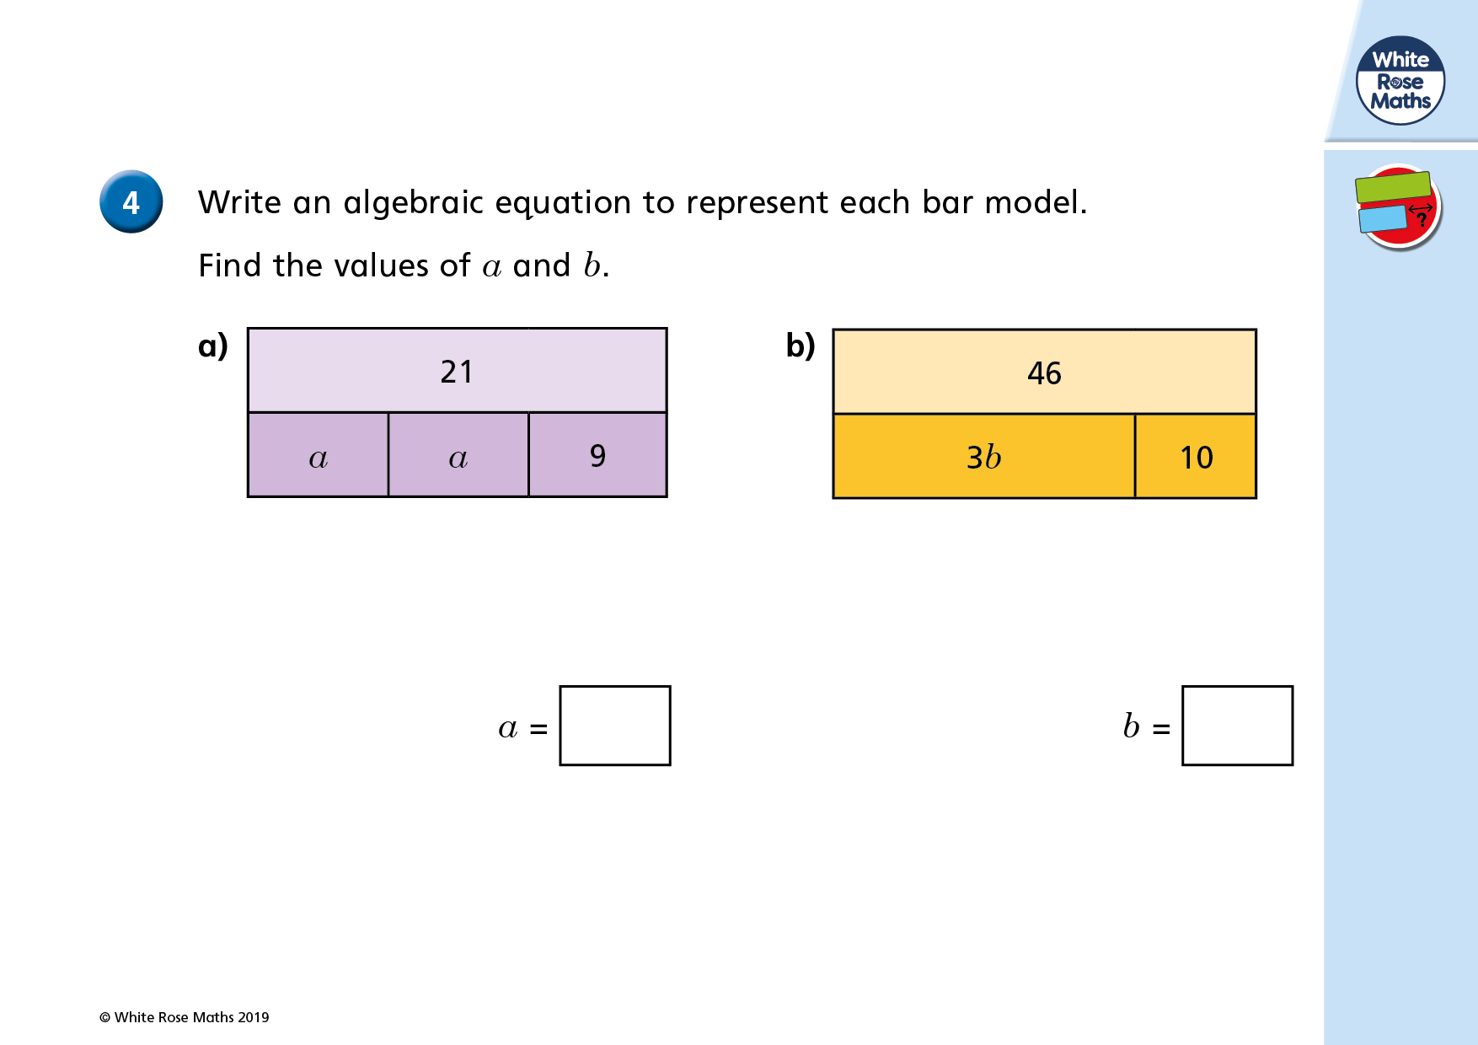

Slide 10
2a + 9 = 21

Slide 11
2a + 9 = 21
2a = 21 - 9

Slide 12
2a + 9 = 21
2a = 21 - 9
2a = 12

Slide 13
2a + 9 = 21
2a = 21 - 9
2a = 12
a = 12 ÷ 2

Slide 14
2a + 9 = 21
2a = 21 - 9
2a = 12
a = 12 ÷ 2
a = 6

Slide 15
2a + 9 = 21
3b + 10 = 46
2a = 21 - 9
2a = 12
a = 12 ÷ 2
a = 6

Slide 16
2a + 9 = 21
3b + 10 = 46
2a = 21 - 9
3b = 46 - 10
2a = 12
a = 12 ÷ 2
a = 6

Slide 17
2a + 9 = 21
3b + 10 = 46
2a = 21 - 9
3b = 46 - 10
2a = 12
3b = 36
a = 12 ÷ 2
a = 6

Slide 18
2a + 9 = 21
3b + 10 = 46
2a = 21 - 9
3b = 46 - 10
2a = 12
3b = 36
a = 12 ÷ 2
b = 36 ÷ 3
a = 6

Slide 19
2a + 9 = 21
3b + 10 = 46
2a = 21 - 9
3b = 46 - 10
2a = 12
3b = 36
a = 12 ÷ 2
b = 36 ÷ 3
a = 6
b = 12

Slide 20
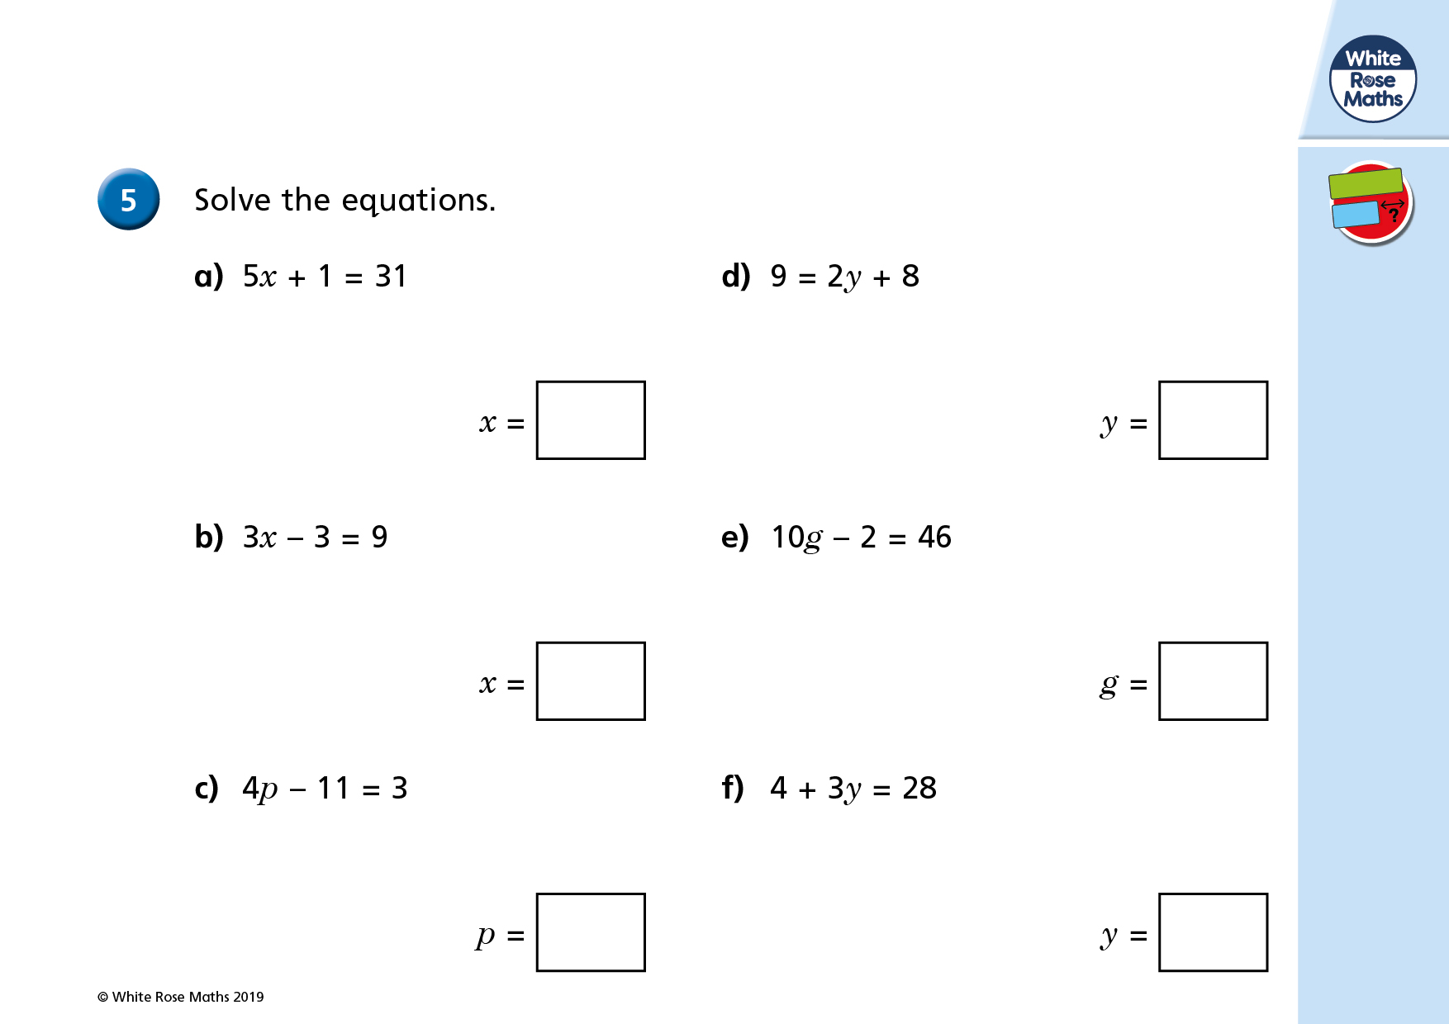

Slide 21
6
4

Slide 22
