Slide 1

Exciting Writing Lesson
26th February 2021

Slide 2
L.O: To write a narrative based on the theme of ‘hope’.
Success Criteria: Punctuation suitable to your year group
Link your paragraphs and sentences with interesting sentence starters
Add in some relative clauses using the following relative pronouns: who, which, where, when, whose, that

Slide 3
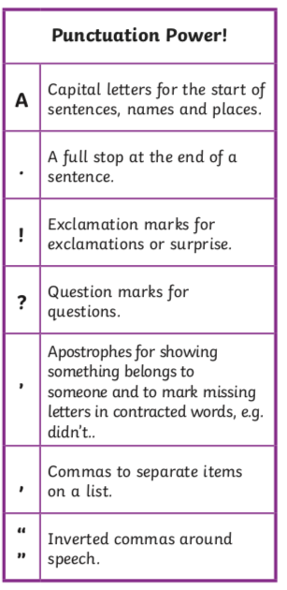

Slide 4




Slide 5
Use your year group writing mat to help you remember what else to include.
Your story can be about anything but must include a theme of hope somewhere.
Please write a reasonably long piece of writing. Remember, your teachers are looking for all the brilliant things you can do.
Remember to make your writing interesting for your reader. Think about how you want to make them feel throughout.

Slide 6

Quick top-tip about speech!
Include some speech (but not too much)
All punctuation must sit inside your inverted commas
All speech should move your story along. Don’t use it unless it’s useful to show your reader what’s going on, how a character is feeling or thinking

Slide 7
When you have finished:
Check your spellings.
Read through to check your story makes sense.
Check against our success criteria from the start of this presentation.
Upload your work to your teacher via Tapestry or the office email address.

