Slide 1
English Day 8
English day 8 – Wednesday 20th January

Slide 2
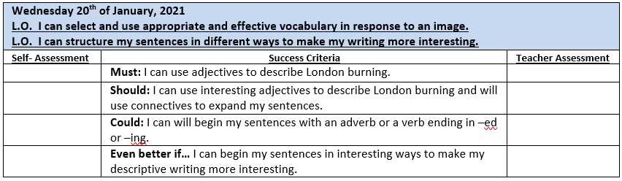

Slide 3
What is the adjective - in this sentence?
Mistress Jenkins is old.
The noun phrase?
Mistress Jenkins has grey hair.
The extended noun phrase?
Mistress Jenkins pinned her grey hair under her white cap with a bone clasp.

Slide 4
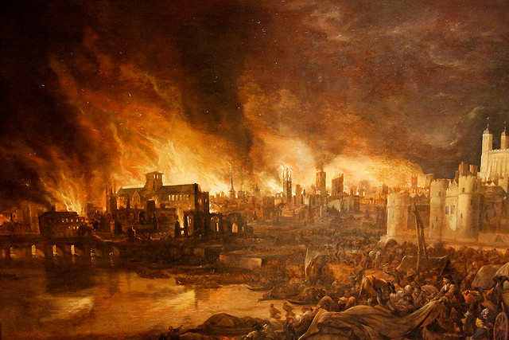
Imagine what it would have been like to be there
Use your 5 senses to describe the scene: the smell, the noise, what you saw and how you were feeling.
In your book, write down five adjectives to describe this scene and rank them in order of impact 1 to 5 with 1 being the best.
Use your best adjective to write a sentence containing a noun phrase.
Use another adjective to write a sentence containing an extended noun phrase.

Slide 5
Tricks to make your writing more interesting
Using three related ‘-ed’ adjectives
E .g. Frightened, terrified, exhausted, William raced home.
Using 2 pairs of related adjectives to begin a sentence
E.g. Exhausted and worried, tired and hungry, William didn’t know how much longer he could continue.
Using a compound sentence where the two clauses are separated by a colon. Description: Details (De:De)
E.g. William was exhausted: he hadn’t slept for two days.

Slide 6
Your task today:
In Year 4: Imagine you were there, using your 5 senses and the sheet provided, write as many adjectives, noun phrases and extended phrases around the image as you can think of. Challenge: Can you write a sentence with 3 related ‘-ed’ adjectives e.g. Frightened, terrified, exhausted, William raced home.
In Year 5: In your books, write a selection of sentences about the images, underline the noun phrases and extended noun phrases. Challenge: Try to include a sentence with two pairs of adjectives separated by and.
E.g. Exhausted and worried, tired and hungry, William didn’t know how much longer he could continue.
Year 6: Try to write a descriptive passage about the scene. Underline the noun phrases and extended noun phrases. Challenge: Try to begin with an –ing verb include a ‘De:De’ sentence where two clauses are separated by a colon – the first clause describes the second adds detail. E.g. William was exhausted: he hadn’t slept for two days.

Slide 7
Plenary:
Choose your favourite/best sentence and explain why it appeals to you as a reader.
Choose your weakest sentence – why do you think it is weak? Improve it.
REMEMBER to return this work for marking.

