Slide 1
English 24.02.21
Wednesday 24th of February, 2021

Slide 2
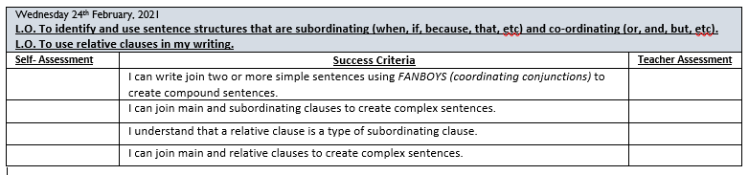

Slide 3
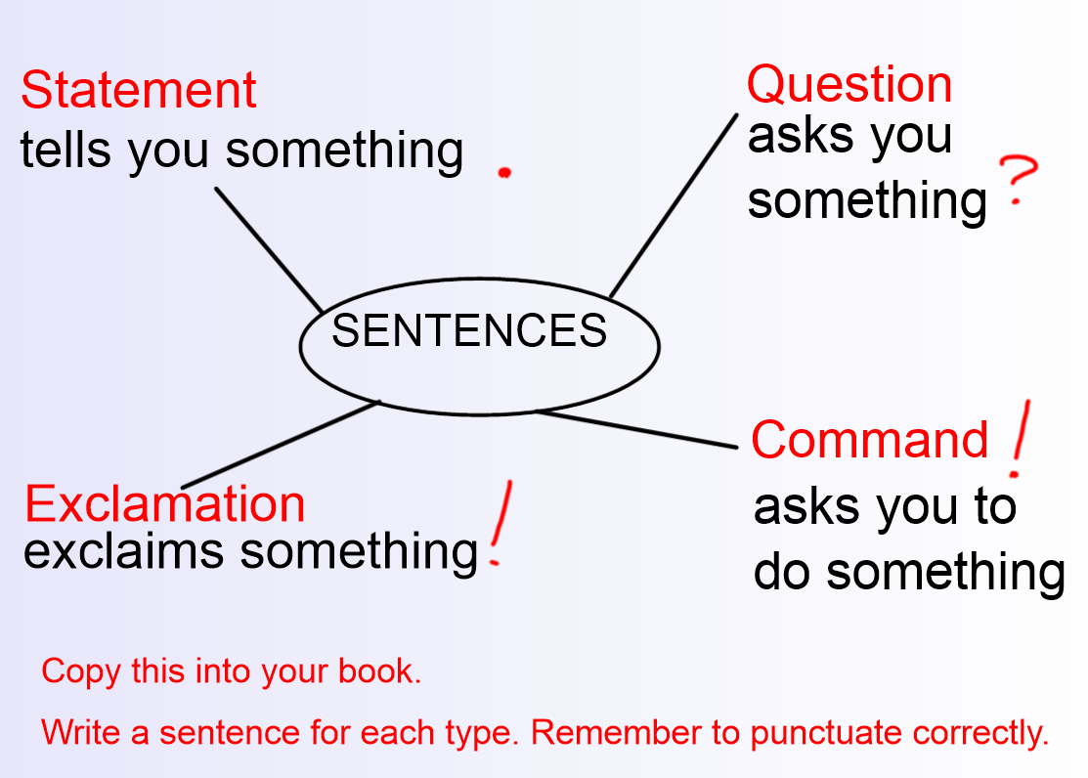

Slide 4
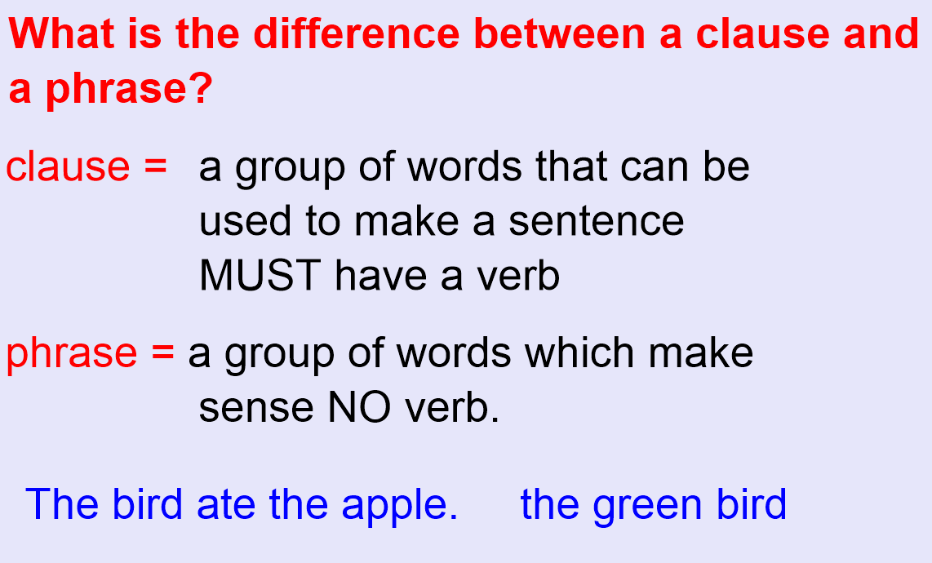

Slide 5
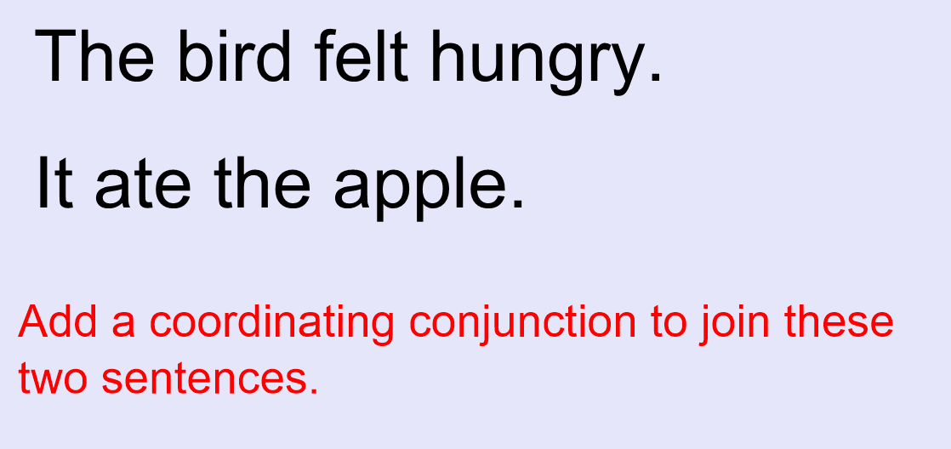

Slide 6
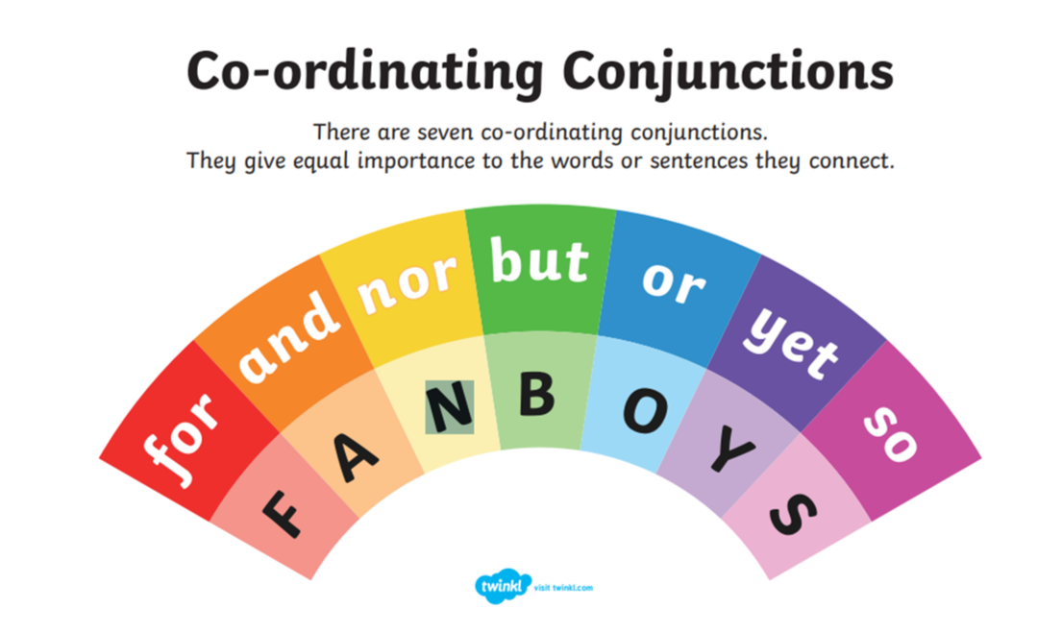

Slide 7
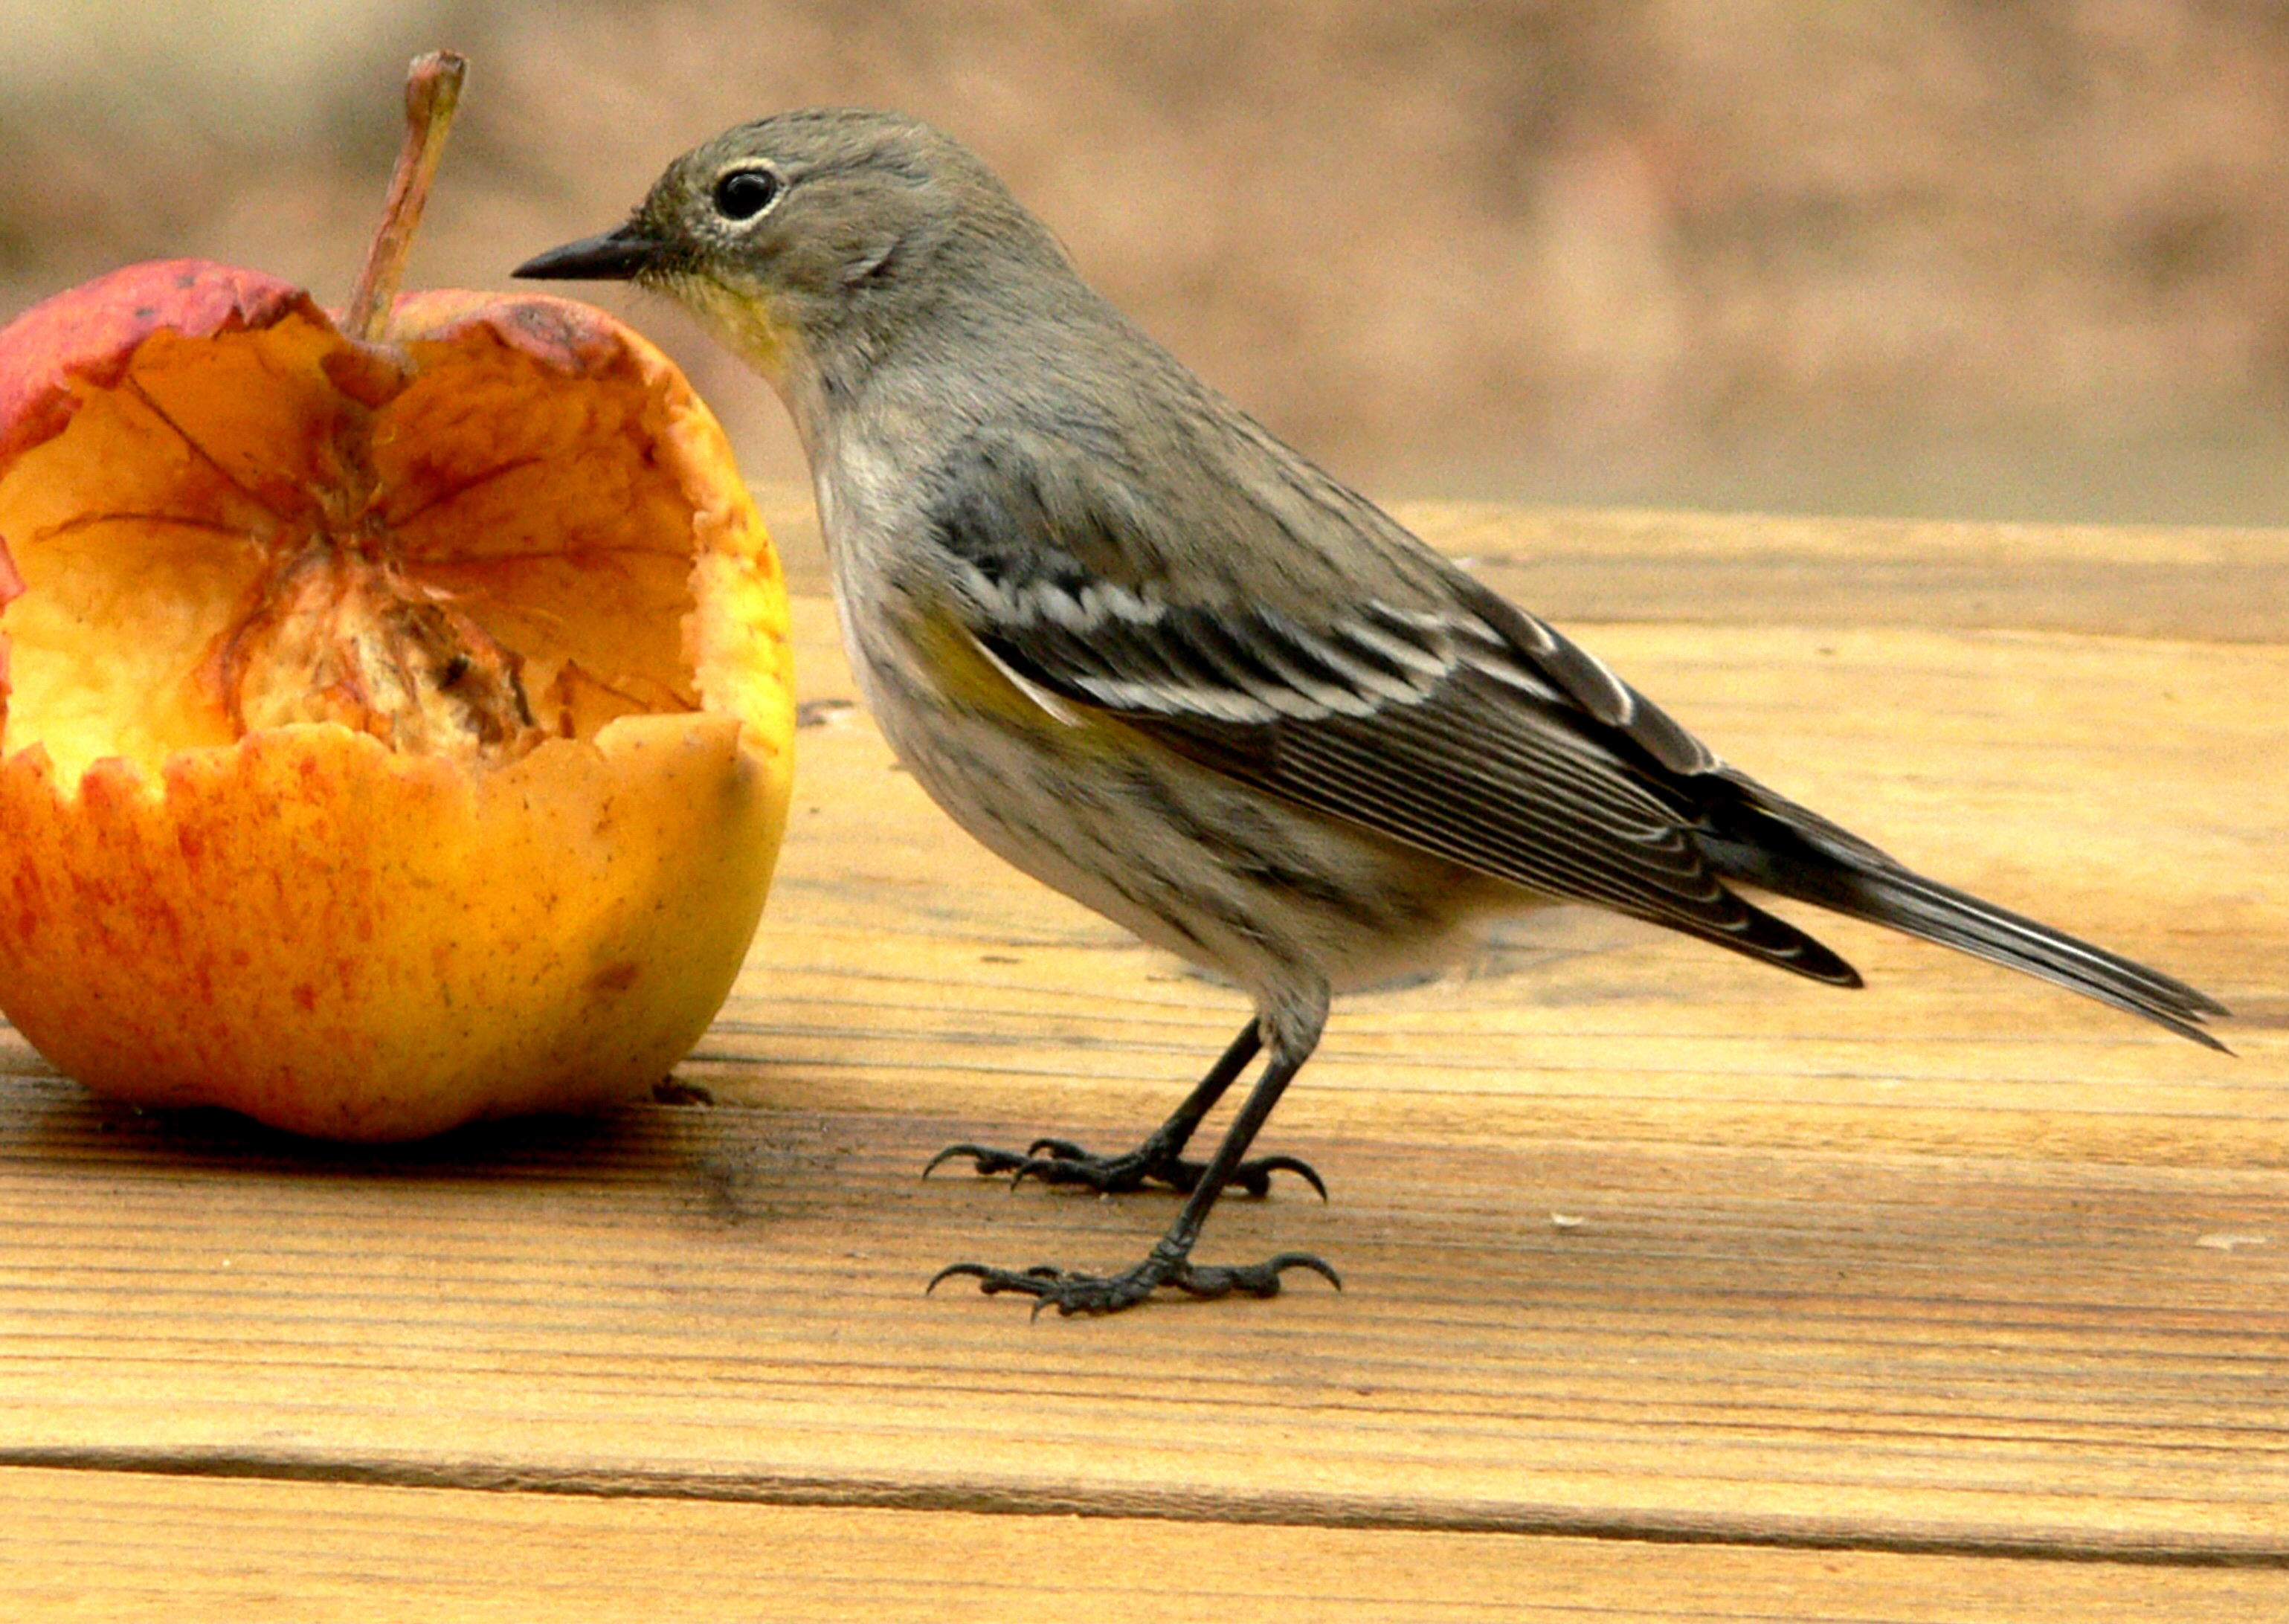
The bird felt hungry so it ate an apple.
The bird felt hungry and it ate an apple.
The bird felt hungry yet it ate an apple.
Co-ordinating conjunctions link main clauses together to form compound sentences.

Slide 8
The bird felt hungry.
It ate an apple.
Use a subordinating conjunction to link the two clauses together to make a complex sentence.

Slide 9
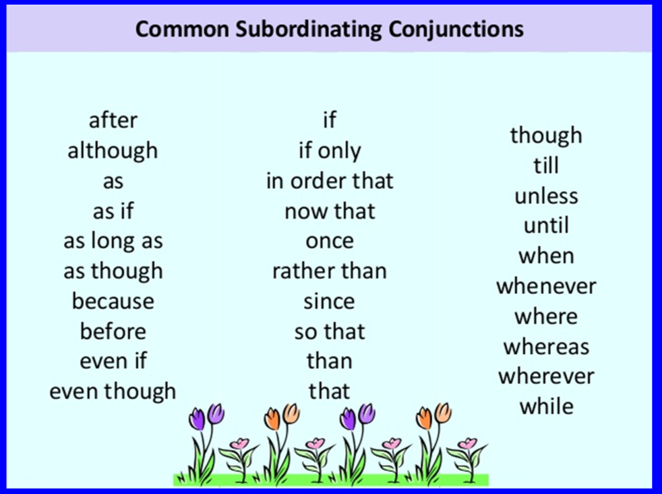

Slide 10
Because the bird felt hungry, it ate an apple. (Main clause)
After it ate an apple, the bird felt hungry.
The bird felt hungry until it ate an apple. (Subordinate clause)
The bird felt hungry before it ate an apple.
A subordinate conjunction links a main clause and a subordinate clause.

Slide 11
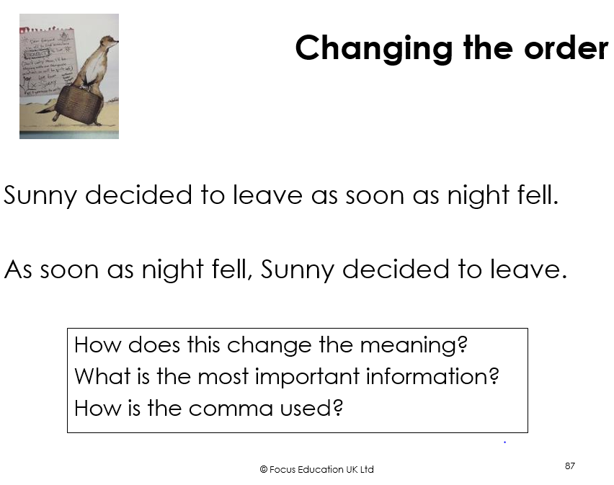
Sometimes, changing clause order changes the meaning of a sentence e.g. how has the meaning been changed here?

Slide 12
Independent Work
Year 4:
Write two compound sentences using two different co-ordinating conjunctions. Underline the conjunction.
Complete the Y4 sheet on main and subordinate clauses. Underline the subordinate clause using coloured pencil.
Extension: Write some examples of complex sentences of your own in your book. Underline the subordinate clause. Try to include sentences with the subordinate clause at the beginning.
Remember: that if the subordinate clause is at the beginning of your sentence, you will need a comma between it and the main clause.

Slide 13
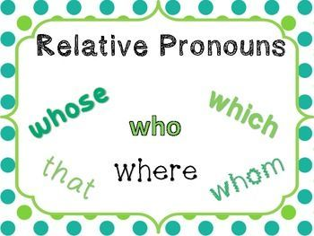
Relative clauses are a type of subordinate clause
Used to add extra information in a sentence
Begin with a relative pronoun
e.g. The cat belongs to Mrs King, who lives next door.
Relative clause

Slide 14
Relative Pronouns: who; whom, whose, which, that (when, where)
This is John, who lives next door.
Mrs Grayson, whose cat is missing, has offered a reward.
There’s the hotel that we are staying in.
This is the house where my son was born.
The race will begin when the whistle blows.

Slide 15
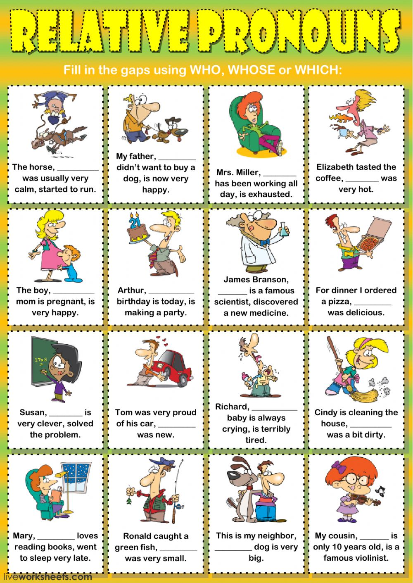
Your turn:
Insert the correct relative pronoun to complete each card.
E.g. For dinner I ordered a pizza, which was delicious.
Richard, whose baby is always crying, is terribly tired.

Slide 16
Independent Task:
Year 5: Cut up the sentences page along the dotted lines and mix them all up. Match up each main clause to its appropriate relative clause. Write the completed sentences in your book.
Year 6: Copy the main clauses into your books and add an appropriate relative clause to complete.
Extension: Write some sentences of your own.

