Slide 1
English 23.02.21
Tuesday 23rd February, 2021

Slide 2
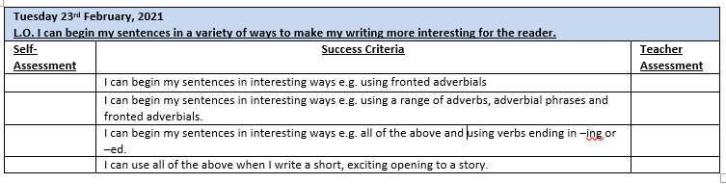

Slide 3
Interesting sentence openers
Interjection e.g. Fire! Fire!
Dialogue e.g. “Just wait there Sonny!”
Adjective/description e.g. Wizened and old, Mrs Marple was as grey as…
Adverb/Adverbial phrase e.g. Lonely…. or Quietly tiptoed…
Fronted adverbial e.g. Early the next morning,..
Verb ending in -ed or -ing e.g. Weakened by hunger… Fighting fiercely

Slide 4
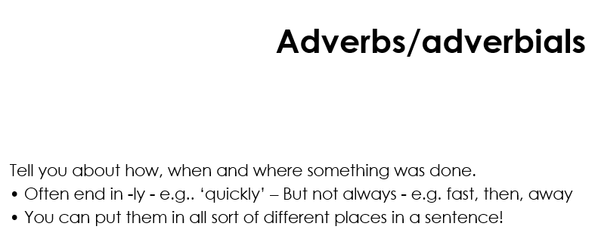
How? When? Where?

Slide 5

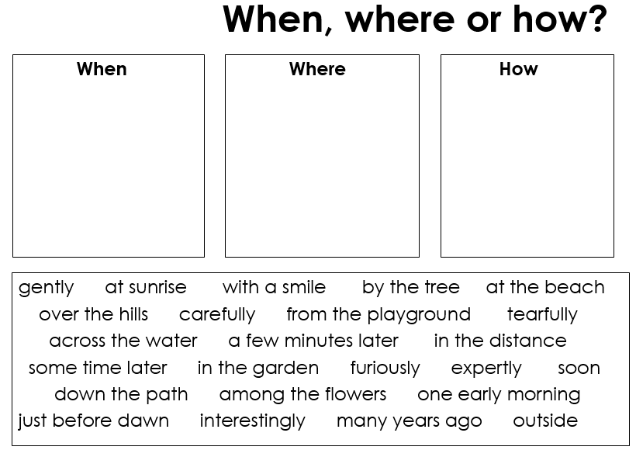
Many years ago, just before dawn, an old man carefully trudged down the path.
In the garden, among the flowers, an old man sat tearfully staring at the flower he held in his trembling hands.

Slide 6
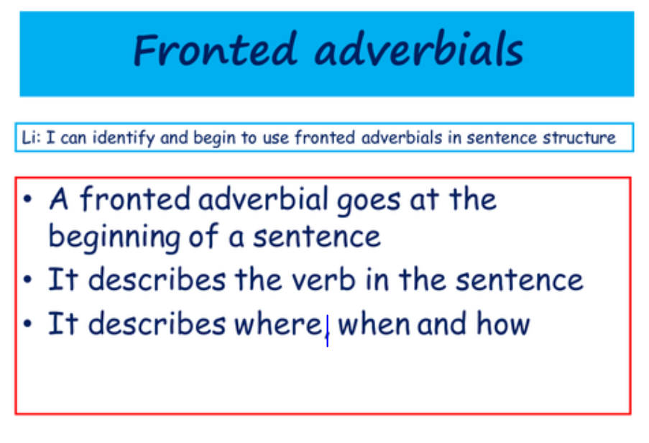

Slide 7
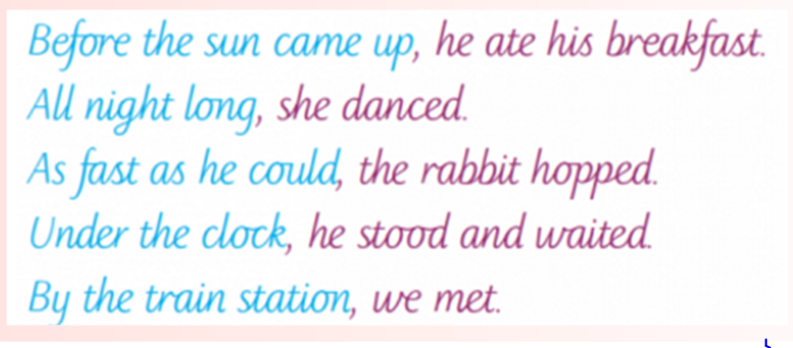

Slide 8
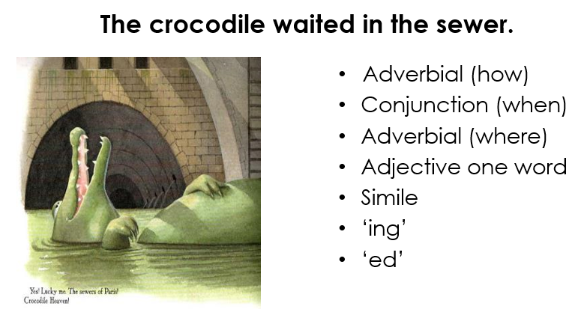
Try beginning a sentence with one of the following:

Slide 9
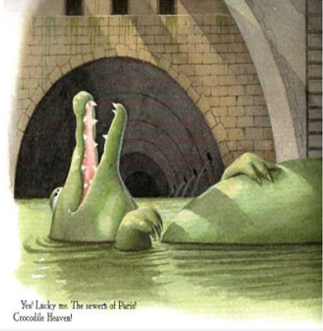
Patiently, the crocodile lay contemplating his next meal.
While the rats scavenged, the crocodile waited patiently in the sewer.
In the centre of Paris, the crocodile waited in the sewer.
Lonely, the crocodile waited in the sewer.
As large as an elephant, the crocodile waited.
Floating gently, the crocodile waited in the sewer.
Submerged in slimy water, the crocodile waited in the sewer.

Slide 10
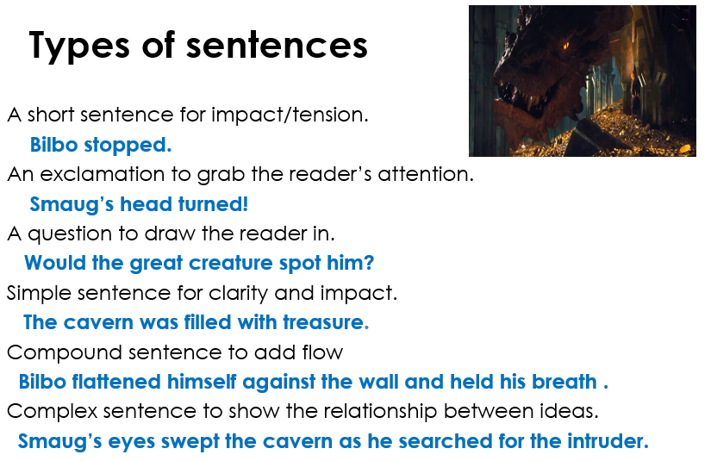

Slide 11
Independent Work
Year 4: Play the fronted adverbial matching game on the website. Write completed sentences in your book.
Year 5: In your book, write a range of sentences beginning in interesting ways e.g. with adverbs, adverbial phrases and fronted adverbials.
Year 6: In your book, write a short paragraph with sentences that begin in a range of interesting ways e.g. interjections, adverbs, adverbial phrases, fronted adverbials and verbs.

Slide 12
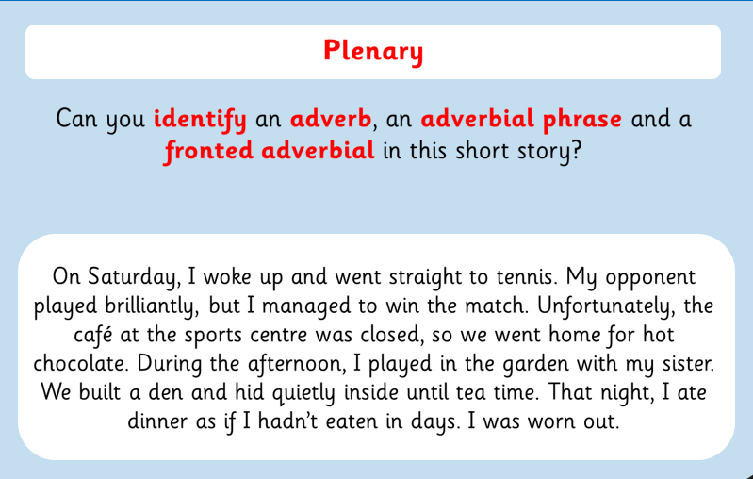

Slide 13
