Slide 1
English 22.02.21
Monday 22nd February, 2021

Slide 2
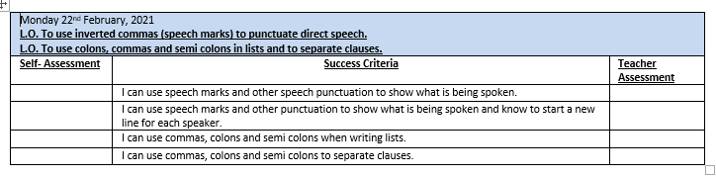

Slide 3
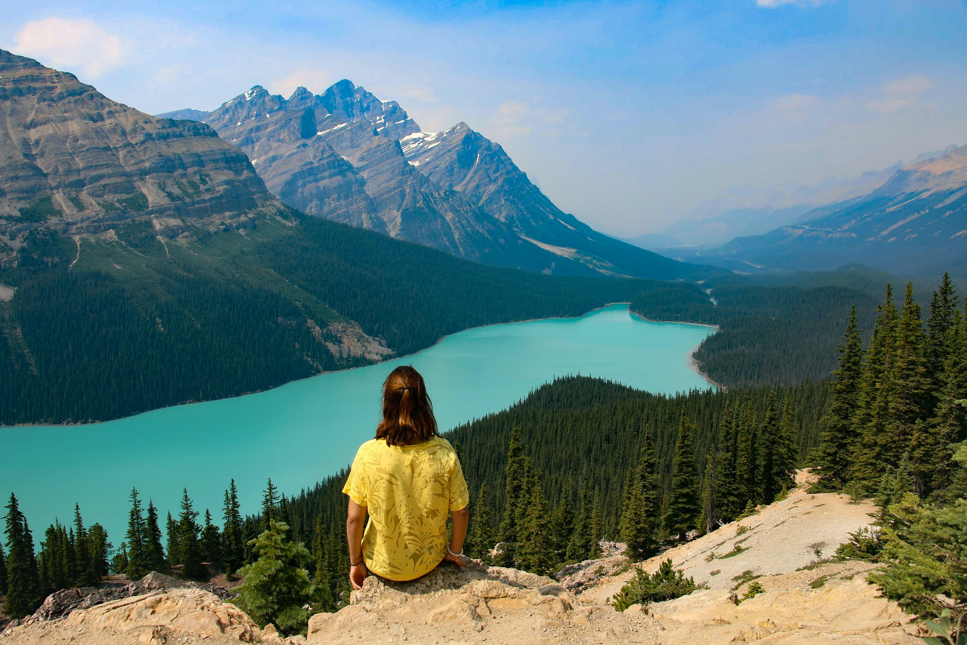
Mum! Look at this yelled Lucy. What? questioned her mother. It’s the lake… the dairy has been flooded again.
What? replied Mrs Farmer. The dairy has flooded repeated Lucy, look at the water. What water, Lucy quizzed her mum.

Slide 4
“Mum! Look at this,” yelled Lucy.
“What ?” questioned her mother.
“It’s the lake, the dairy has been flooded again,” replied Lucy.
“What?” shouted Mrs Farmer.
“The dairy has flooded!” repeated Lucy, “look at the water.”
“What water, Lucy?” quizzed her mum.

Slide 5
“Mum! Look at this,” yelled Lucy.
“What ?” questioned her mother.
“It’s the lake, the dairy has been flooded again,” replied Lucy.
“What?” shouted Mrs Farmer.
“The dairy has flooded!” repeated Lucy, “look at the water.”
“What water, Lucy?” quizzed her mum.
What someone says is inside speech marks (or inverted commas).
Note that there is always punctuation before the second pair of speech marks.
Need a new line for each new speaker.

Slide 6
What someone says is inside speech marks (or inverted commas).
There is always punctuation before the second set of speech marks.
The reporting clause begins with a lower case unless it is at the start of a sentence. Then a comma is needed.
“Mum! Look at this,” yelled Lucy.
“What ?” questioned her mother.
“The dairy has flooded!” repeated Lucy, “look at the water.”
“What water, Lucy?” quizzed her mum.
Her daughter replied, “Come and see!”

Slide 7
:
What is this punctuation mark called?
When do we need to use it?

Slide 8
:
Colon
Introduce a list E.g. On Saturday, please bring: a hat, a coat and a packed lunch
Before a definition or quotation E.g. Penguins (nouns): flightless birds that are adapted for swimming
When an explanation has been added E.g. The children are wearing their hats, scarves and gloves today: it is very cold.

Slide 9
Independent Task:
Year 4: You may stop the video now.
Please complete the Y4 activity on the website – the ‘Comic Strip’ speech.
Extension: Write your own conversation between two people.
Remember to use the correct punctuation and leave a line each new speaker.

Slide 10


Colons, semi-colons and commas in a list
We are going to the beach on Saturday, remember to bring: a hat, sunscreen, water and some lunch.
We are going to the beach on Saturday, remember to bring: a thick, warm coat; a blanket to sit on; a flask of hot tea and some chocolate.
John Lewis stocks: red, blue, green and yellow ties; plain and patterned shirts; spotted, striped and plain socks and linen, wool and tweed suits.

Slide 11

This is a semi-colon
Used to join independent clauses together when they is some sort of relationship between them, creating a longer pause than a comma. E.g.
I like to visit Paris; I live in London.
It is very cold outside; it snowed heavily yesterday.
The children were upset; they were unable to play outside as it was too dark.

Slide 12
Independent Work
Year 5: Complete Y5 sheet on colons and commas.
Year 6: In your book, practise writing sentences with colons and semi colons being used for a variety of purposes including to separate clauses.

