Slide 1
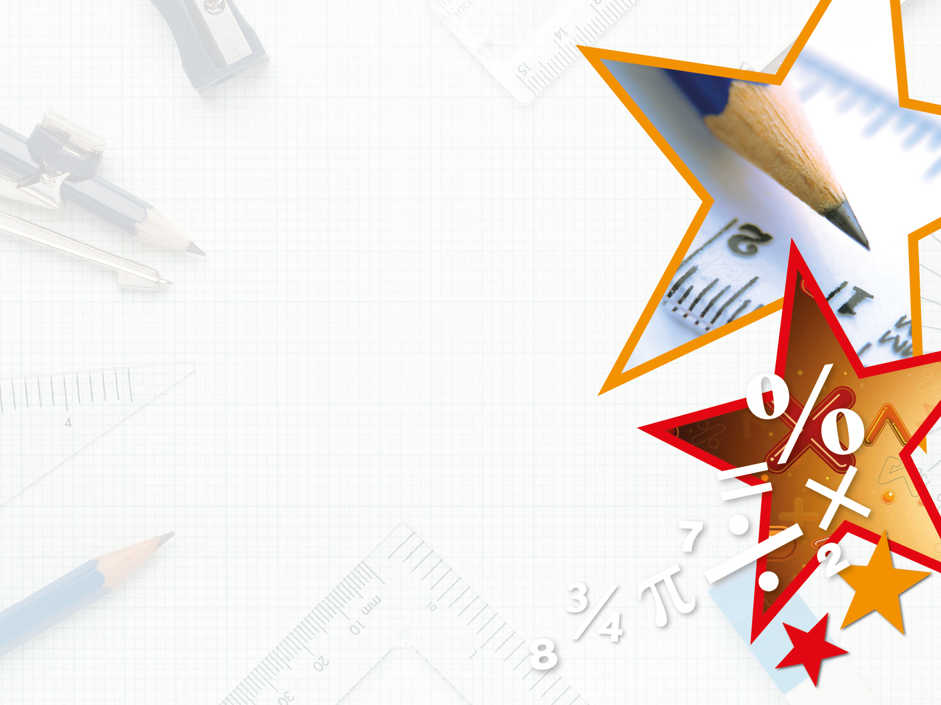

Year 6 – Spring Block 2 – Percentages
Step 2: Equivalent FDP
© Classroom Secrets Limited 2018

Slide 2
Introduction
Match the fraction to its equivalent percentage and decimal.
3 |  | 60% |  | 0.25
5
3 |  | 25% |  | 0.6
4
2 |  | 75% |  | 0.4
8
20 |  | 40% |  | 0.75
50
© Classroom Secrets Limited 2018

Slide 3
Introduction
Match the fraction to its equivalent percentage and decimal.
3 |  | 60% |  | 0.25
5
3 |  | 25% |  | 0.6
4
2 |  | 75% |  | 0.4
8
20 |  | 40% |  | 0.75
50
© Classroom Secrets Limited 2018

Slide 4
Varied Fluency 1
Use the shaded part of the 100 square to write an equivalent fraction, decimal and percentage.
© Classroom Secrets Limited 2018

Slide 5
Varied Fluency 1
Use the shaded part of the 100 square to write an equivalent fraction, decimal and percentage.
Fraction:
Decimal: 0.08
Percentage: 8%
8
100
© Classroom Secrets Limited 2018

Slide 6
Varied Fluency 2
Which numbers are missing?
= |  | = | 80%
5
© Classroom Secrets Limited 2018

Slide 7
Varied Fluency 2
Which numbers are missing?
= |  | = | 80%
 | 0.8
4
5
© Classroom Secrets Limited 2018

Slide 8
Varied Fluency 3
Convert the following decimals to their equivalent percentages and fractions.
Display each fraction in its simplest form.
A) 0.625
B) 0.01
C) 0.1
© Classroom Secrets Limited 2018

Slide 9
Varied Fluency 3
Convert the following decimals to their equivalent percentages and fractions.
Display each fraction in its simplest form.
A) 0.625 = 62.5% =
B) 0.01 = 1% =
C) 0.1 = 10% =
5
8
1
100
1
10
© Classroom Secrets Limited 2018

Slide 10
Varied Fluency 4
Which conversion is incorrect?
A. = 1%
B. 0.6 = 60%
C. 80% =
1
10
4
5
© Classroom Secrets Limited 2018

Slide 11
Varied Fluency 4
Which conversion is incorrect?
A. = 1%
B. 0.6 = 60%
C. 80% =
A is the odd one out because the conversion is incorrect. should
be converted to 10%, not 1%.
1
10
4
5
1
10
© Classroom Secrets Limited 2018

Slide 12
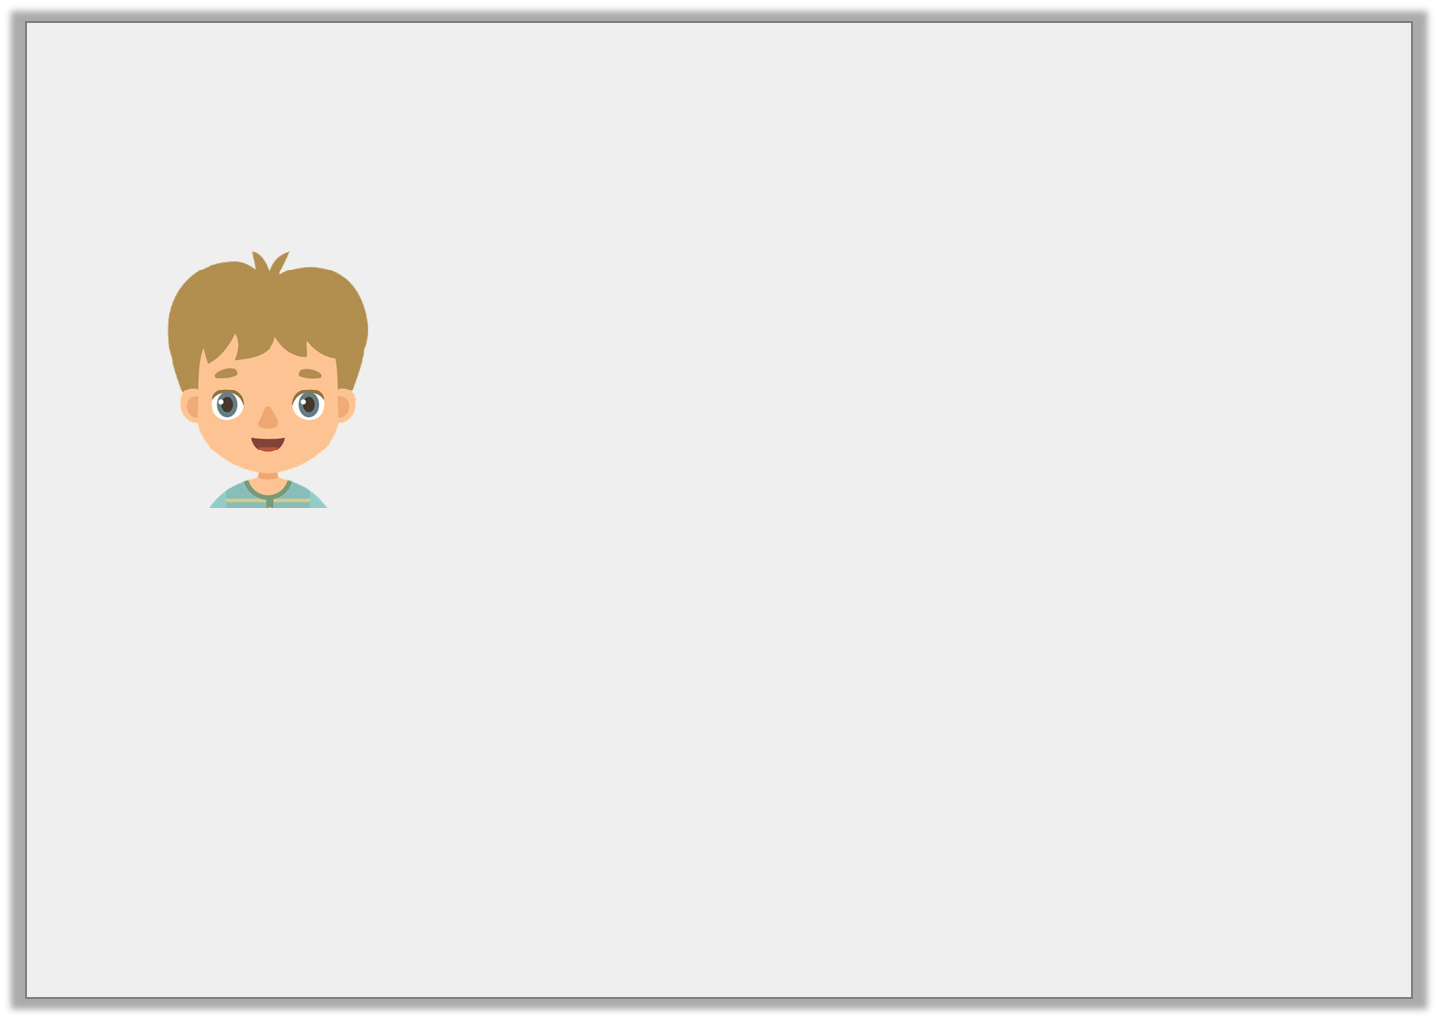
Reasoning 1
Jaxon says,
Do you agree? Prove it.
If I eat seven eighths of my birthday cake, there will be 0.25, or 25% left.
© Classroom Secrets Limited 2018

Slide 13
Reasoning 1
Jaxon says,
Do you agree? Prove it.
No, because…
If I eat seven eighths of my birthday cake, there will be 0.25, or 25% left.
© Classroom Secrets Limited 2018

Slide 14
Reasoning 1
Jaxon says,
Do you agree? Prove it.
No, because if Jaxon eats seven eighths there will be one eighth left. One eighth is equivalent to 0.125 and 12.5%.
If I eat seven eighths of my birthday cake, there will be 0.25, or 25% left.
© Classroom Secrets Limited 2018

Slide 15
Problem Solving 1
Ethan scored 62.5% on his Science test.
Felix got of his answers correct.
Jaiden expresses her result as a decimal, which is 0.75.
Who scored the highest?
Show your working.
7
8
© Classroom Secrets Limited 2018

Slide 16
Problem Solving 1
Ethan scored 62.5% on his Science test.
Felix got of his answers correct.
Jaiden expresses her result as a decimal, which is 0.75.
Who scored the highest?
Show your working.
Ethan: 62.5% = 0.625 =
Felix: = 0.875 = 87.5%
Jaiden: 0.75 = 75% =
Felix scored the highest.
7
8
5
8
7
8
3
4
© Classroom Secrets Limited 2018

Slide 17
Reasoning 2
May thinks that of the squares are shaded.
Iqra thinks that 30% of the squares are shaded.
India thinks that 0.2 of the squares are shaded.
Who is correct? Explain your answer.
1
10
© Classroom Secrets Limited 2018

Slide 18
Reasoning 2
May thinks that of the squares are shaded.
Iqra thinks that 30% of the squares are shaded.
India thinks that 0.2 of the squares are shaded.
Who is correct? Explain your answer.
India is correct because…
1
10
© Classroom Secrets Limited 2018

Slide 19
Reasoning 2
May thinks that of the squares are shaded.
Iqra thinks that 30% of the squares are shaded.
India thinks that 0.2 of the squares are shaded.
Who is correct? Explain your answer.
India is correct because ten out of fifty squares are shaded, which is
equivalent to , 0.2 and 20%.
1
10
1
5
© Classroom Secrets Limited 2018

