Slide 2
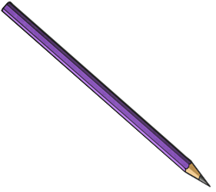
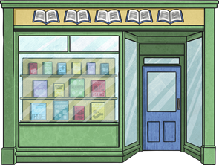
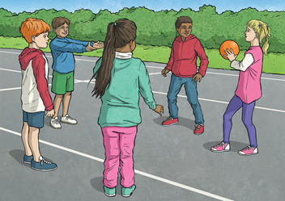

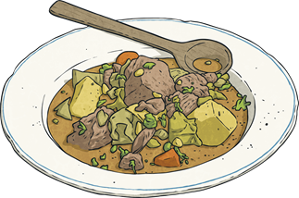
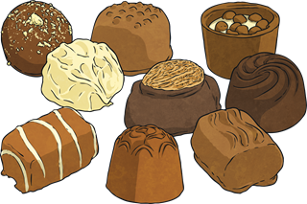
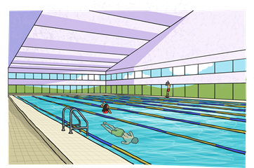
Question 1
Question 2
Question 3
Question 4
Question 5
Question 6

Slide 3
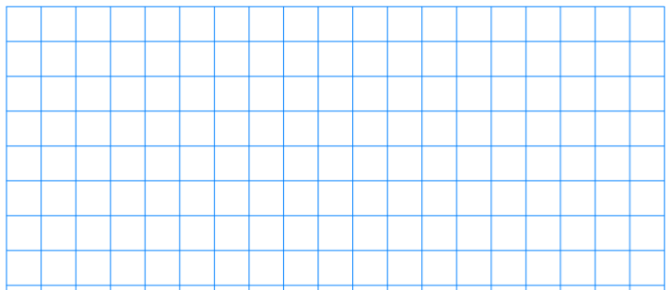
Question 1
A box of six pencils costs £1.56.
A box of eight rubbers costs £2.72.
What is the difference in cost between one pencil and one rubber?
Show your method
6 | 1 | 5 | 6
0 | 2 | 6
One pencil costs 26p
1 | 5 | 6 | ÷ | 6 | =
1
3
Guided Solve
8 | 2 | 7 | 2
0 | 3 | 4
One rubber costs 34p
Show Answer
2 | 7 | 2 | ÷ | 8 | =
2
3
8p
34p - 26p =
8p
Back to menu

Slide 4
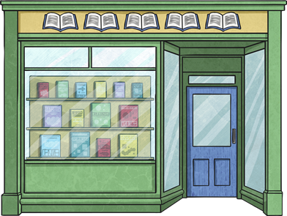
Question 2
At the start of the week, a book shop has 7687 books in stock.
During the week, 2305 more books are delivered and 3021 books are sold.
How many books does the shop have in stock by the end of the week?
Show your method
7 | 6 | 8 | 7 | + | 2 | 3 | 0 | 5 | =
 | 7 | 6 | 8 | 7
+ | 2 | 3 | 0 | 5
Guided Solve
 | 9 | 9 | 9 | 2 | - | 3 | 0 | 2 | 1 | =
9 | 9 | 9 | 2
1
Show Answer
 |  | 9 | 9 | 9 | 2
 | - | 3 | 0 | 2 | 1
6 | 9 | 7 | 1
6971 books
6971 books
Back to menu

Slide 5
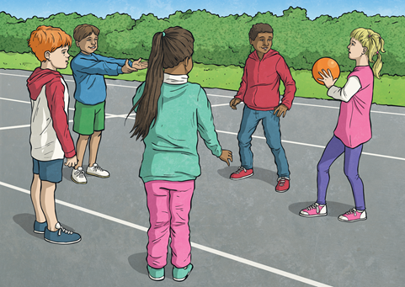
Question 3
There are 72 girls playing in the playground.
Three sevenths of the children in the playground are boys.
How many children are playing in the playground altogether?
Show your method
18
4
72
Guided Solve
7
=
B | B | B | G | G | G | G
18
72 ÷ 4 =
Show Answer
B | B | B | G | G | G | G
126 children
18 × 7 =
126 children
Back to menu

Slide 6

Question 4
Pavel is cooking a chicken casserole. The recipe he is following uses 336g of chicken to make three servings. Pavel is making eight servings. How many grams will he have left over from 1 kilogram of chicken?
Show your method
3 | 3 | 3 | 6
3 | 3 | 6 | ÷ | 3 | =
1 | 1 | 2
One serving is 112 grams
Guided Solve
112 × 8 =
Show Answer
 |  | 1 | 1 | 2
 | × |  |  | 8
1000 grams - 896 grams =
8 | 9 | 6
Eight servings is 896 grams
104 grams
104 grams
1
Back to menu

Slide 7
Question 5
Nikita makes chocolate truffles to sell. The chocolates cost 15p to make and the boxes cost 12p.
She uses the formula:
number of truffles × 15p + (number of boxes × 12p) = cost
George buys one box of truffles for £0.87.
How many truffles did he buy?
Show your method
87p - 12p for one box =
75p
Guided Solve
75p ÷ 15 = number of truffles
Show Answer
5 truffles
5 truffles
Back to menu

Slide 8


Question 6
19 200 people visited the leisure centre this week.
This is 20% fewer people than the week before.
How many people visited the leisure centre the previous week?
Show your method
19 200 = 80% = $\frac{\text{8}}{\text{10}}$
19 200 ÷ 8 =
0 | 2 | 4 | 0 | 0
8 | 1 | 9 | 2 | 0 | 0
Guided Solve
¹
³
Number of people who visited previous week
= 100% = $\frac{\text{10}}{\text{10}}$
Show Answer
2400
24 000 people
2400 × 10 =
24 000 people
Back to menu

