Slide 1
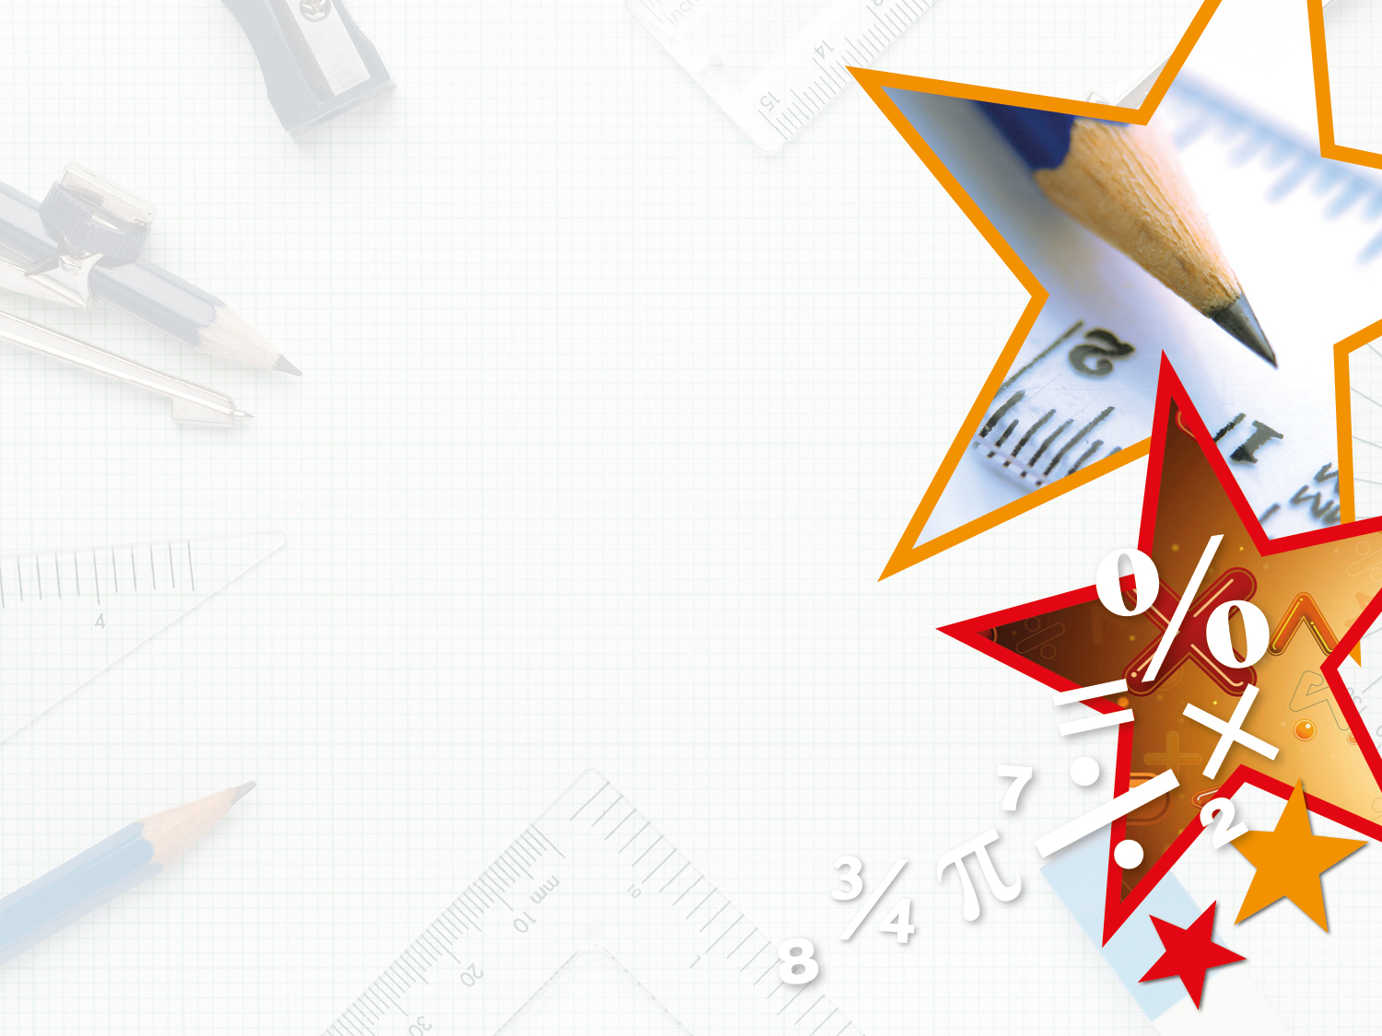

Year 6 – Spring Block 3 – Shapes – Same Area
Shapes – Same Area
© Classroom Secrets Limited 2018

Slide 2
Introduction
Match the rectilinear shapes to the correct area.
= 1cm²
not to scale
14cm² |  | 18cm² |  | 20cm²
© Classroom Secrets Limited 2018

Slide 3
Introduction
Match the rectilinear shapes to the correct area.
= 1cm²
not to scale
14cm² |  | 18cm² |  | 20cm²
© Classroom Secrets Limited 2018

Slide 4
Varied Fluency 1
Circle the shapes with an area of 18cm².
= 1cm²
not to scale
A
B
D
C
E
© Classroom Secrets Limited 2018

Slide 5
Varied Fluency 1
Circle the shapes with an area of 18cm².
= 1cm²
not to scale
A
B
D
C
E
© Classroom Secrets Limited 2018

Slide 6
Varied Fluency 2
Draw a different rectilinear shape to the one below
with the same area.
1cm² =
not to scale
© Classroom Secrets Limited 2018

Slide 7
Varied Fluency 2
Draw a different rectilinear shape to the one below
with the same area.
1cm² =
Any rectilinear shape with an area of 20cm²,
for example:
not to scale
© Classroom Secrets Limited 2018

Slide 8
Varied Fluency 3
Using 1cm² squared paper, draw 2 different rectangles with a combined area of 15cm². One of your rectangles must have a side measurement ending in .5cm.
© Classroom Secrets Limited 2018

Slide 9
Varied Fluency 3
Using 1cm² squared paper, draw 2 different rectangles with a combined area of 15cm². One of your rectangles must have a side measurement ending in .5cm.
Any rectangles with a combined area of 15cm², for example:
2.5cm x 6cm; 1.5cm x 10cm.
not to scale
© Classroom Secrets Limited 2018

Slide 10
Varied Fluency 4
All of these rectangles have an area of 24cm².
Complete the missing lengths.
not to scale
0.5cm
A
?
4cm
8cm
B
?
?
C
© Classroom Secrets Limited 2018

Slide 11
Varied Fluency 4
All of these rectangles have an area of 24cm².
Complete the missing lengths.
not to scale
0.5cm
A
48cm
4cm
8cm
B
3cm
C
6cm
© Classroom Secrets Limited 2018

Slide 12
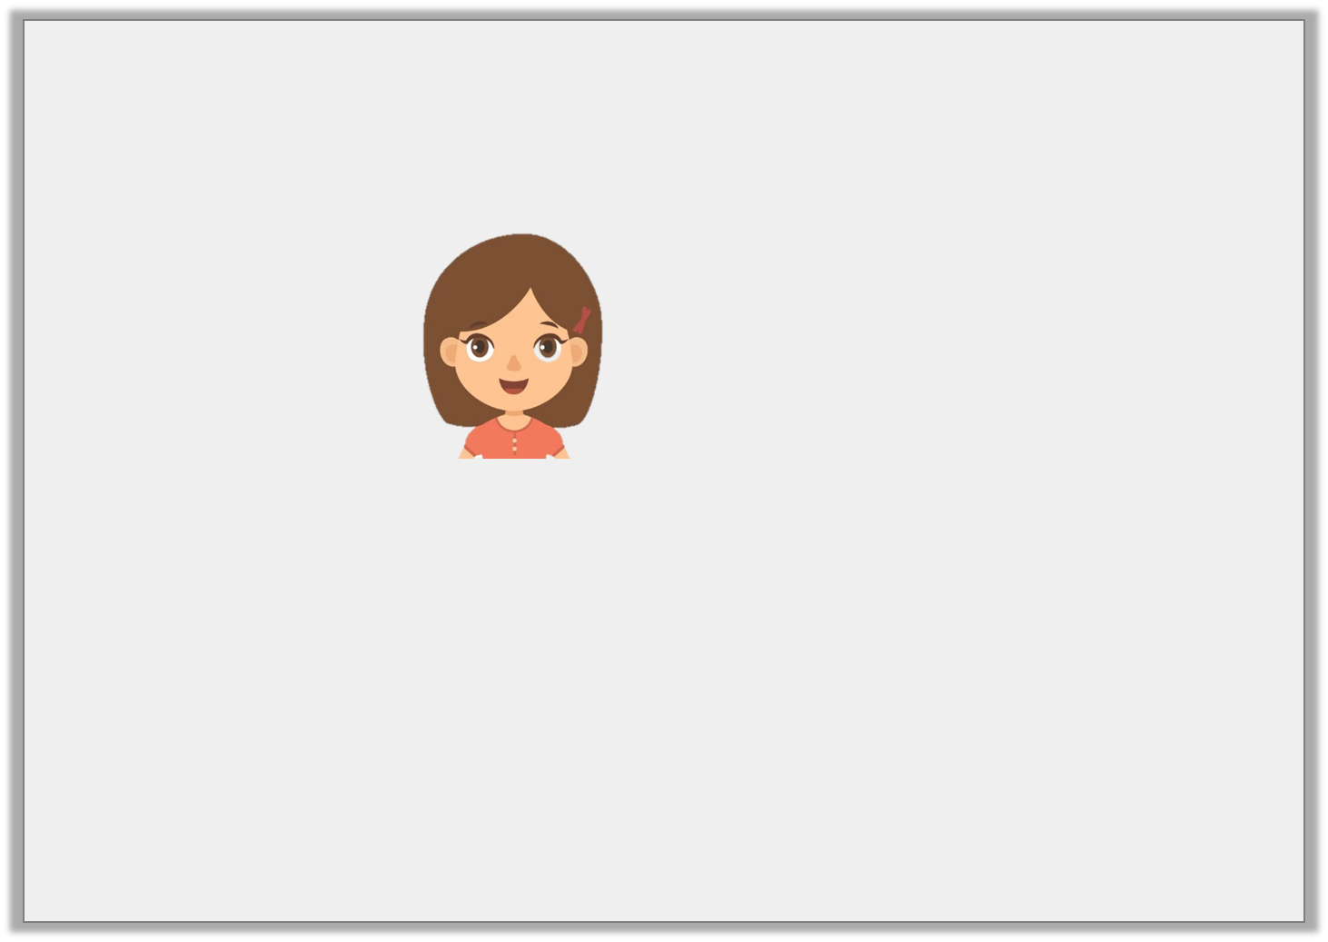
Problem Solving 1
Annie says,
Draw two shapes to prove that Annie is correct. Your shapes must include some half squares.
I can draw a six-sided and an eight-sided rectilinear shape with an area of 21cm².
© Classroom Secrets Limited 2018

Slide 13
Problem Solving 1
Annie says,
Draw two shapes to prove that Annie is correct. Your shapes must include some half squares.
Various answers, for example:
not to scale
I can draw a six-sided and an eight-sided rectilinear shape with an area of 21cm².
1cm
 |  |  |  | 6 sides
 |  |  |  | 8 sides
1cm
© Classroom Secrets Limited 2018

Slide 14
Reasoning 1
True or false? All of these shapes have the same area.
Explain your answer.
not to scale
4cm
8cm
30mm
B
60mm
A
5mm
20mm
4cm
55mm
C
40mm
0.5cm
© Classroom Secrets Limited 2018

Slide 15
Reasoning 1
True or false? All of these shapes have the same area.
Explain your answer.
False, because…
not to scale
4cm
8cm
30mm
B
60mm
A
5mm
20mm
4cm
55mm
C
40mm
0.5cm
© Classroom Secrets Limited 2018

Slide 16
Reasoning 1
True or false? All of these shapes have the same area.
Explain your answer.
False, because shape A and C have an area of 24cm², but shape B has an area of 25cm².
not to scale
4cm
8cm
30mm
B
60mm
A
5mm
20mm
4cm
55mm
C
40mm
0.5cm
© Classroom Secrets Limited 2018

Slide 17
Reasoning 2
Randall is experimenting with the area of rectilinear shapes.
She says,
“If a shape has an area of 14cm², the length of it could be 28cm.”
Is he correct? Explain why.
© Classroom Secrets Limited 2018

Slide 18
Reasoning 2
Randall is experimenting with the area of rectilinear shapes.
She says,
“If a shape has an area of 14cm², the length of it could be 28cm.”
Is he correct? Explain why.
Randall is correct because…
© Classroom Secrets Limited 2018

Slide 19
Reasoning 2
Randall is experimenting with the area of rectilinear shapes.
She says,
“If a shape has an area of 14cm², the length of it could be 28cm.”
Is he correct? Explain why.
Randall is correct because if one side is 28cm, the other side would be 0.5cm. 28cm x 0.5cm = 14cm².
not to scale
© Classroom Secrets Limited 2018

