Slide 1


Year 6 – Converting Units
Y6 Calculate with Metric Measures
© Classroom Secrets Limited 2019

Slide 2
Introduction
Match the measurements to the most appropriate units of measure.
The weight of an elephant.
minutes
kg
How long it takes to brush your teeth.
ml
The amount of milk needed to make a Yorkshire pudding mixture.
seconds
The duration of a film.
mm
The length of a school book.
cm
hours, minutes
The height of a giraffe.
m
© Classroom Secrets Limited 2019

Slide 3
Introduction
Match the measurements to the most appropriate units of measure.
The weight of an elephant.
minutes
kg
How long it takes to brush your teeth.
ml
The amount of milk needed to make a Yorkshire pudding mixture.
seconds
The duration of a film.
mm
The length of a school book.
cm
hours, minutes
The height of a giraffe.
m
© Classroom Secrets Limited 2019

Slide 4
Varied Fluency 1
Adam and Rachael have been growing sunflowers.
Rachael’s sunflower is 2.628m high.
Adam’s is only half the size of Rachael’s.
How tall is Adam’s flower in cm?
© Classroom Secrets Limited 2019

Slide 5
Varied Fluency 1
Adam and Rachael have been growing sunflowers.
Rachael’s sunflower is 2.628m high.
Adam’s is only half the size of Rachael’s.
How tall is Adam’s flower in cm?
131.4cm
© Classroom Secrets Limited 2019

Slide 6
Varied Fluency 2
Tick the correct statement.
A. If Mia shared 1.35kg of flour equally between 3 bowls, there would be 460g in each bowl .
B. If one egg weighs 387g, then 4 eggs would weigh 1.5kg.
C. 1.25kg of sugar, added to 608g of butter, has a combined weight of 1.858kg.
© Classroom Secrets Limited 2019

Slide 7
Varied Fluency 2
Tick the correct statement.
A. If Mia shared 1.35kg of flour equally between 3 bowls, there would be 460g in each bowl .
B. If one egg weighs 387g, then 4 eggs would weigh 1.5kg.
C. 1.25kg of sugar, added to 608g of butter, has a combined weight of 1.858kg.
© Classroom Secrets Limited 2019

Slide 8
Varied Fluency 3
Amanda is timing how long it takes her two daughters to tidy their rooms.
Emily’s is tidy after 2 hours, then she spends 17 minutes dusting and vacuuming.
Charlotte has finished everything after 3.25 hours.
How many minutes quicker was Emily than Charlotte?
1
4
© Classroom Secrets Limited 2019

Slide 9
Varied Fluency 3
Amanda is timing how long it takes her two daughters to tidy their rooms.
Emily’s is tidy after 2 hours, then she spends 17 minutes dusting and vacuuming.
Charlotte has finished everything after 3.25 hours.
How many minutes quicker was Emily than Charlotte?
43 minutes
1
4
© Classroom Secrets Limited 2019

Slide 10
Varied Fluency 4
Victoria has recorded the weight of her 5 puppies
on the table below.
If the total weight of the puppies is 19.575kg, how much does Jasper weigh?
Fido | Betty | Jasper | Albert | Monty
2,700g | 3.62kg | ______ kg | 3,435g | 5 kg
1
2
© Classroom Secrets Limited 2019

Slide 11
Varied Fluency 4
Victoria has recorded the weight of her 5 puppies
on the table below.
If the total weight of the puppies is 19.575kg, how much does Jasper weigh?
Fido | Betty | Jasper | Albert | Monty
2,700g | 3.62kg | 4.32kg | 3,435g | 5 kg
1
2
© Classroom Secrets Limited 2019

Slide 12
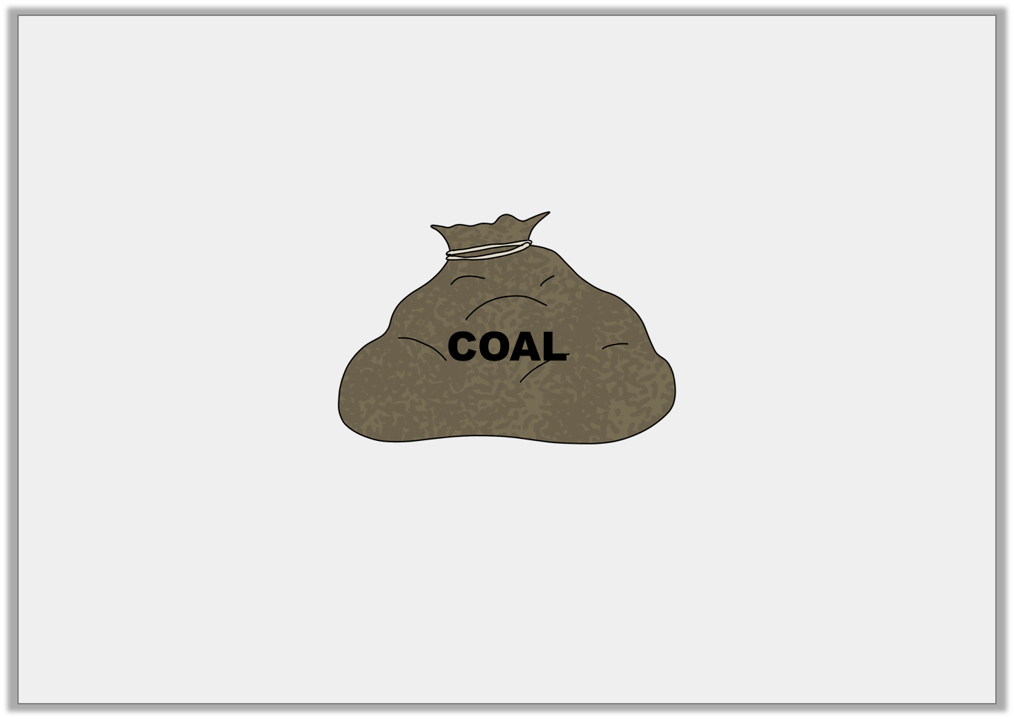
Problem Solving 1
A sack of coal weighs 4,050g.
A trailer can carry a maximum weight of 48.6kg.
How many sacks can be loaded onto the trailer?
© Classroom Secrets Limited 2019

Slide 13
Problem Solving 1
A sack of coal weighs 4,050g.
A trailer can carry a maximum weight of 48.6kg.
How many sacks can be loaded onto the trailer?
12
© Classroom Secrets Limited 2019

Slide 14
Problem Solving 2
Arrange the digit cards to make the following statement true.
2
0
?
6
?
.
0
?
m
cm
>
4
5
0
© Classroom Secrets Limited 2019

Slide 15
Problem Solving 2
Arrange the digit cards to make the following statement true.
2,006cm > 4.05m
2
0
0
6
4
.
0
5
m
cm
>
4
5
0
© Classroom Secrets Limited 2019

Slide 16

Reasoning 1
A petrol tank holds 45,000ml. Dave puts 12 L of fuel in his car and says,
Is he correct? Explain your answer.
3
4
I have space for 30L left in the tank.
© Classroom Secrets Limited 2019

Slide 17
Reasoning 1
A petrol tank holds 45,000ml. Dave puts 12 L of fuel in his car and says,
Is he correct? Explain your answer.
No, Dave is incorrect because...
3
4
I have space for 30L left in the tank.
© Classroom Secrets Limited 2019

Slide 18
Reasoning 1
A petrol tank holds 45,000ml. Dave puts 12 L of fuel in his car and says,
Is he correct? Explain your answer.
No, Dave is incorrect because 45L – 12.75L = 32.25L.
3
4
I have space for 30L left in the tank.
© Classroom Secrets Limited 2019

