Slide 1


Year 6 – Converting Units
Y6 Convert Metric Measures
© Classroom Secrets Limited 2019

Slide 2
Introduction
Match the item to the most appropriate unit of measurement.
Weight of a sack of potatoes |  | L
Volume of water in a glass |  | mm
Length of a park |  | cm
Length of a finger |  | m
Weight of an apple |  | ml
Volume of water in a bucket |  | g
Length of an ant’s leg |  | kg
© Classroom Secrets Limited 2019

Slide 3
Introduction
Match the item to the most appropriate unit of measurement.
Weight of a sack of potatoes |  | kg
Volume of water in a glass |  | ml
Length of a park |  | m
Length of a finger |  | cm
Weight of an apple |  | g
Volume of water in a bucket |  | L
Length of an ant’s leg |  | mm
© Classroom Secrets Limited 2019

Slide 4
Varied Fluency 1
Complete the following statement.
3,500ml is equal to ____L.
© Classroom Secrets Limited 2019

Slide 5
Varied Fluency 1
Complete the following statement.
3,500ml is equal to ____L.
3.5
© Classroom Secrets Limited 2019

Slide 6
Varied Fluency 2
Put these measurements in order from smallest to largest.
155cm
2.6m
0.6m
1,050mm
155mm
165cm
© Classroom Secrets Limited 2019

Slide 7
Varied Fluency 2
Put these measurements in order from smallest to largest.
155mm; 0.6m; 1,050mm; 155cm; 165cm; 2.6m
155cm
2.6m
0.6m
1,050mm
155mm
165cm
© Classroom Secrets Limited 2019

Slide 8
Varied Fluency 3
Complete the missing operation and measurement to convert between g and kg.
285g |  | = |  | kg
© Classroom Secrets Limited 2019

Slide 9
Varied Fluency 3
Complete the missing operation and measurement to convert between g and kg.
285g | ÷ 1,000 | = | 0.285 | kg
© Classroom Secrets Limited 2019

Slide 10
Varied Fluency 4
Find and correct the errors in these conversions:
A. | 1,565g | = | 1.565kg
B. | 2.35L | = | 235ml
C. | 15cm | = | 150mm
D. | 1,500mm | = | 1.05m
© Classroom Secrets Limited 2019

Slide 11
Varied Fluency 4
Find and correct the errors in these conversions:
A. | 1,565g | = | 1.565kg
B. | 2.35L | = | 2,350ml
C. | 15cm | = | 150mm
D. | 1,500mm | = | 1.5m
© Classroom Secrets Limited 2019

Slide 12
Reasoning 1
Roland thinks that he walked the farthest on Wednesday.
Do you agree? Explain why.
 | 9am | 12pm | 3pm
Mon | 3.565km | 2,425m | 2,475m
Tue | 1.5km | 1,050m | 5,255m
Wed | 6,065m | 2km | 500m
Thu | 4,650m | 3.05km | 1,455m
Fri | 2.075km | 50m | 3,615m
© Classroom Secrets Limited 2019

Slide 13
Reasoning 1
Roland thinks that he walked the farthest on Wednesday.
Do you agree? Explain why.
Roland is incorrect because…
 | 9am | 12pm | 3pm
Mon | 3.565km | 2,425m | 2,475m
Tue | 1.5km | 1,050m | 5,255m
Wed | 6,065m | 2km | 500m
Thu | 4,650m | 3.05km | 1,455m
Fri | 2.075km | 50m | 3,615m
© Classroom Secrets Limited 2019

Slide 14
Reasoning 1
Roland thinks that he walked the farthest on Wednesday.
Do you agree? Explain why.
Roland is incorrect because he walked 9.155km (9,155m) on Thursday, which is farther than any other day.
 | 9am | 12pm | 3pm
Mon | 3.565km | 2,425m | 2,475m
Tue | 1.5km | 1,050m | 5,255m
Wed | 6,065m | 2km | 500m
Thu | 4,650m | 3.05km | 1,455m
Fri | 2.075km | 50m | 3,615m
total
8.465km
7.805km
8.565km
9.155km
5.74km
© Classroom Secrets Limited 2019

Slide 15
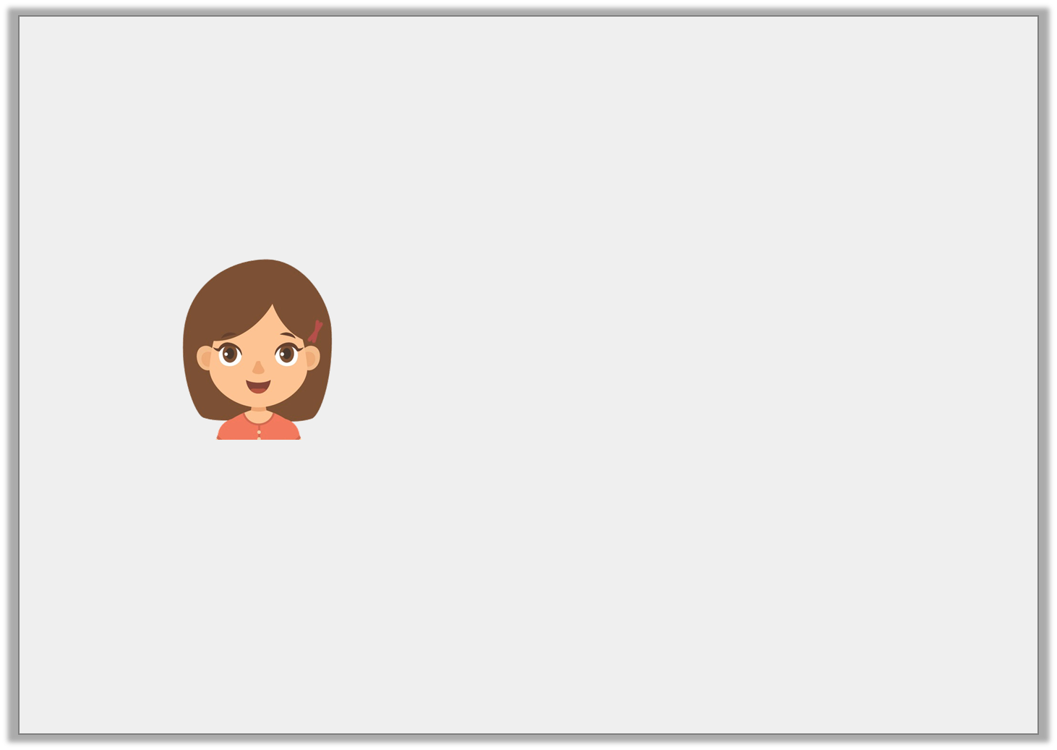
Problem Solving 1
Erin is practicing converting different units of measure.
She says,
What could her starting number have been? Find 3 possibilities.
I start off with a number of millilitres. When converted to litres, my amount has 2 decimal places and is between 6.3L and 6.4L.
© Classroom Secrets Limited 2019

Slide 16
Problem Solving 1
Erin is practicing converting different units of measure.
She says,
What could her starting number have been? Find 3 possibilities.
Various answers, for example: 6,310ml (6.31L); 6,320ml (6.32L); 6,330ml (6.33L)
I start off with a number of millilitres. When converted to litres, my amount has 2 decimal places and is between 6.3L and 6.4L.
© Classroom Secrets Limited 2019

Slide 17
Reasoning 2
Harry has filled in a table after converting from cm to m.
Is his table correct? Explain why.
cm | m
302cm | 3.2m
1,204cm | 12.4m
4,305cm | 43.5m
© Classroom Secrets Limited 2019

Slide 18
Reasoning 2
Harry has filled in a table after converting from cm to m.
Is his table correct? Explain why.
Harry’s table is incorrect because…
cm | m
302cm | 3.02m
1,204cm | 12.04m
4,305cm | 43.05m
© Classroom Secrets Limited 2019

Slide 19
Reasoning 2
Harry has filled in a table after converting from cm to m.
Is his table correct? Explain why.
Harry’s table is incorrect because he has not included the zero as a placeholder when converting.
cm | m
302cm | 3.02m
1,204cm | 12.04m
4,305cm | 43.05m
© Classroom Secrets Limited 2019

