Slide 1


Year 6 – Spring Block 6 – Ratio
Calculating Ratio
© Classroom Secrets Limited 2019

Slide 2
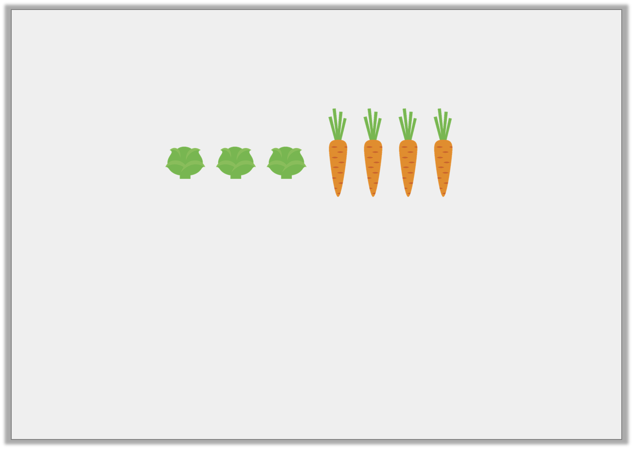
Introduction
Complete the sentences using the images below.
For every |  | sprouts there are |  | carrots.
 | of the vegetables are sprouts, |  | of the vegetables are carrots.
 | :
© Classroom Secrets Limited 2019

Slide 3
Introduction
Complete the sentences using the images below.
For every | 3 | sprouts there are | 4 | carrots.
3 | of the vegetables are sprouts, | 4 | of the vegetables are carrots.
 |  | 7
7
3 | : | 4
© Classroom Secrets Limited 2019

Slide 4

Varied Fluency 1
Use the image below to complete the ratio statements.
For every _____ teacher, there are _____ pupils.
If there are 12 teachers, how many pupils will there be?
© Classroom Secrets Limited 2019

Slide 5
Varied Fluency 1
Use the image below to complete the ratio statements.
For every _____ teacher, there are _____ pupils.
If there are 12 teachers, how many pupils will there be?
120
1
10
© Classroom Secrets Limited 2019

Slide 6
Varied Fluency 2
There are 35 animals on a farm. For every 5 cows there are 2 pigs. Use the bar model to help you calculate:
How many cows altogether?
How many pigs altogether?
© Classroom Secrets Limited 2019

Slide 7
Varied Fluency 2
There are 35 animals on a farm. For every 5 cows there are 2 pigs. Use the bar model to help you calculate:
How many cows altogether?
How many pigs altogether?
25
10
© Classroom Secrets Limited 2019

Slide 8

Varied Fluency 3
What is the ratio of suns to rainclouds?
Use the ratio to calculate how many symbols there
will be altogether if there are 20 suns.
suns
rainclouds
symbols altogether
:
20
© Classroom Secrets Limited 2019

Slide 9
Varied Fluency 3
What is the ratio of suns to rainclouds?
Use the ratio to calculate how many symbols there
will be altogether if there are 20 suns.
suns
rainclouds
symbols altogether
5
:
3
20
12
32
© Classroom Secrets Limited 2019

Slide 10
Problem Solving 1
Mary is making buns for her birthday party but has limited ingredients.
For every 3 chocolate buns, she makes 2 vanilla buns.
There are 66 people at the party and of the people want
a vanilla bun.
How many chocolate buns will Mary make?
How many people will not receive a bun?
1
3
© Classroom Secrets Limited 2019

Slide 11
Problem Solving 1
Mary is making buns for her birthday party but has limited ingredients.
For every 3 chocolate buns, she makes 2 vanilla buns.
There are 66 people at the party and of the people want
a vanilla bun.
How many chocolate buns will Mary make?
33
How many people will not receive a bun?
11
1
3
© Classroom Secrets Limited 2019

Slide 12
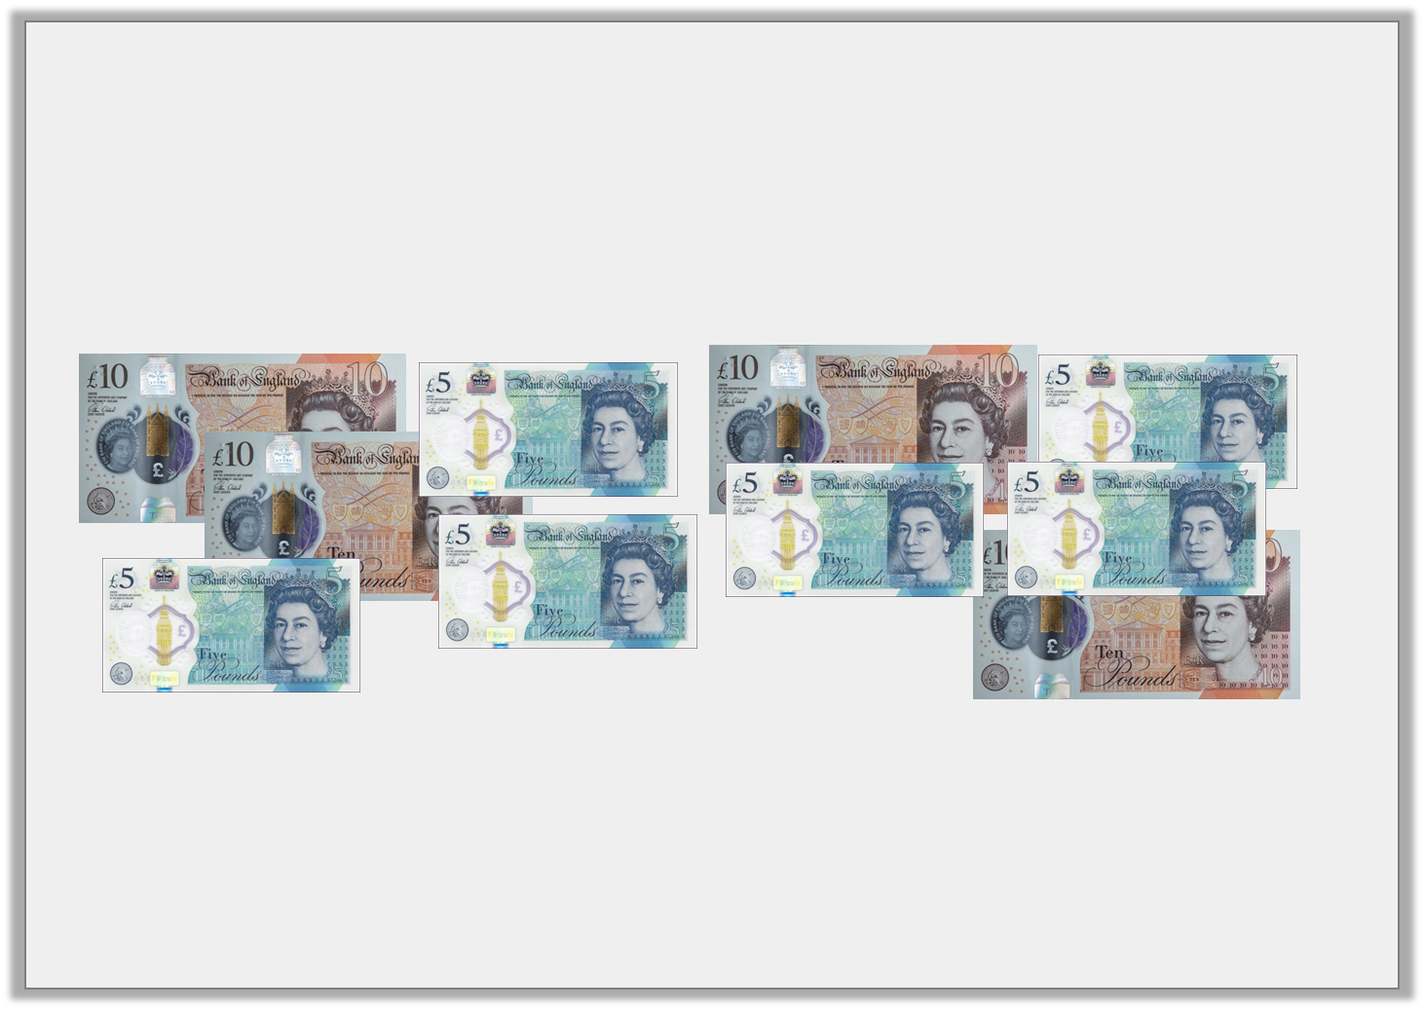
Reasoning 1
A cashier is sorting the money in the till.
He works out the ratio of £5 notes to £10 notes is 2:1
Have the notes been sorted correctly?
Explain your answer.
© Classroom Secrets Limited 2019

Slide 13
Reasoning 1
A cashier is sorting the money in the till.
He works out the ratio of £5 notes to £10 notes is 2:1
Have the notes been sorted correctly?
Explain your answer.
No because…
© Classroom Secrets Limited 2019

Slide 14
Reasoning 1
A cashier is sorting the money in the till.
He works out the ratio of £5 notes to £10 notes is 2:1
Have the notes been sorted correctly?
Explain your answer.
No because there are 1 too many £10 notes (or there needs to be 2 more £5 notes).
© Classroom Secrets Limited 2019

Slide 15
Problem Solving 2
For every blue front door on the row of terraces, there are 2 red doors. There are 12 blue doors altogether.
One third of the red doors are repainted blue.
What is the new ratio of blue doors to red doors?
How many red doors are there altogether?
© Classroom Secrets Limited 2019

Slide 16
Problem Solving 2
For every blue front door on the row of terraces, there are 2 red doors. There are 12 blue doors altogether.
One third of the red doors are repainted blue.
What is the new ratio of blue doors to red doors?
20:16 (accept 5:4)
How many red doors are there altogether?
16
© Classroom Secrets Limited 2019

