Slide 1
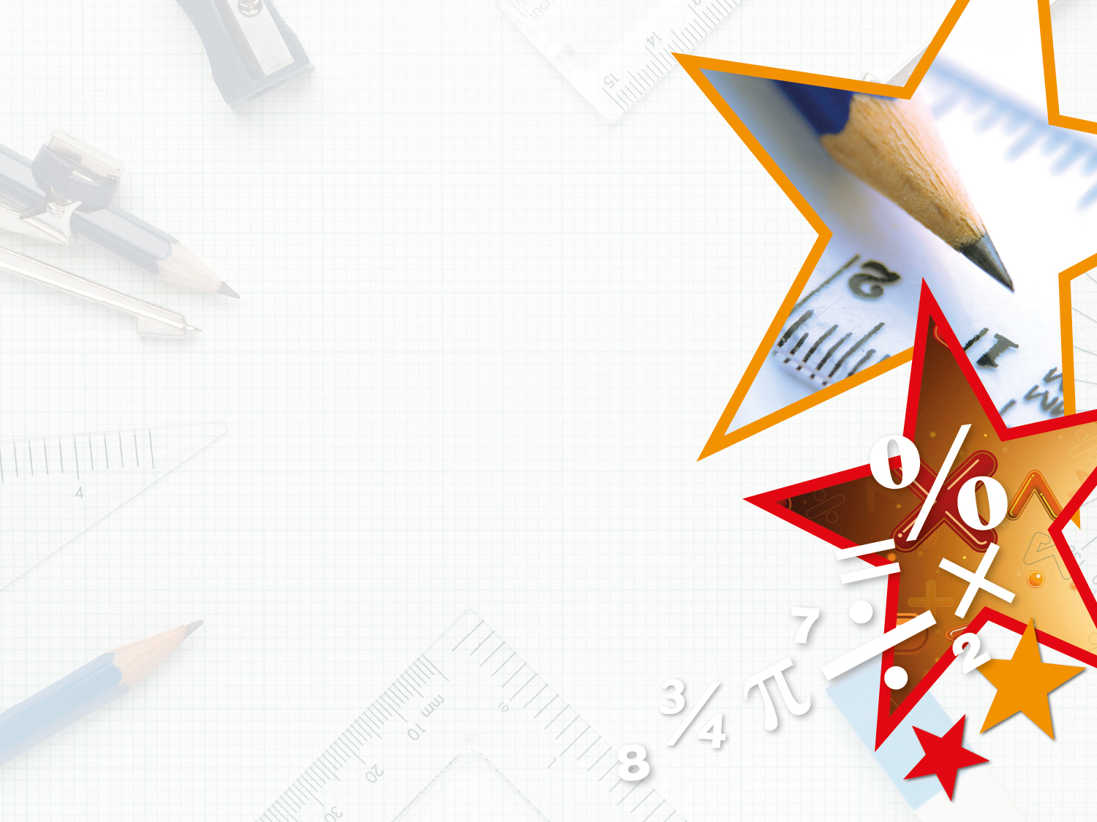

Year 5 – Spring Block 3 – Decimals and Percentages – Order and Compare Decimals
About This Resource:
This PowerPoint has been designed to support your teaching of this small step. It includes a starter activity and an example of each question from the Varied Fluency and Reasoning and Problem Solving resources also provided in this pack. You can choose to work through all examples provided or a selection of them depending on the needs of your class.
National Curriculum Objectives:
Mathematics Year 5: (5F8) Read, write, order and compare numbers with up to three decimal places
Mathematics Year 5: (5F10) Solve problems involving number up to three decimal places
More Year 5 Decimals and Percentages resources.
Did you like this resource? Don’t forget to review it on our website.
© Classroom Secrets Limited 2019

Slide 2
Year 5 – Spring Block 3 – Decimals and Percentages
Step 7: Order and Compare Decimals
© Classroom Secrets Limited 2019

Slide 3
Introduction
Think of a number larger and a number smaller than this decimal.
1
0.1
0.01
0.001
1
0.1
0.01
0.001
0.1
0.01
0.01
© Classroom Secrets Limited 2019

Slide 4
Introduction
Think of a number larger and a number smaller than this decimal.
Various possible answers, for example:
Larger numbers: 2.489, 2.578, 3.521
Smaller numbers: 2.266, 1.789, 2.0
1
0.1
0.01
0.001
1
0.1
0.01
0.001
0.1
0.01
0.01
© Classroom Secrets Limited 2019

Slide 5
Varied Fluency 1
Tick the rows of decimals that are ordered correctly from smallest to largest.
1.709 | 1.719 | 1.83 | 1.904
3.48 | 3.5 | 3.508 | 3.099
6.039 | 6.531 | 6.635 | 6.75
© Classroom Secrets Limited 2019

Slide 6
Varied Fluency 1
Tick the rows of decimals that are ordered correctly from smallest to largest.
1.709 | 1.719 | 1.83 | 1.904 |  | ✓
3.48 | 3.5 | 3.508 | 3.099
6.039 | 6.531 | 6.635 | 6.75 |  | ✓
© Classroom Secrets Limited 2019

Slide 7
Varied Fluency 2
These decimals have been placed in descending order.
Circle the decimal that completes the sequence.
8.387 | 7.531 |  | 7.252
7.29 | seven and six tenths | 7.038 | 7.165
© Classroom Secrets Limited 2019

Slide 8
Varied Fluency 2
These decimals have been placed in descending order.
Circle the decimal that completes the sequence.
8.387 | 7.531 |  | 7.252
7.29 | seven and six tenths | 7.038 | 7.165
© Classroom Secrets Limited 2019

Slide 9
Varied Fluency 3
Complete the statement using >, < or = to make it correct.
852cm |  | 8.491m |  | 8.49m
© Classroom Secrets Limited 2019

Slide 10
Varied Fluency 3
Complete the statement using >, < or = to make it correct.
852cm | > | 8.491m | > | 8.49m
© Classroom Secrets Limited 2019

Slide 11
Varied Fluency 4
Place the numbers in ascending order.
3.581 | 3 | 561 |  | 3.658 | 3 | 165
 |  | 1000 |  |  |  | 1000
© Classroom Secrets Limited 2019

Slide 12
Varied Fluency 4
Place the numbers in ascending order.
3 | 165
 | 1000
3 | 561
 | 1000
3.581
3.658
3.581 | 3 | 561 |  | 3.658 | 3 | 165
 |  | 1000 |  |  |  | 1000
© Classroom Secrets Limited 2019

Slide 13
Problem Solving 1
Louise made a number between 5.81 and six and three tenths, using counters on a place value mat.
Six of the counters have fallen off.
List 3 possibilities of what Louise’s number could be.
1 | 0.1 | 0.01 | 0.001
© Classroom Secrets Limited 2019

Slide 14
Problem Solving 1
Louise made a number between 5.81 and six and three tenths, using counters on a place value mat.
Six of the counters have fallen off.
List 3 possibilities of what Louise’s number could be.
Various possible answers, for example:
6.023, 6.14, 6.212
1 | 0.1 | 0.01 | 0.001
© Classroom Secrets Limited 2019

Slide 15
Problem Solving 2
Look at this number sequence.
Use the number cards to make all the possible numbers with 3 decimal places that can complete the sequence.
5 | 508 |  | 5.67 |  | 5 | 961
 | 1000 |  |  |  |  | 1000
5
6
7
8
© Classroom Secrets Limited 2019

Slide 16
Problem Solving 2
Look at this number sequence.
Use the number cards to make all the possible numbers with 3 decimal places that can complete the sequence.
5.678, 5.687, 5.768, 5.786 5.867, 5.876
5 | 508 |  | 5.67 |  | 5 | 961
 | 1000 |  |  |  |  | 1000
5
6
7
8
© Classroom Secrets Limited 2019

Slide 17
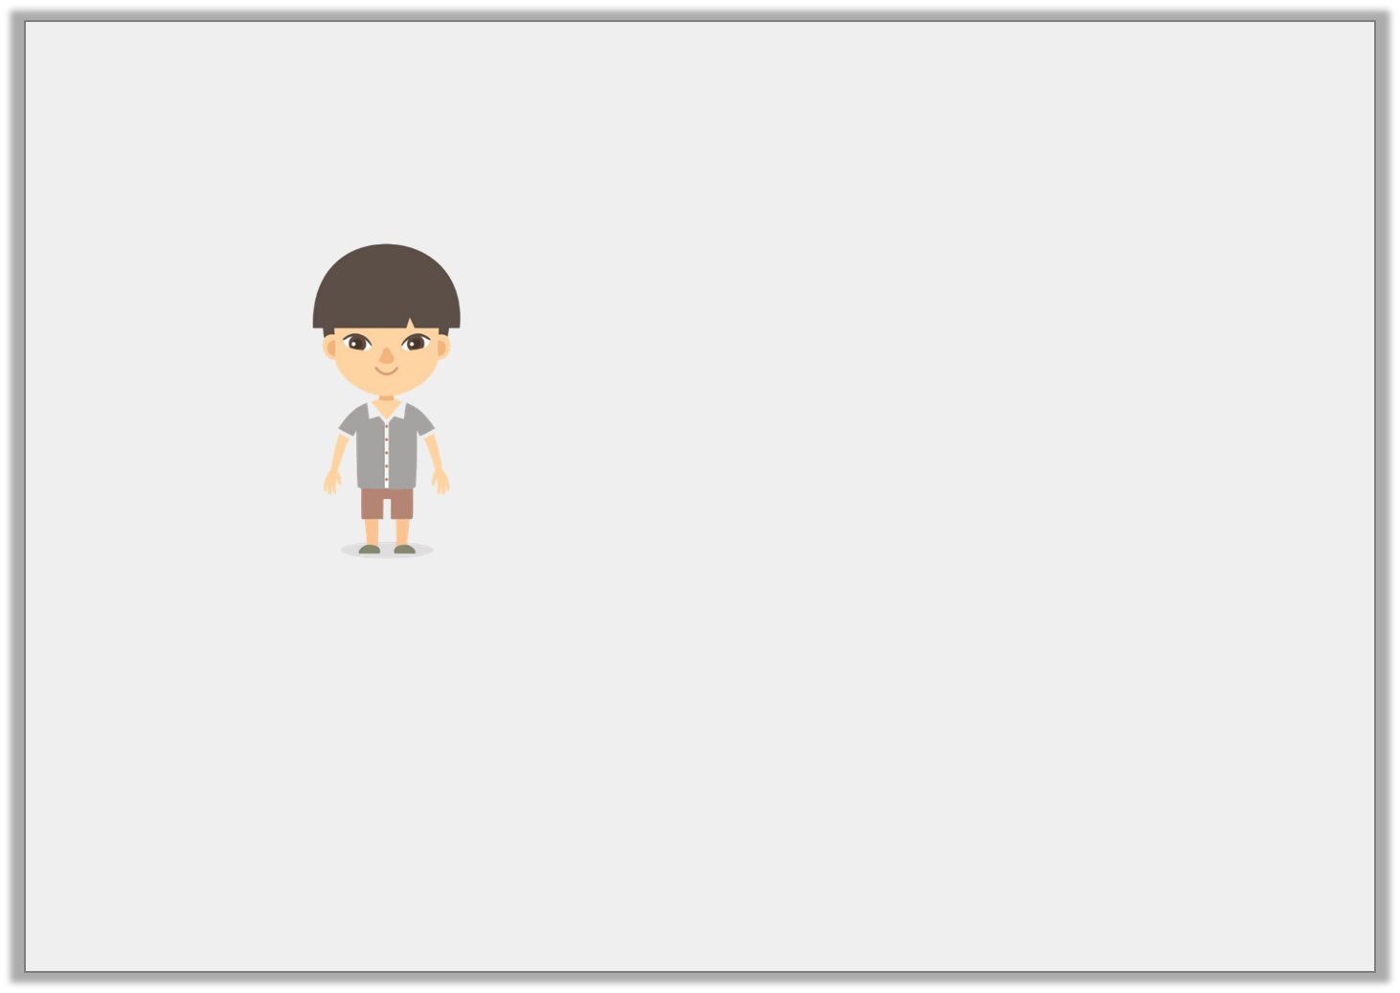
Reasoning 1
Jian is comparing numbers. He says,
Is Jian correct? Explain your answer.
I think that
9.218km > 9214m
© Classroom Secrets Limited 2019

Slide 18
Reasoning 1
Jian is comparing numbers. He says,
Is Jian correct? Explain your answer.
Jian is correct because…
I think that
9.218km > 9214m
© Classroom Secrets Limited 2019

Slide 19
Reasoning 1
Jian is comparing numbers. He says,
Is Jian correct? Explain your answer.
Jian is correct because 9,214 ÷ 1000 = 9.214 so 9,214m = 9.214km.
9.218 has 8 thousandths but 9.214 only has 4 so 9.218 is greater than 9.214.
I think that
9.218km > 9214m
© Classroom Secrets Limited 2019

