Slide 1
Year 5 Maths 21.01.2021
LO: To count on and back in decimal steps

Slide 2
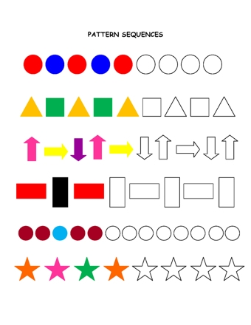
Starter (sequences)

Slide 3
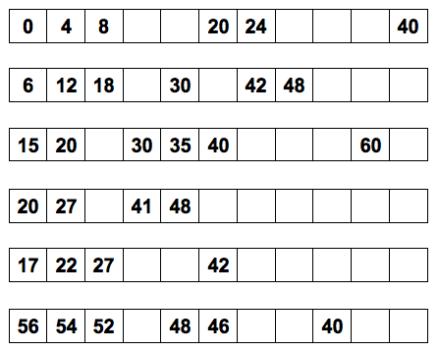

Slide 4
Counting in 4s
Counting in 6s
Counting in 5s
Counting in 7s
Counting in 5s
Counting in 2s

Slide 5
Counting on and back in decimal steps
Think about the next numbers:
1.5 2 2.5 3 3.5 ___ ___ ___
5.5 5.3 5.1 4.9 ___ ___ ___ ___
Start at 0.6 Count on 5 steps of 0.3

Slide 6
