Slide 1



LIFE/work balance
We have started a #LIFEworkbalance campaign and we need your help to complete our LIFE/work balance survey.
We hope to publish the results soon, so please give 15 minutes of your time to help us get a true picture of school life.
Want to be a part of this campaign? Take the survey on our website and share it with your colleagues!
© Classroom Secrets Limited 2019

Slide 2
Year 4 – Autumn Block 2 – Addition and Subtraction
Subtract Two 4-Digit Numbers 2
About This Resource:
This PowerPoint has been designed to support your teaching of this small step. It includes a starter activity and an example of each question from the Varied Fluency and Reasoning and Problem Solving resources also provided in this pack. You can choose to work through all examples provided or a selection of them depending on the needs of your class.
National Curriculum Objectives:
Mathematics Year 4: (4C2) Add and subtract numbers with up to 4 digits using the formal written methods of columnar addition and subtraction where appropriate
More Year 4 Addition and Subtraction resources.
Did you like this resource? Don’t forget to review it on our website.
© Classroom Secrets Limited 2018

Slide 3
Year 4 – Autumn Block 2 – Addition and Subtraction
Step 6: Subtract Two 4-Digit Numbers 2
© Classroom Secrets Limited 2018

Slide 4
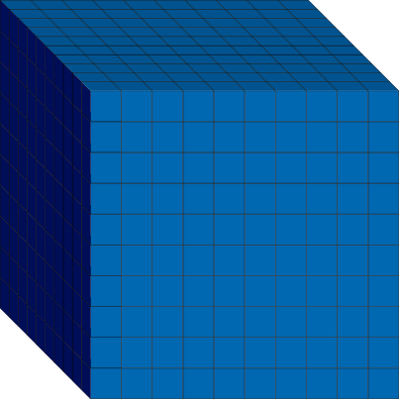


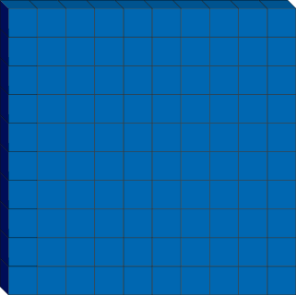
Introduction
Match the Base 10 with its equivalent value.
© Classroom Secrets Limited 2018

Slide 5
Introduction
Match the Base 10 with its equivalent value.
© Classroom Secrets Limited 2018

Slide 6
Varied Fluency 1
True or false? The difference between 6,452 and 4,414 is 2,041.
 | Th | H | T | O
–
© Classroom Secrets Limited 2018

Slide 7
Varied Fluency 1
True or false? The difference between 6,452 and 4,414 is 2,041.
False
 | Th | H | T | O
–
 | 2 | 0 | 3 | 8
10
© Classroom Secrets Limited 2018

Slide 8
Varied Fluency 2
Circle the correct answer to the question below.
 | 5 | 6 | 8 | 1
– | 3 | 9 | 7 | 0
A. 1,311 |  | B. 2,311 |  | C. 1,711
© Classroom Secrets Limited 2018

Slide 9
Varied Fluency 2
Circle the correct answer to the question below.
 | 5 | 6 | 8 | 1
– | 3 | 9 | 7 | 0
 | 1 | 7 | 1 | 1
4
1
A. 1,311 |  | B. 2,311 |  | C. 1,711
© Classroom Secrets Limited 2018

Slide 10
Varied Fluency 3
Complete the calculation below.
 | 9 | 2 | 8 | 5
– | 2 | 7 | 1 | 3
© Classroom Secrets Limited 2018

Slide 11
Varied Fluency 3
Complete the calculation below.
 | 9 | 2 | 8 | 5
– | 2 | 7 | 1 | 3
 | 6 | 5 | 7 | 2
8
1
© Classroom Secrets Limited 2018

Slide 12
Varied Fluency 4
If Andy has 3,409 stickers and he gives 1,265 of them to Tina, how many stickers does he have left?
 | 3 | 4 | 0 | 9
– | 1 | 2 | 6 | 5
© Classroom Secrets Limited 2018

Slide 13
Varied Fluency 4
If Andy has 3,409 stickers and he gives 1,265 of them to Tina, how many stickers does he have left?
2,144 stickers
 | 3 | 4 | 0 | 9
– | 1 | 2 | 6 | 5
 | 2 | 1 | 4 | 4
3
1
© Classroom Secrets Limited 2018

Slide 14
Problem Solving 1
Complete the calculation below.
 |  | 3 | 6 | 5
– | 2 | 1
 | 6 |  | 7 | 3
© Classroom Secrets Limited 2018

Slide 15
Problem Solving 1
Complete the calculation below.
 |  | 3 | 6 | 5
– | 2 | 1
 | 6 |  | 7 | 3
8
2
1
9
2
1
© Classroom Secrets Limited 2018

Slide 16
Problem Solving 2
Use digits from 0 - 9 to create a subtraction calculation with two 4-digit numbers and one exchange.
–
© Classroom Secrets Limited 2018

Slide 17
Problem Solving 2
Use digits from 0 - 9 to create a subtraction calculation with two 4-digit numbers and one exchange.
–
6
8
1
9
0
4
4
2
5
3
2
6
5
1
© Classroom Secrets Limited 2018

Slide 18
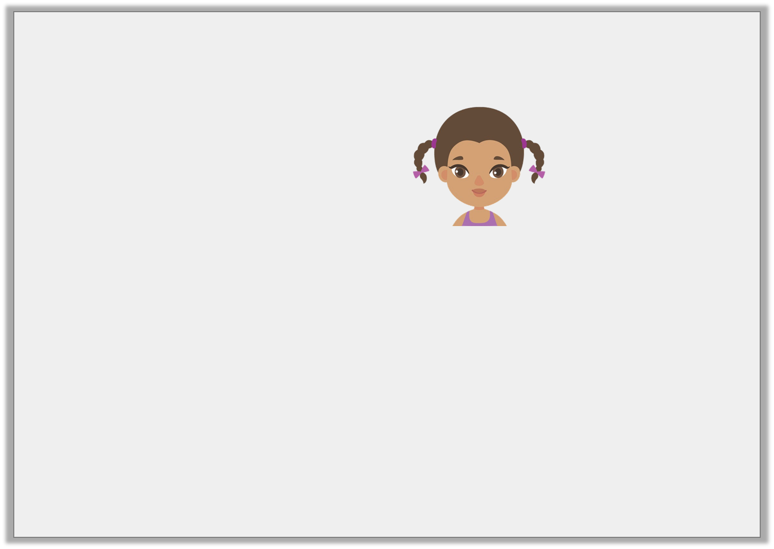
Reasoning 1
Class 4 are given the following calculation. Monica says,
We need to exchange one of the hundreds for ten tens.
 | 4 | 8 | 9 | 4
– | 1 | 8 | 3 | 7
© Classroom Secrets Limited 2018

Slide 19
Reasoning 1
Class 4 are given the following calculation. Monica says,
We need to exchange one of the hundreds for ten tens.
 | 4 | 8 | 9 | 4
– | 1 | 8 | 3 | 7
Monica is incorrect because...
© Classroom Secrets Limited 2018

Slide 20
Reasoning 1
Class 4 are given the following calculation. Monica says,
We need to exchange one of the hundreds for ten tens.
 | 4 | 8 | 9 | 4
– | 1 | 8 | 3 | 7
Monica is incorrect because they need to exchange one of the tens for ten ones.
© Classroom Secrets Limited 2018

