Slide 1
Year 5 Maths 01.02.2021
LO: To read and write time on an analogue and digital clock

Slide 2
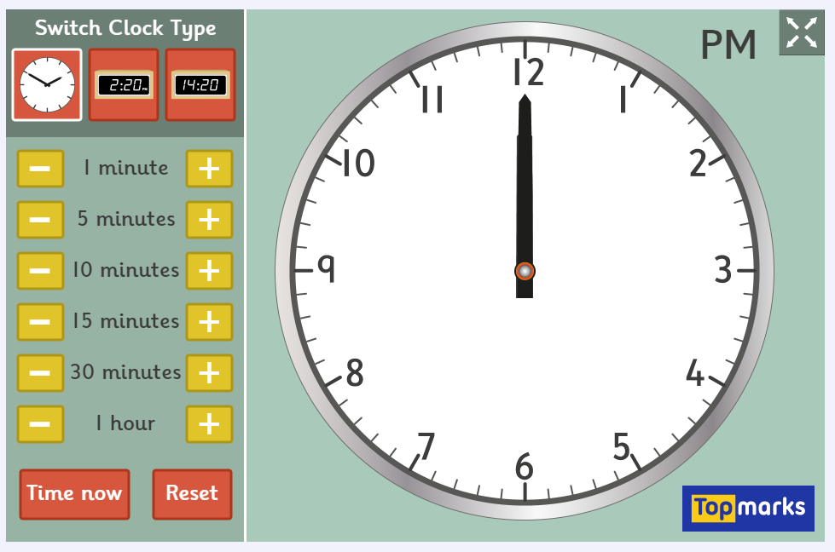
Using an analogue and digital clock

Slide 3
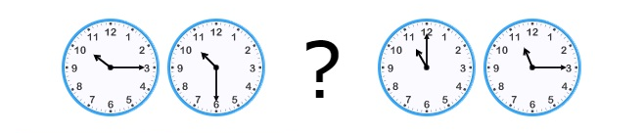

Slide 4
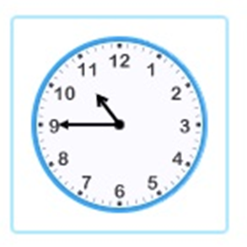

Slide 5
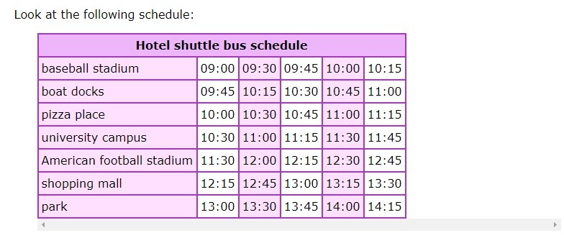
What do you notice about the times on this bus schedule?

Slide 6
Now it’s time to work out some time intervals!

Slide 7
Time Intervals (using jottings)

Slide 8
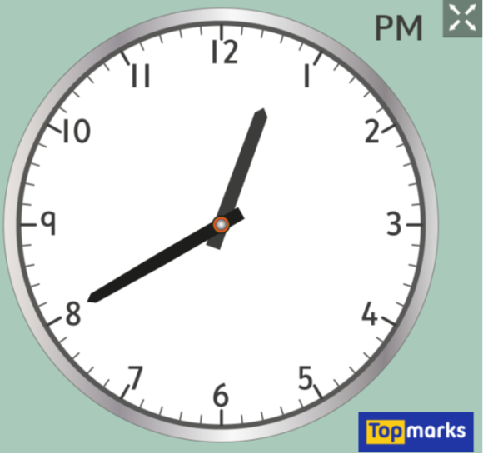
Time Intervals (using jottings)

Slide 9
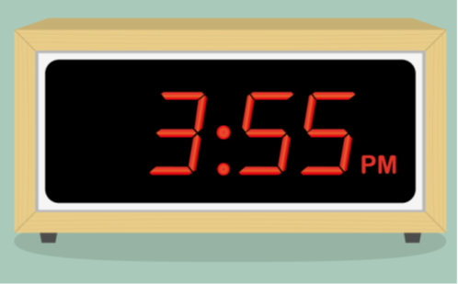
Time Intervals (using jottings)

Slide 10
Activity 1: Telling the time

Slide 11
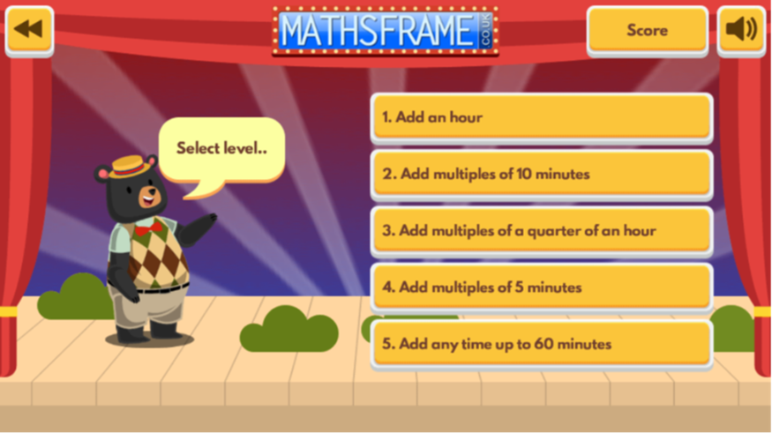
Activity 2: Time intervals

