Slide 1
Exciting Writing
To write a new ‘Cinderella’ story – Friday 4th February

Slide 2
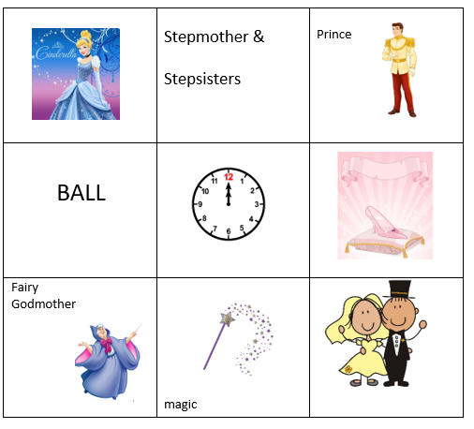
Exciting Writing:
Create a set of ‘bones’ for a new story using aspects selected from your grids of previous versions of the Cinderella story.
Use these new ‘bones’ to write a new version of the Cinderella story.

Slide 3
Remember to include key features of this text including:
Special words
Good and bad characters
Royalty
Palaces, castles and kingdoms
Special objects
Helpers
Magic
A problem that is resolved
Rich language, similes and metaphors
MORAL

Slide 4
Other common features include:
Characters: Evil witch or stepmother; a handsome prince, a beautiful and kind (but persecuted) heroine
Place: a hut in the wood, a ballroom/palace, a river
Objects: a glass slipper, a magical tablecloth
Actions/events: a ball, a journey, tricking the baddies, riddles
Special helpers: dead mother, fairy godmother, a tree, animals
Repetition: things happen in threes (or 7)

Slide 5
Your fairy tale must have a ‘persecuted’ heroine/hero:
But the rest is up to you - set your imagination free!
Be a storyteller!

