Slide 1
English Day 9
English day 9 – Thursday 21st january

Slide 2
Why is punctuation so important?
What’s the point of commas?

Slide 3
Commas - ,
A comma is a punctuation mark
It tells us to take a brief pause when we are reading – not as long as a full stop.
It is the most common punctuation mark but has to be used carefully.

Slide 4
Commas
Commas can change the meaning of a sentence
For example, in the title of a well known book
  Eats shoots and leaves.
  Eats, shoots and leaves.
  How does the comma change the meaning?

Slide 5
Changing meaning 2
The old lady collected all sorts of things: silver, paper, hats, clocks and tablecloths.
The old lady collected all sorts of things: silver paper, hats, clocks and tablecloths.
The old lady collected all sorts of things: silver, paper hats, clocks and tablecloths.
Explain the impact of the commas

Slide 6
Different Uses - 1
When there is a list of words in a sentence
  We will need hammers, nails and a saw.
  She stopped, stared and ran.
  Mr Cherry was a warm, hospitable man.
  Sam frightened the cat, teased the dog and annoyed the neighbours.

Slide 7
Different Uses - 2
Commas are used to break up longer sentences into smaller parts to make more sense.
  When he saw the pirate ship on the horizon, the captain gave the alarm.
  She called as loudly as she could, but no-one could hear her.

Slide 8
Different Uses - 3
Commas are used to separate any extra information that is added.
The words enclosed by the commas could be left out without changing the general meaning of the sentence.

Slide 9
Adding information
Paul Mann broke his leg in the match on Saturday.
Paul Mann, our star player, broke his leg in the match on Saturday.
The man slid silently into the room.
The man, who was wearing a blue hat, slid silently into the room.

Slide 10
Separating clauses and fronted adverbials
Later that day, Will took his brothers and sisters to their grandparents’ house.
After lunch, Nick continued to repair the wooden wharf.
Although it was raining heavily, Tom did not wear his coat.
Because Mistress Jenkins was tired, she asked Mercy to help in the kitchen.

Slide 11
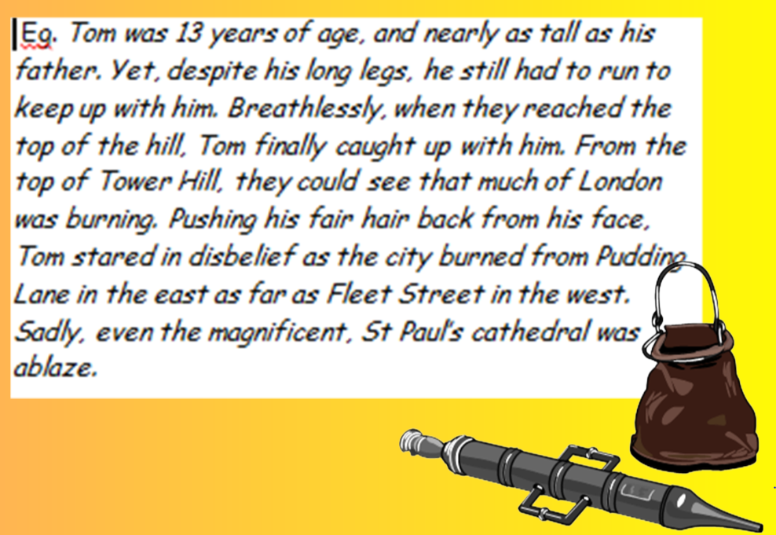
Why were commas used?

Slide 12




Your task today:
Choose your ‘chilli’ task for today – how spicy can you go today?
Use commas in a list and after fronted adverbials.
As above and to separate clauses in sentences.
As all of above and when adding additional information.
Extension: Use commas to manipulate clause order for effect

Slide 13
PLENARY:
Read out your sentences to yourself – does it sound as if the commas are in the correct place
Move or insert commas where necessary.
Check – comma use
Seth who was a carpenter carried his heavy tool bag towards the wharf. In his bag he carried: a hammer, a saw, a plane, and handful of nails.

