Slide 1
English Day 7
English Day 7 Tuesday 19th of January, 2021

Slide 2
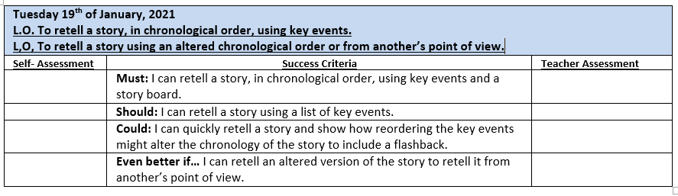

Slide 3
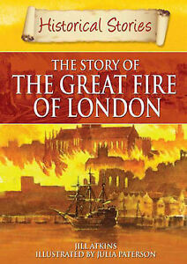
Finishing the story.
Read Chapters 6 and 7
What does ‘chronological order’ mean?
Task 1:
To orally retell the story
List the key events of the story in chronological order.

Slide 4
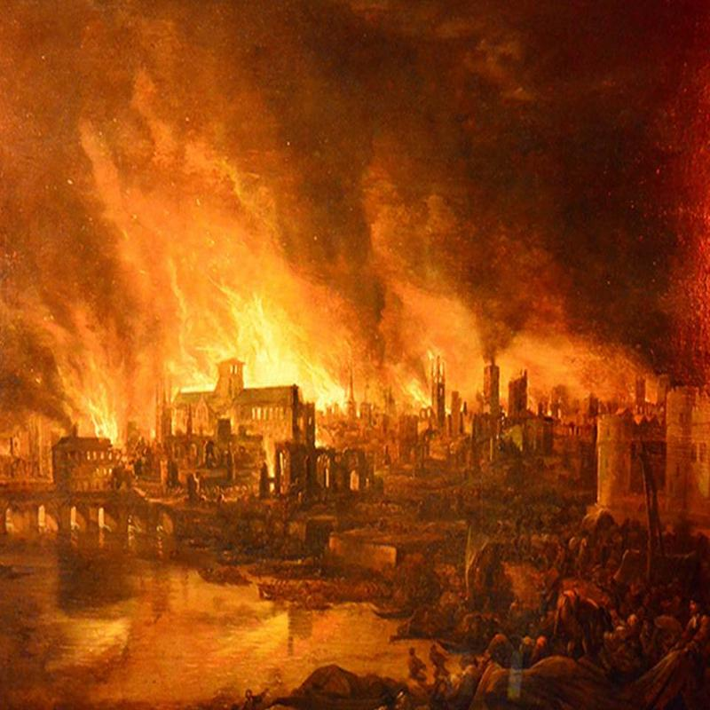
CHRONOLOGY OF THE FIRE
Sunday, September 2nd 1666: Fire breaks out in Pudding Lane at the King's Bakers. Fire spreads quickly due to the strong easterly wind.
Monday, September 3rd 1666: Houses are pulled down in the path of the fire. Still spreading fast. Hundreds of people are fleeing. King's brother, the Duke of York takes charge. Sets up fire-fighting posts.
Tuesday, 4th: St. Paul's Cathedral burns down. Soldiers begin blowing up houses. Homeless are sleeping in fields outside city.
Wednesday, 5th: Wind dies down. Soldiers blow up many houses to create fire-breaks. King & Duke of York organise chains of people with buckets of water.
Thursday, 6th: Fire out. Buildings are still smouldering. King orders that homeless people are fed. Friday: Clearing up.

Slide 5
What were the key events in chronological order in the book?
Will wakes up - realises there’s a fire – people are running away
Will’s father asked a stranger – fire started in Pudding Lane
William and his father walk up Tower Hill - the view made them gasp - dozens of houses were ablaze and lots of thick black smoke
Met a man who told them that 300 houses had burned in one night and that the fire spread quickly due to a lack of rain and the wind
Streets were packed, no-one could put the fire out ‘Keeling’s engines, leather pails
Will’s mother asks him to take children to their grandparents
He leaves them at his grandparent’s and rushes home – his father cross
Next day, they take the boat to rescue others then race home
Bury their prize possessions then race to grandparents, return after the fire – house is safe – firebreaks worked!

Slide 6




Task 2:
Choose your ‘chilli’ task for today – how spicy can you go today?
Retell the story from Will’s point of view using the storyboard provided.
Retell the story from Will’s point of view using your list of key events.
Retell the story from Will’s point of view but include a ‘flashback’.
Extension: Tell the story from more than one point of view with/without a flashback.

Slide 7
Plenary:
What happened next?
After the fire?
What happened to Will and his family?
How do you think London was changed?

