Slide 1
English Day 6
English Day 6 – Monday 18th of January

Slide 2
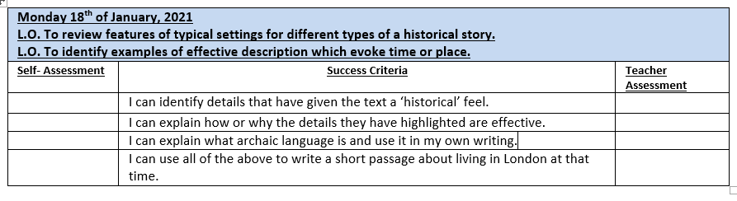

Slide 3
Key Features of historical fiction:
Tricky to write – attention to detail.
Historical fiction needs a historical setting.
Historical settings need details to make them sound ‘authentic’ or real

Slide 4
Historical Details including:
Historical objects e.g. a lantern or a closet
Clothing of the period e.g. a doublet or cape
Food eaten at the time – e.g. mutton, hare, deer, boar, fish, bread, cheese; ale and wine
Transport e.g. by foot; horse or horse and cart
Archaic language e.g. Let me carry thy basket, Mistress.

Slide 5

Read ‘Raven Boy’ by Pippa Goodhart
Historical Fiction. Chapter 1 has been uploaded on the website.
Reading from Chapter 2 p23-24
Listen out for historical details – note them in your book.

Slide 6
Archaic Language and phrasing obsolete or not in common use now
Vocabulary e.g. hath, thee, thy, lest
Sentence structure e.g. ‘That which ye seek, you shall find in the forest’
Religious references e.g ‘May the good lord have mercy’

Slide 7
What historical details did you notice?
Mistress Jenkins
mother’s shift
great purple swelling (buboes)
mutton on the bone – wrapped in a cloth left drying by the fire
‘searcher’ would come in his long black gown and bird-head mask
with a death cart and long, hooked poles
…they would nail tight the house for 40 days

Slide 8
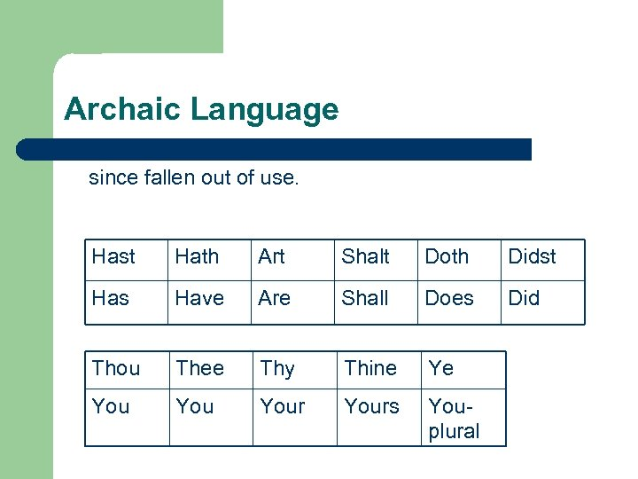

Slide 9
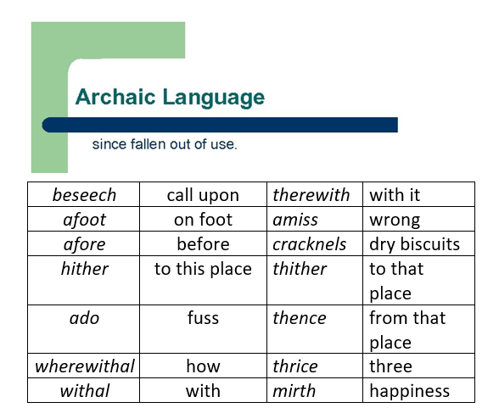

Slide 10
Your task today:
Using the vocabulary for your year group, try one of the tasks below:
* Write 4 or 5 sentences using the words on your sheet
** Include all of the words on your sheet in sentences – can you include some historical details?
*** As above but try to write a paragraph that includes some dialogue, historical details or description.
Challenge: Can you include some dialogue?

Slide 11
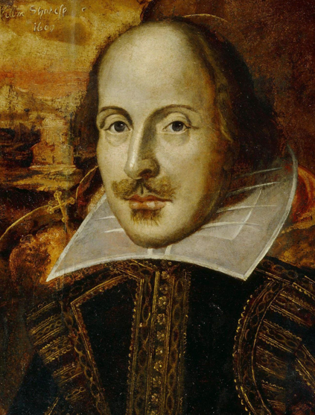
For example:
Thy Mother is ill, haste thee back Master Webb.
Didst thou take bread and cheese?
“I beseech thee Sire! Help thy people.” begged the Lord Mayor.
Out of my sight! Thou dost infect my eyes.

Slide 12
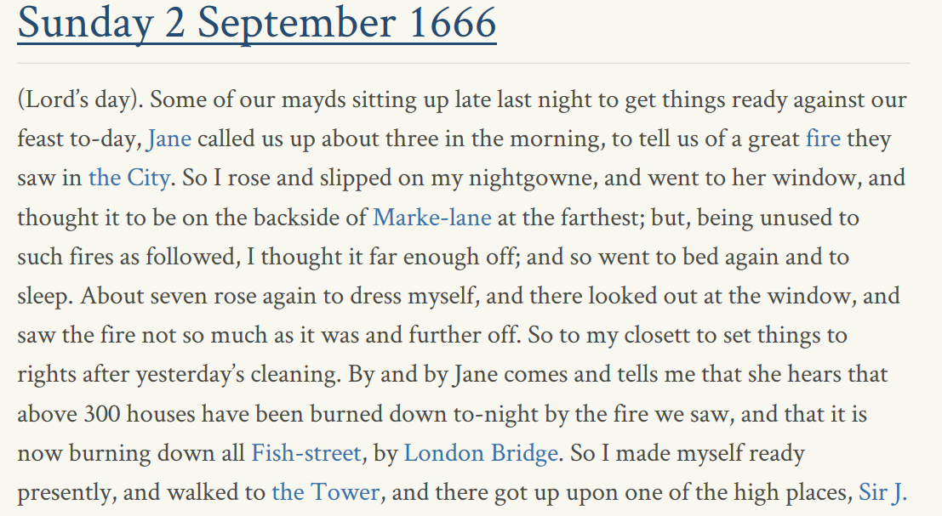
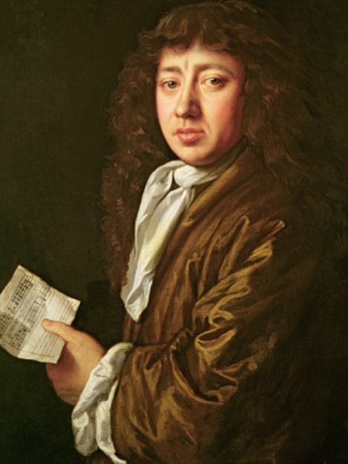
Excerpt from Samuel Pepys’ diary.
Much of what we know about the fire comes from this document.

