Slide 1
English Day 19
English day 19 – Thursday 4th February

Slide 2
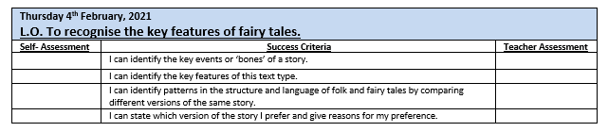

Slide 3
Features of a folk stories and fairy tales

Slide 4
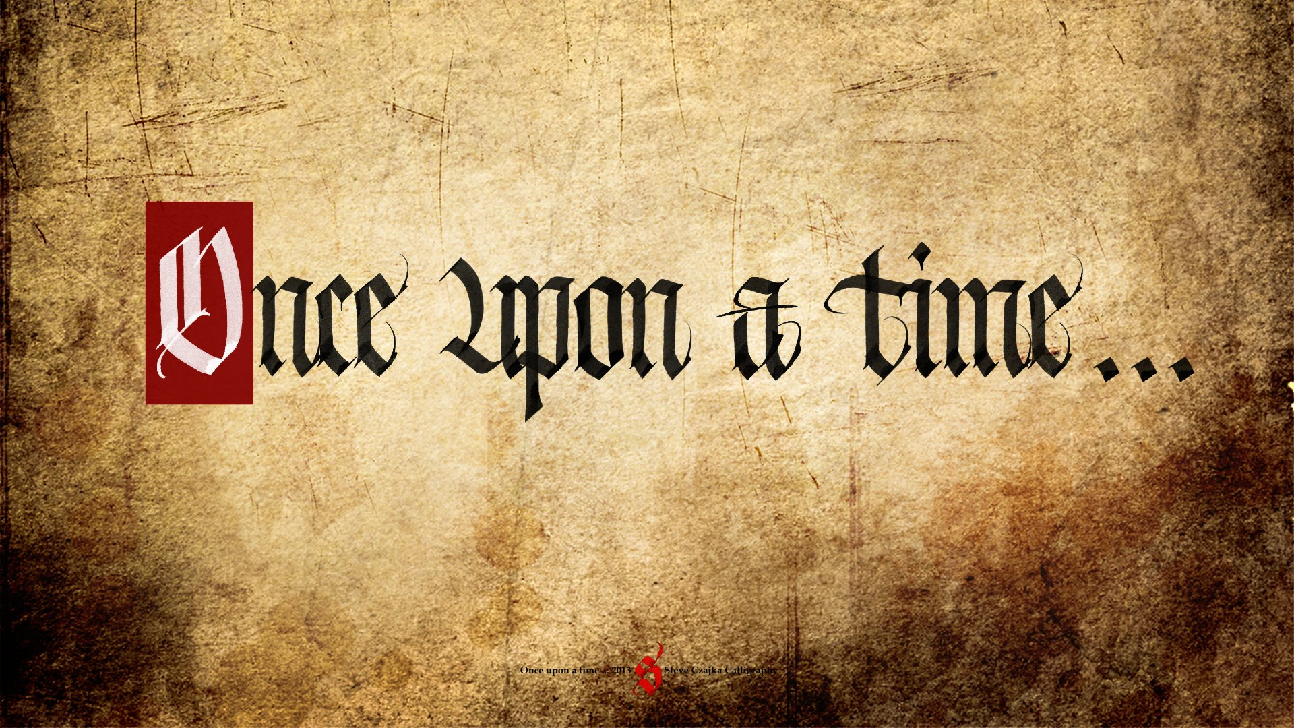
Special Words

Slide 5
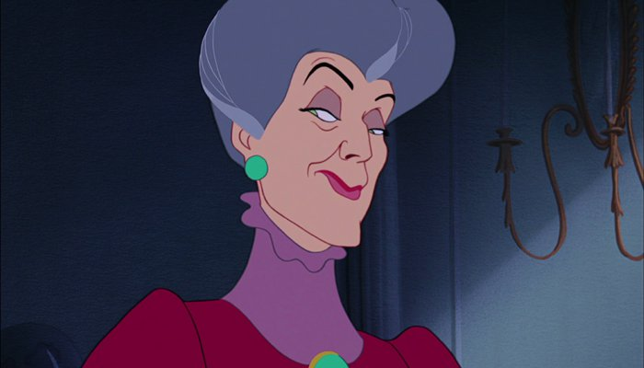
Good & Bad
Characters

Slide 6

Royalty:
Kings, Queens, Princes and Princesses
Palaces, castles and kingdoms

Slide 7
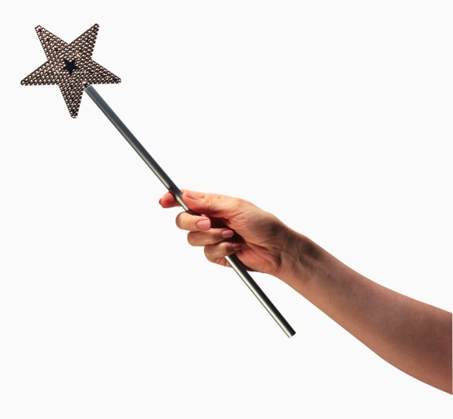
Magic
Spells
Charms

Slide 8
Other common features include:
Characters: Evil witch or stepmother; a handsome prince, a beautiful and kind (but persecuted) heroine
Place: a hut in the wood, a ballroom/palace, a river
Objects: a glass slipper, a magical tablecloth
Actions/events: a ball, a journey, tricking the baddies, riddles
Special helpers: dead mother, fairy godmother, a tree, animals
Repetition: things happen in threes (or 7)

Slide 9
Your Task:
Y4: on the sheet provided, record the different key features seen for two of the stories you have read/listened to
Y5: on the sheet provided or in your books, record the different key features for all three versions of the Cinderella story
Y6: in your books, record the different key features for all three stories. Do these stories have a moral? If so, what is it?

Slide 10
Plenary:
Decide which of the three stories you like best.
Explain why.
Y6 include examples from the text(s)

