Slide 1
English Day 18
English day 18 – Wednesday 3rd february

Slide 2
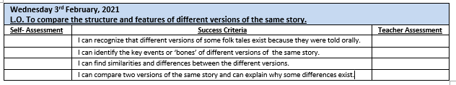

Slide 3
When was Cinderella written?
Most of us, when we think of the story of Cinderella, think of the Disney version.
‘Cinderella’ is a very old story – told orally over generations – there are many versions
Appeared in 1st century BC in ancient Greece – ‘Rhodopis’
First recorded version, Yi Shen (or Yi Xian) comes from China around 850 AD.
The version we know best, was ‘written’ by Charles Perrault in 1697.

Slide 4
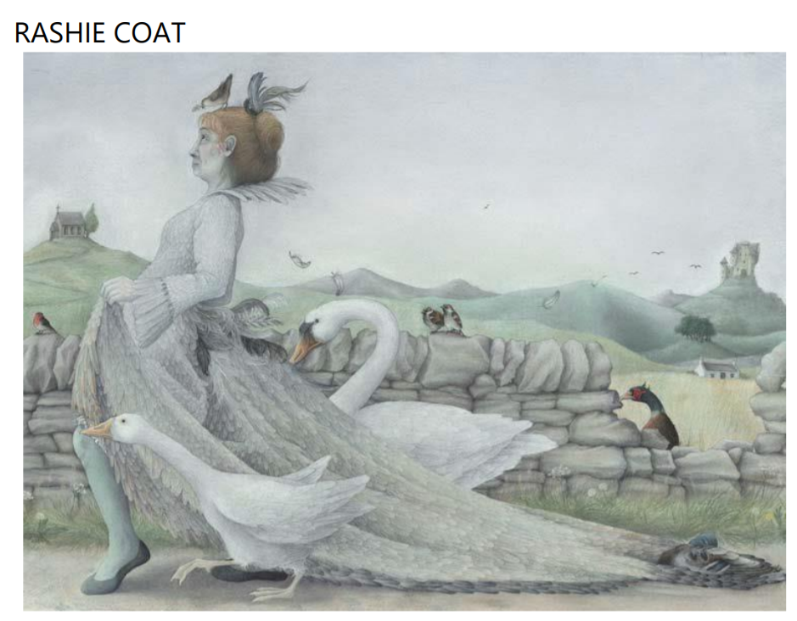
On the website, listen to or read the tale of ‘Rashie Coat’
In your books, make note of the key events of this story.
Then use the key events, to create a ‘bones’ grid similar to yesterday’s lesson.

Slide 5
Today’s Main Task:
In your books or on the sheets provided (Y4 and Y5 only)
Compare the two stories: Cinderella and Rashie Coat.
What is the same or similar? What is different?
Y6: Why do you think the ending is not the same in both stories?

Slide 6
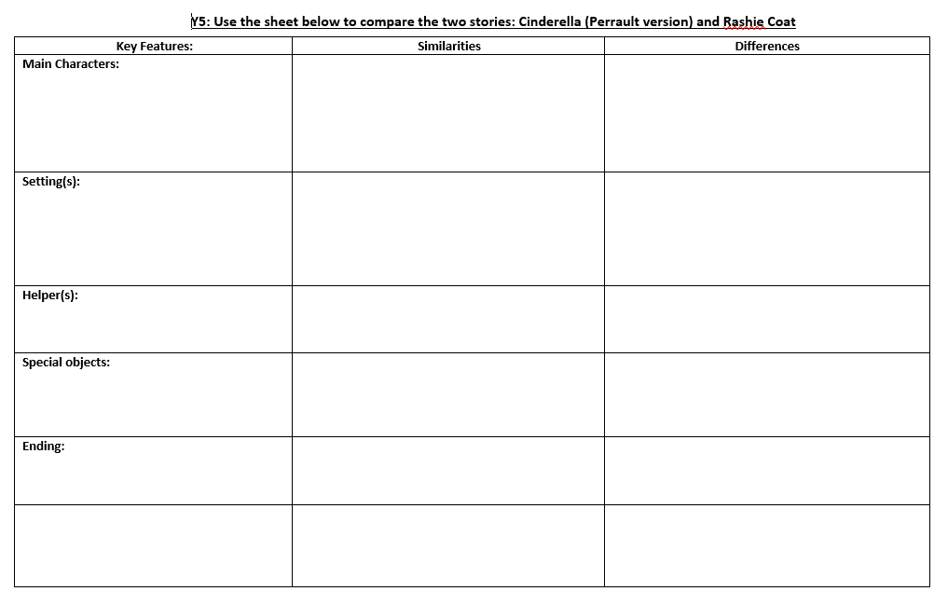

Slide 7
Plenary:
Using the ‘bones’ of Rashie Coat – retell the story in your own words.

