Slide 1
English Day 17
English day 17 – Tuesday 2nd February, 2021

Slide 2
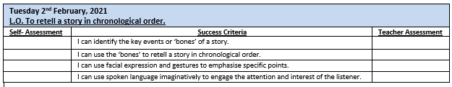

Slide 3

NATIONAL STORY TELLING WEEK
January 30th – February 6th

Slide 4

Listening to
Reading and
Retelling
Stories

Slide 5
Remind yourself of the details -
Listen to the story being read using the link below
https://www.youtube.com/watch?app=desktop&v=66LUVBIEOR4
While you are listening - make notes of the key events in chronological order in your book

Slide 6
What were the key events?
Cinderella lives with her evil stepmother and her stepsisters
She is treated badly
Prince announces a ball at the palace – all young ladies are invited
Stepsisters excited to go – Cinderella is not allowed
Night of ball – Cinderella left alone – crying
Fairy Godmother appears – magic – creates coach, gown etc
12 o’clock curfew – she must be home
Cinderella dances with the Prince all night – clock strikes 12
Rushes out – loses a glass slipper
Next day – Prince says he will marry whoever the glass slipper fits
At Cinderellas’s house stepsisters try the slipper – doesn’t fit
Fits Cinderella – and she has the other
Cinderella marries the Prince
Everyone lives ‘Happily Ever After’

Slide 7

To help you to remember the story:
Write or draw key words in a nine by nine grid
What words will help you to remember the story?
e.g. Cinderella; Prince; stepsisters/mother; magic
‘aide memoir’ – ‘bones’ of the story

Slide 8
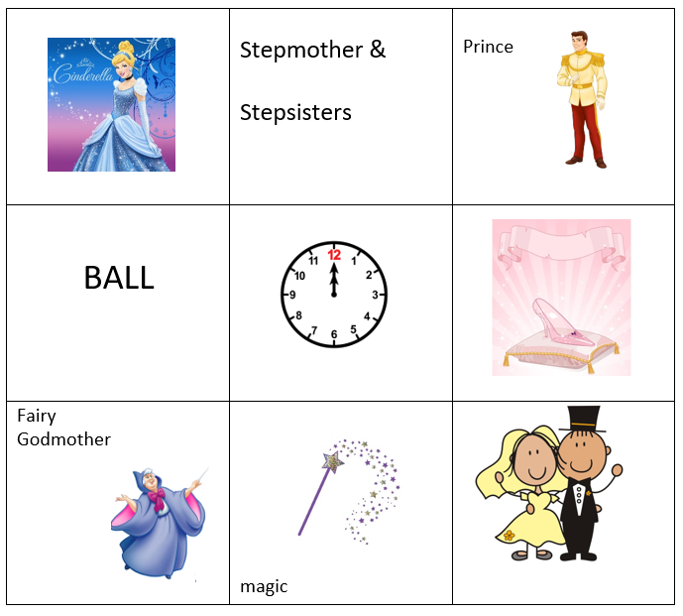

Using the ‘bones’ of the story…
Practise retelling the story till you no longer need to look at the ‘bones’
Check your performance

Slide 9
Your performance:
Y4: Retell the story in chronological order. Speak audibly and clearly.
Y5: As above. Include facial expressions and gestures for emphasis.
Y6: Use spoken language imaginatively to engage the attention and interest of the listener.
When you are happy, video all or of part of your performance (<5 min) and upload onto Tapestry.

