Slide 1
English Day 16
English day16 – Monday 1st February, 2021

Slide 2
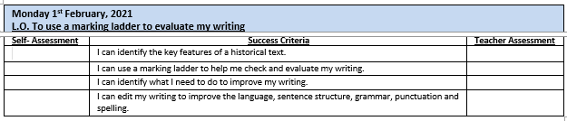

Slide 3
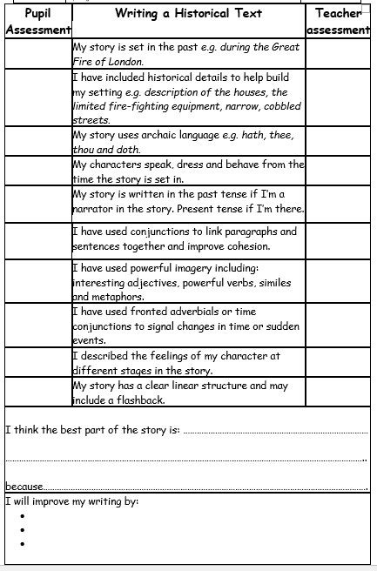
Edit the content of your work using a marking ladder for guidance
Indicate where in the text you have seen evidence
Complete bottom sections
Use this ladder and your success criteria to EDIT your work

Slide 4

Historical Details
Marking Ladder
Historical Details
Might include:
“Yes, Mistress Jenkins,” replied the housemaid.
Ten years ago (when Sarah was 12) the Great Plague had broken out in London…
Sarah knew that once people knew her mother had the plague, the whole family would be locked in.
79 houses were being guarded, marked with a red cross on the door

Slide 5

Archaic language
Marking Ladder
Examples of archaic language
“Mother,” asked Sarah, “are thee alright?”
“Yes, dearest daughter, I am well,” replied Mistress Baker.
“Mother, thee must rest!” exclaimed Sarah.
“Didst ye see the flames and feel the heat of yonder fire?”
“I beseech thee, haste thee home!”

Slide 6

Flashback
Marking ladder
Example from text
Thinking about Mistress Jenkin’s sister, Sarah also thought about her own sister, Elizabeth, and how they left home together (ten years ago) to escape the plague…
Ten years later….
Tears fell down Sarah’s face as she recalled what happened to her family all those years ago and how she came to be working, as a maid, for Mistress Jenkins.

Slide 7
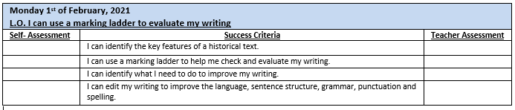
After completing the marking ladder – check success criteria

Slide 8

This work needs to be returned to your teacher for feedback!

