Slide 1


Year 5 – Spring Block 2 – Fractions
Step 6: Compare and Order Fractions Greater than 1
© Classroom Secrets Limited 2018

Slide 2
Introduction
Circle the fractions which are greater than 1.
12
6
11
10
12
15
5
5
13
12
7
14
8
9
20
19
© Classroom Secrets Limited 2018

Slide 3
Introduction
Circle the fractions which are greater than 1.
12
6
11
10
12
15
5
5
13
12
7
14
8
9
20
19
© Classroom Secrets Limited 2018

Slide 4
Varied Fluency 1
Using the representations below, complete the statement.
 |  |  | >
© Classroom Secrets Limited 2018

Slide 5
Varied Fluency 1
Using the representations below, complete the statement.
2 |  | 2 | > | 2 |  | 3
 |  | 4 |  |  |  | 8
© Classroom Secrets Limited 2018

Slide 6
Varied Fluency 2
Rewrite the sequence to include the fraction .
11 | , | 26 | , | 4 | 4
4 |  | 8 |  |  | 16
3 | 3
 | 4
 | 11
 | 4
 | 26
 | 8
4 | 4
 | 16
3 | 3
 | 4
© Classroom Secrets Limited 2018

Slide 7
Varied Fluency 2
Rewrite the sequence to include the fraction .
11 | , | 26 | , | 4 | 4
4 |  | 8 |  |  | 16
3 | 3
 | 4
 | 11
 | 4
 | 26
 | 8
3 | 3
 | 4
4 | 4
 | 16
11 | , | 26 | , | 3 | 3 | , | 4 | 4
4 |  | 8 |  |  | 4 |  |  | 16
© Classroom Secrets Limited 2018

Slide 8
Varied Fluency 3
Order the fractions from smallest to largest.
32
14
18
7
2 | 12
 | 28
© Classroom Secrets Limited 2018

Slide 9
Varied Fluency 3
Order the fractions from smallest to largest.
32
14
2 | 12
 | 28
18
7
© Classroom Secrets Limited 2018

Slide 10
Problem Solving 1
Using the clue and digit cards below, complete the statement with improper fractions.
28 |  | 4 |  | 8 |  | 13
 | >
© Classroom Secrets Limited 2018

Slide 11
Problem Solving 1
Using the clue and digit cards below, complete the statement with improper fractions.
28 |  | 4 |  | 8 |  | 13
28 | > | 13
8 |  | 4
© Classroom Secrets Limited 2018

Slide 12
Reasoning 1
Circle the mistake in the table below.
Explain why this is incorrect.
5 | 3
 | 4
5 | 3
 | 4
Less than | More than
84
16
5 | 7
 | 8
5 | 4
 | 8
6 | 2
 | 8
80
16
23
4
© Classroom Secrets Limited 2018

Slide 13
Reasoning 1
Circle the mistake in the table below.
Explain why this is incorrect.
is incorrect because…
5 | 3
 | 4
5 | 3
 | 4
Less than | More than
84
16
5 | 7
 | 8
5 | 4
 | 8
6 | 2
 | 8
80
16
23
4
23
4
© Classroom Secrets Limited 2018

Slide 14
Reasoning 1
Circle the mistake in the table below.
Explain why this is incorrect.
is incorrect because it is equivalent to .
5 | 3
 | 4
5 | 3
 | 4
Less than | More than
84
16
5 | 7
 | 8
5 | 4
 | 8
6 | 2
 | 8
80
16
23
4
23
4
5 | 3
 | 4
© Classroom Secrets Limited 2018

Slide 15
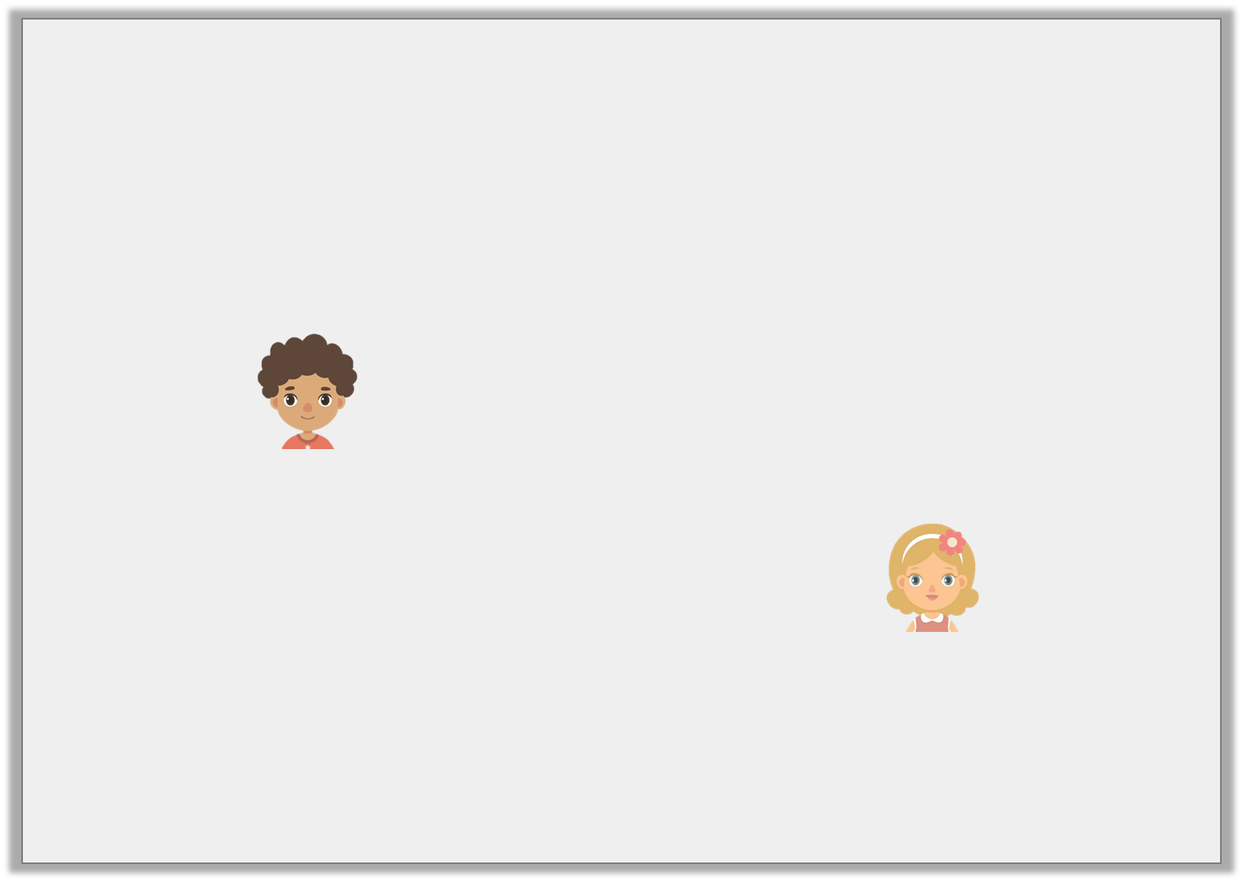
Reasoning 2
Two children are ordering fractions.
Jake says,
Alice says,
Who is correct? Convince me.
60 |  |  |  | 21
24 |  |  |  | 6
The missing fraction could be .
39
12
The missing fraction could be .
48
12
© Classroom Secrets Limited 2018

Slide 16
Reasoning 2
Two children are ordering fractions.
Jake says,
Alice says,
Who is correct? Convince me.
Jake is correct because…
60 |  |  |  | 21
24 |  |  |  | 6
The missing fraction could be .
39
12
The missing fraction could be .
48
12
© Classroom Secrets Limited 2018

Slide 17
Reasoning 2
Two children are ordering fractions.
Jake says,
Alice says,
Who is correct? Convince me.
Jake is correct because the fractions are ordered from smallest to largest and his fraction comes between the two given fractions.
Alice’s fraction is equivalent to 4 and is bigger than the last given fraction.
60 |  |  |  | 21
24 |  |  |  | 6
The missing fraction could be .
39
12
The missing fraction could be .
48
12
© Classroom Secrets Limited 2018

