Slide 1


Year 5 – Decimals and Percentages
Y5 Understand Percentages
© Classroom Secrets Limited 2019

Slide 2
Introduction
Circle the fraction and decimal which match the picture.
70
100
0.34
0.75
3
4
30
100
0.7
© Classroom Secrets Limited 2019

Slide 3
Introduction
Circle the fraction and decimal which match the picture.
70
100
0.34
0.75
3
4
30
100
0.7
© Classroom Secrets Limited 2019

Slide 4
Varied Fluency 1
Match the grids to their percentages.
A
78%
B
60%
80%
C
© Classroom Secrets Limited 2019

Slide 5
Varied Fluency 1
Match the grids to their percentages.
A
78%
B
60%
80%
C
© Classroom Secrets Limited 2019

Slide 6
Varied Fluency 2
Write the percentage represented by the grids below.
A
B
© Classroom Secrets Limited 2019

Slide 7
Varied Fluency 2
Write the percentage represented by the grids below.
A
B
90%
63%
© Classroom Secrets Limited 2019

Slide 8
Varied Fluency 3
Represent 40% on the grids below.
A
B
© Classroom Secrets Limited 2019

Slide 9
Varied Fluency 3
Represent 40% on the grids below.
Various possible answers, for example:
A
B
© Classroom Secrets Limited 2019

Slide 10
Reasoning 1
Circle the odd one out.
Explain your reasoning.
A
B
C
D 45%
© Classroom Secrets Limited 2019

Slide 11
Reasoning 1
Circle the odd one out.
Explain your reasoning.
C is the odd one out because…
A
B
C
D 45%
© Classroom Secrets Limited 2019

Slide 12
Reasoning 1
Circle the odd one out.
Explain your reasoning.
C is the odd one out because it represents 50%.
A, B and D represent 45%.
A
B
C
D 45%
© Classroom Secrets Limited 2019

Slide 13
Problem Solving 1
Put the cards in order from largest to smallest.
53 parts per 100
35%
4 parts out of 10
61%
7 parts per 10
16 parts out of 100
© Classroom Secrets Limited 2019

Slide 14
Problem Solving 1
Put the cards in order from largest to smallest.
7 parts per 10
61%
53 parts per 100
4 parts out of 10
35%
16 parts out of 100
© Classroom Secrets Limited 2019

Slide 15
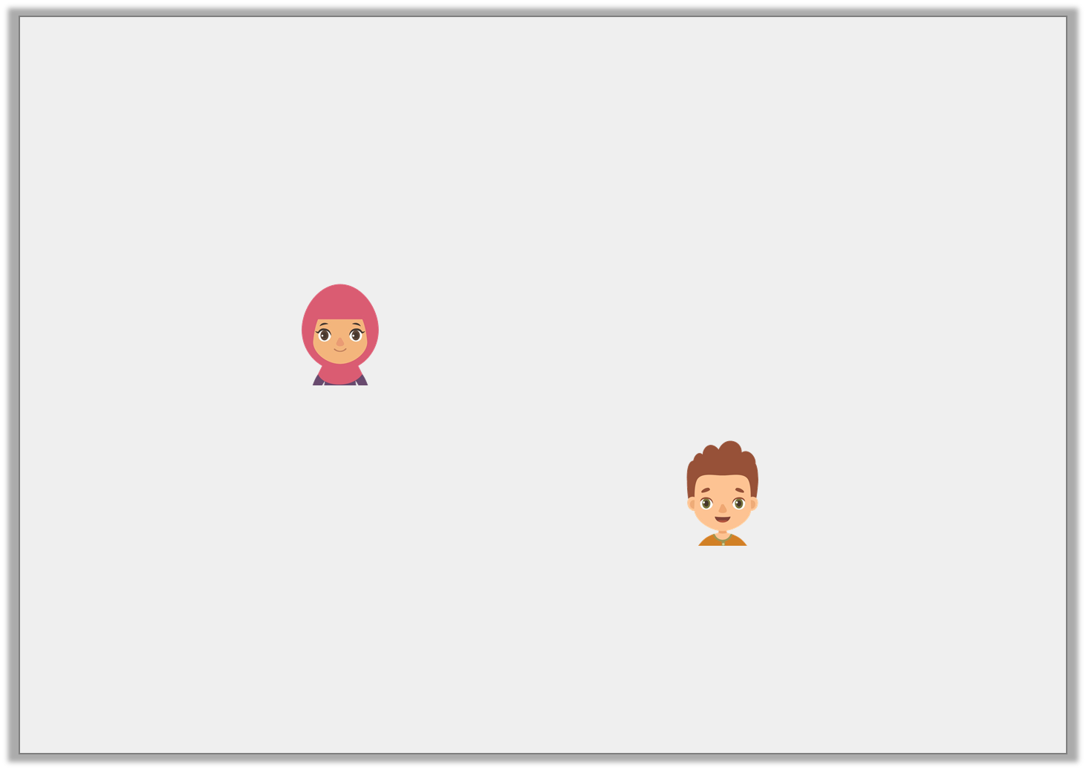
Reasoning 2
Alia and Ben are shown a bar model.
Alia says,
Ben says,
Who is correct? Convince me.
9% is shaded
90% is shaded
© Classroom Secrets Limited 2019

Slide 16
Reasoning 2
Alia and Ben are shown a bar model.
Alia says,
Ben says,
Who is correct? Convince me.
Ben is correct because…
9% is shaded
90% is shaded
© Classroom Secrets Limited 2019

Slide 17
Reasoning 2
Alia and Ben are shown a bar model.
Alia says,
Ben says,
Who is correct? Convince me.
Ben is correct because the bar model is split into 10 parts. Percentages are the number of parts out of 100 so
9 needs to be multiplied by 10 to find the percentage.
9% is shaded
90% is shaded
© Classroom Secrets Limited 2019

