Slide 1


Step 3: Metric Units
© Classroom Secrets Limited 2018

Slide 2
Introduction
Multiply or divide the following numbers.
 | Thousands | Hundreds | Tens | Ones
x 10 |  |  |  | 7
x 100 |  |  |  | 5
x 1000 |  |  |  | 4
 | Thousands | Hundreds | Tens | Ones
÷ 10 |  |  | 2 | 0
÷ 100 |  | 6 | 0 | 0
÷ 1000 | 3 | 0 | 0 | 0
© Classroom Secrets Limited 2018

Slide 3
Introduction
Multiply or divide the following numbers.
 | Thousands | Hundreds | Tens | Ones
x 10 |  |  | 7 | 0
x 100 |  | 5 | 0 | 0
x 1,000 | 4 | 0 | 0 | 0
 | Thousands | Hundreds | Tens | Ones
÷ 10 |  |  |  | 2
÷ 100 |  |  |  | 6
÷ 1,000 |  |  |  | 3
© Classroom Secrets Limited 2018

Slide 4

Varied Fluency 1
Convert the height of the flower to millimetres.
37cm
© Classroom Secrets Limited 2018

Slide 5
Varied Fluency 1
Convert the height of the flower to millimetres.
37cm x 10 = 370mm
© Classroom Secrets Limited 2018

Slide 6
Varied Fluency 2
True or false?
72m = 720cm
© Classroom Secrets Limited 2018

Slide 7
Varied Fluency 2
True or false?
72m = 720cm
False;
72m > 720cm
© Classroom Secrets Limited 2018

Slide 8
Varied Fluency 3
Fill in the missing symbol to make the statement correct.
7 | 1 | km |  |  | 7,500m
 | 2
© Classroom Secrets Limited 2018

Slide 9
Varied Fluency 3
Fill in the missing symbol to make the statement correct.
7 | 1 | km |  | = | 7,500m
 | 2
© Classroom Secrets Limited 2018

Slide 10
Varied Fluency 4
Find the difference between the longest line
and the shortest line.
Give your answer in centimetres.
A
150cm
B
1,400mm
C
3m
© Classroom Secrets Limited 2018

Slide 11
Varied Fluency 4
Find the difference between the longest line
and the shortest line.
Give your answer in centimetres.
3m (300cm) – 1,400mm (140cm) = 160cm
A
150cm
B
1,400mm
C
3m
© Classroom Secrets Limited 2018

Slide 12
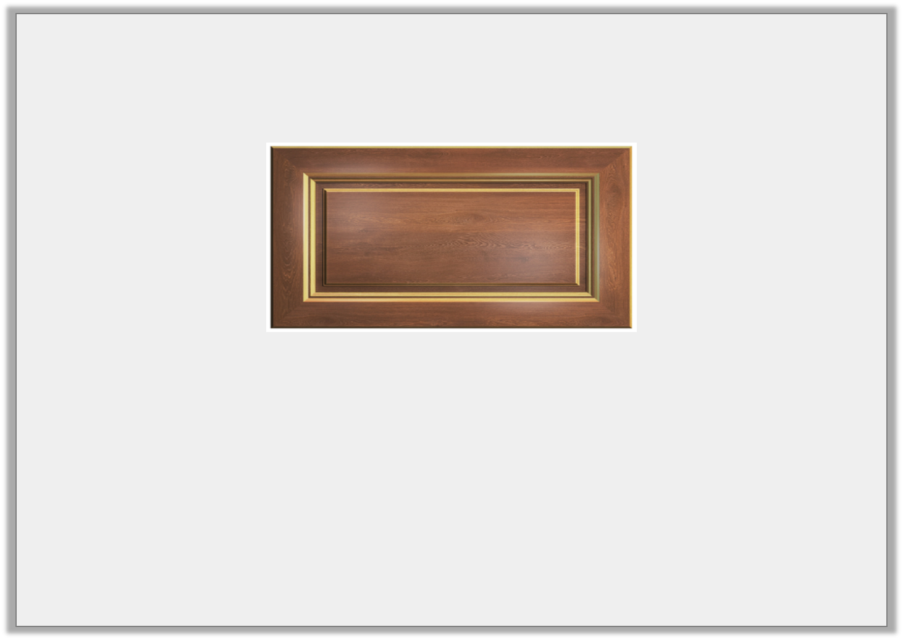
Problem Solving 1
Kaleb needs to fit seven 6cm cereal boxes in his cupboard.
Will the cereal boxes fit?
How many cm are spare/needed?
0.5m
© Classroom Secrets Limited 2018

Slide 13
Problem Solving 1
Kaleb needs to fit seven 6cm cereal boxes in his cupboard.
Will the cereal boxes fit?
How many cm are spare/needed?
Yes they will fit, as seven cereal boxes will be 42cm. The cupboard measures 50cm so there will be 8cm spare.
0.5m
© Classroom Secrets Limited 2018

Slide 14
Reasoning 1
Clay is converting millimetres to centimetres and metres using the table.
Explain and correct his mistakes.
mm | cm | m
250 | 25 | 2.5
1,560 | 156 | 1.56
3,140 | 31.4 | 3.14
© Classroom Secrets Limited 2018

Slide 15
Reasoning 1
Clay is converting millimetres to centimetres and metres using the table.
Explain and correct his mistakes.
mm | cm | m
250 | 25 | 0.25
1,560 | 156 | 1.56
3,140 | 314 | 3.14
Divided by 10 instead of 100.
Divided by 100 instead of 10.
© Classroom Secrets Limited 2018

Slide 16
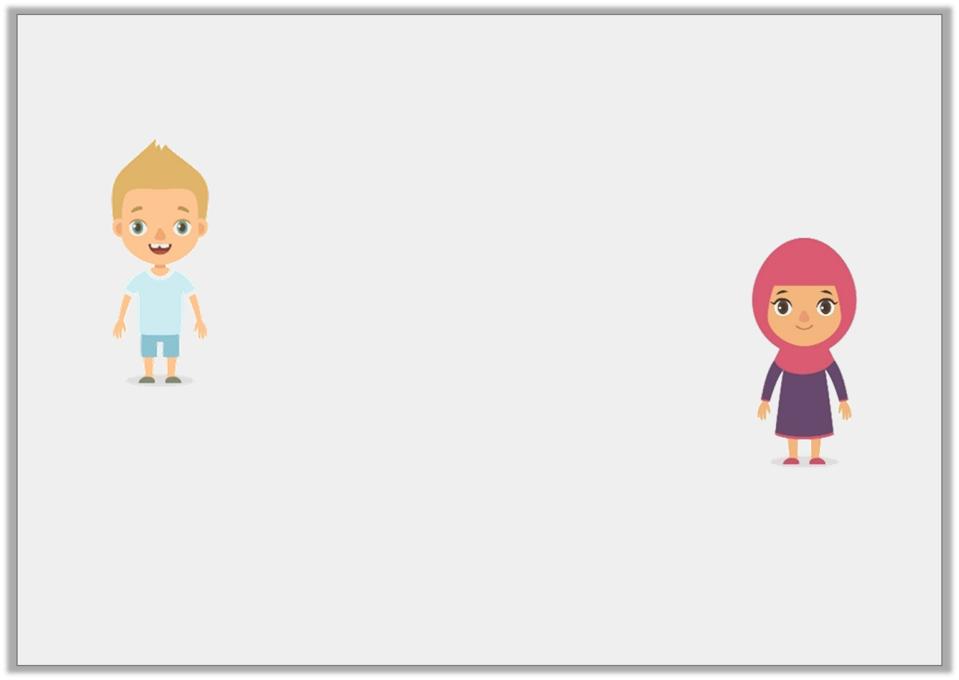
Reasoning 2
Francis and Ariel are converting millimetres to centimetres.
Who is correct? Why?
1,260 millimetres is the same as 126 centimetres.
1,260 millimetres is the same as 1.26 centimetres.
Francis
Ariel
© Classroom Secrets Limited 2018

Slide 17
Reasoning 2
Francis and Ariel are converting millimetres to centimetres.
Who is correct? Why?
Francis is correct because…
1,260 millimetres is the same as 126 centimetres.
1,260 millimetres is the same as 1.26 centimetres.
Francis
Ariel
© Classroom Secrets Limited 2018

Slide 18
Reasoning 2
Francis and Ariel are converting millimetres to centimetres.
Who is correct? Why?
Francis is correct because you have to divide by 10 to convert from millimetres to centimetres.
1,260mm ÷ 10 = 126cm.
1,260 millimetres is the same as 126 centimetres.
1,260 millimetres is the same as 1.26 centimetres.
Francis
Ariel
© Classroom Secrets Limited 2018

