Slide 1



LIFE/work balance
We have started a #LIFEworkbalance campaign and we need your help to complete our LIFE/work balance survey.
We hope to publish the results soon, so please give 15 minutes of your time to help us get a true picture of school life.
Want to be a part of this campaign? Take the survey on our website and share it with your colleagues!
© Classroom Secrets Limited 2019

Slide 2
Year 4 – Spring Block 1 – Multiplication and Division – Multiplying 3 Digits by 1 Digit
About This Resource:
This PowerPoint has been designed to support your teaching of this small step. It includes a starter activity and an example of each question from the Varied Fluency and Reasoning and Problem Solving resources also provided in this pack. You can choose to work through all examples provided or a selection of them depending on the needs of your class.
National Curriculum Objectives:
Mathematics Year 4: (4C6a) Recall multiplication and division facts for multiplication tables up to 12 × 12
Mathematics Year 4: (4C7) Multiply two-digit and three-digit numbers by a one-digit number using formal written layout
More Year 4 Multiplication and Division resources.
Did you like this resource? Don’t forget to review it on our website.
© Classroom Secrets Limited 2018

Slide 3
Year 4 – Spring Block 1 – Multiplication and Division
Step 7: Multiply 3 Digits by 1 Digit
© Classroom Secrets Limited 2018

Slide 4
Introduction
Which multiplication sentences match this image?
6 x 5
8 x 4
2 x 8
12 x 3
1 x 22
5 x 6
14 x 2
3 x 9
© Classroom Secrets Limited 2018

Slide 5
Introduction
Which multiplication sentences match this image?
6 x 5
8 x 4
2 x 8
12 x 3
1 x 22
5 x 6
14 x 2
3 x 9
© Classroom Secrets Limited 2018

Slide 6
Varied Fluency 1
True or false? The calculation below has been worked out correctly.
Hundreds | Tens | Ones
 | 3 | 0 | 5
x |  |  | 3
 | 6 | 1 | 5
© Classroom Secrets Limited 2018

Slide 7
Varied Fluency 1
True or false? The calculation below has been worked out correctly.
False, 300 x 3 = 900, not 600. The answer should be 915.
Hundreds | Tens | Ones
 | 3 | 0 | 5
x |  |  | 3
 | 6 | 1 | 5
© Classroom Secrets Limited 2018

Slide 8
Varied Fluency 2
Circle the correct answer to the calculation below.
Hundreds | Tens | Ones
 | 4 | 2 | 0
x |  |  | 4
1,608
1,860
1,680
© Classroom Secrets Limited 2018

Slide 9
Varied Fluency 2
Circle the correct answer to the calculation below.
Hundreds | Tens | Ones
 | 4 | 2 | 0
x |  |  | 4
1 | 6 | 8 | 0
1,608
1,860
1,680
© Classroom Secrets Limited 2018

Slide 10
Varied Fluency 3
Complete the calculation.
Hundreds | Tens | Ones
 | 5 | 2 | 3
x |  |  | 6
© Classroom Secrets Limited 2018

Slide 11
Varied Fluency 3
Complete the calculation.
Hundreds | Tens | Ones
 | 5 | 2 | 3
x |  |  | 6
3 | 1 | 3 | 8
1
1
© Classroom Secrets Limited 2018

Slide 12
Problem Solving 1
Which calculation has an answer with a digit sum of 18.
A. B.
 | 7 | 4 | 0
x |  |  | 5
 | 6 | 0 | 9
x |  |  | 6
© Classroom Secrets Limited 2018

Slide 13
Problem Solving 1
Which calculation has an answer with a digit sum of 18.
A. B.
B: 3 + 6 + 5 + 4 = 18
 | 7 | 4 | 0
x |  |  | 5
3 | 7 | 0 | 0
 | 6 | 0 | 9
x |  |  | 6
3 | 6 | 5 | 4
2
5
© Classroom Secrets Limited 2018

Slide 14
Problem Solving 2
Add the missing digits to the calculation below.
6
5
2
1
7
 | 4 |  | 2
x |  |  | 3
 | 4 | 1 | 6
© Classroom Secrets Limited 2018

Slide 15
Problem Solving 2
Add the missing digits to the calculation below.
6
5
2
1
7
 | 4 |  | 2
x |  |  | 3
 | 4 | 1 | 6
7
1
2
© Classroom Secrets Limited 2018

Slide 16
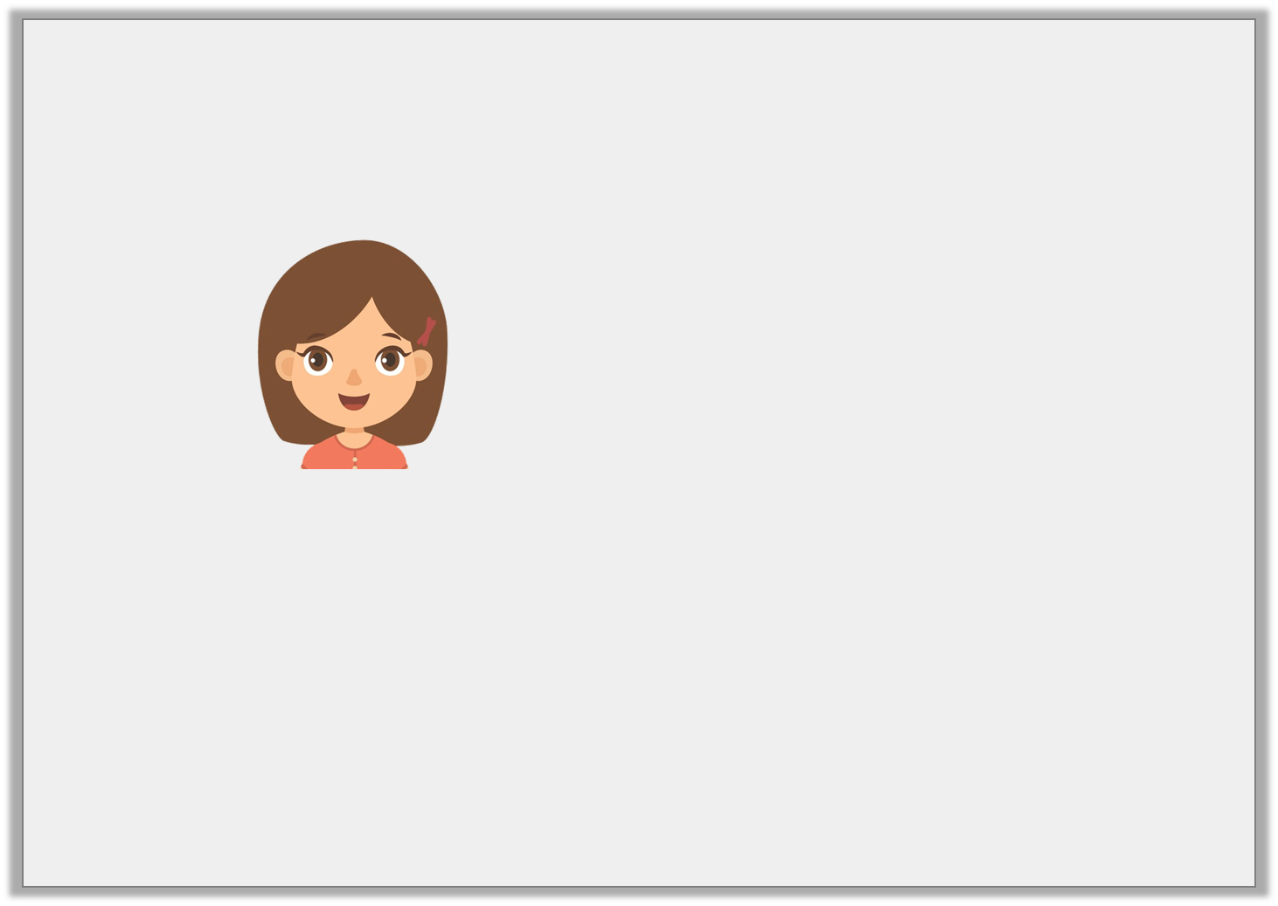
Reasoning 1
Jade says,
Is Jade correct? Prove it.
My number 5,870 is 6 times larger than 980.
© Classroom Secrets Limited 2018

Slide 17
Reasoning 1
Jade says,
Is Jade correct? Prove it.
No, Jade is incorrect because....
My number 5,870 is 6 times larger than 980.
© Classroom Secrets Limited 2018

Slide 18
Reasoning 1
Jade says,
Is Jade correct? Prove it.
No, Jade is incorrect because 980 x 6 = 5,880.
My number 5,870 is 6 times larger than 980.
© Classroom Secrets Limited 2018

