Slide 1
Year 4 Maths 25.01.2021
LO: To convert amounts of money and order them by their value

Slide 2
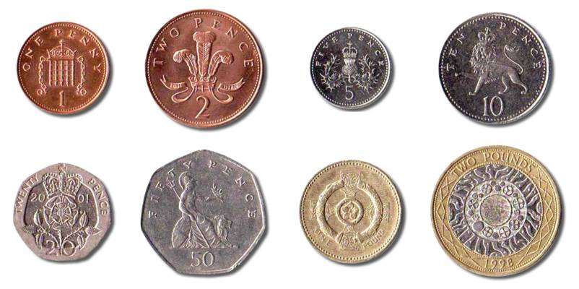
Starter

Slide 3
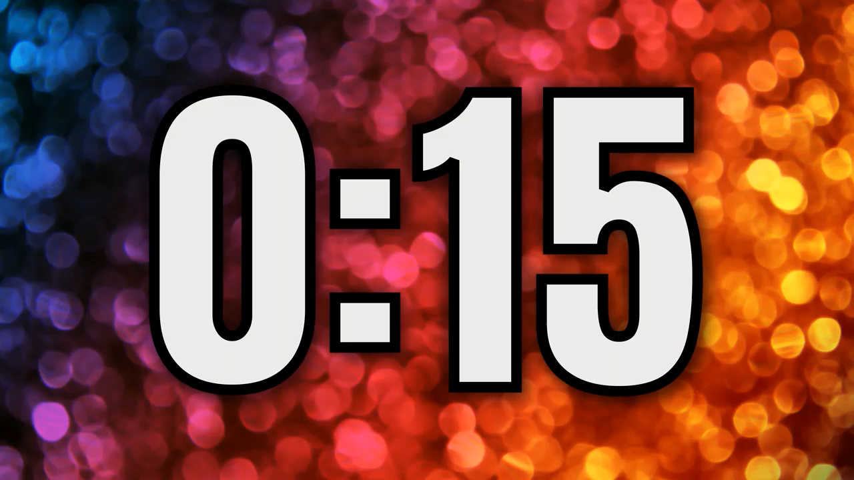
What is the total value of these coins?

Slide 4
What is the twice the value of these coins?

Slide 5
What 6 coins could you use to make £1.50?

Slide 6
What 6 coins could you use to make £1.50?

Slide 7

To convert amounts of money
What facts do we already know?

Slide 8
Money facts
£1 = 100p

Slide 9
Money facts
10p = 1p x 10

Slide 12
