Slide 1


Slide 3
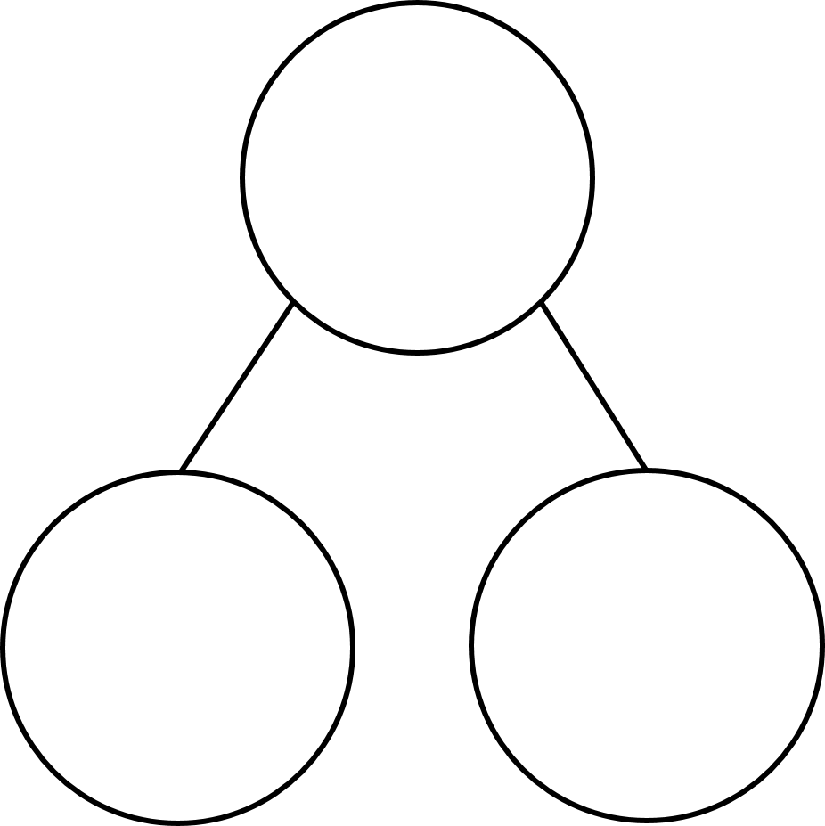
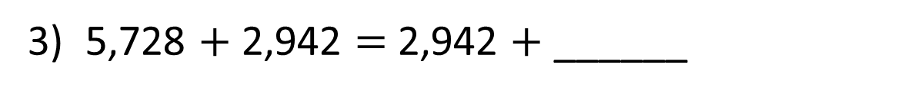
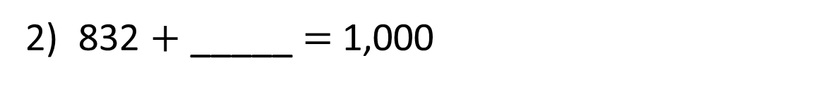
1) Complete the part-whole model.
1,453
5,000
2) 832 $+$ _____ $=$ 1,000
3) 5,728 $+$ 2,942 $=$ 2,942 $+$ ______

Slide 4
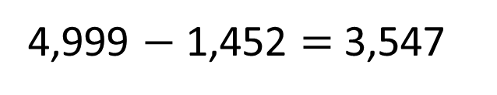
1) Complete the part-whole model.
1,453
5,000
4,999 $−$ 1,452 $=$ 3,547
3,547
168
2) 832 $+$ _____ $=$ 1,000
3) 5,728 $+$ 2,942 $=$ 2,942 $+$ ______
5,728

Slide 6
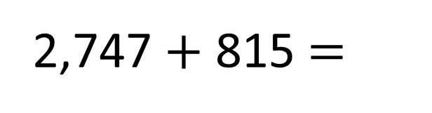

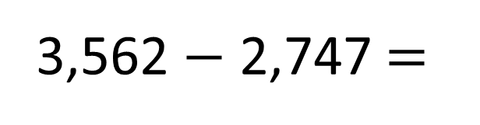

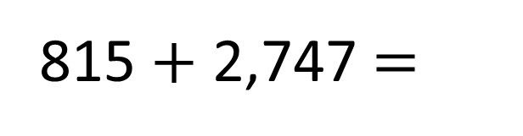
Th | H | T | O
2 | 7 | 4 | 7
 | 8 | 1 | 5
3,562
Th | H | T | O
3 | 5 | 6 | 2
2 | 7 | 4 | 7
2
1
5
1
$$+$$
$$−$$
2,747
815
3
5
6
2
?
0
8
1
5
1
1
3,562 $−$ 2,747 =
815
2,747 $+$ 815 =
3,562
815 $+$ 2,747 =
3,562

Slide 7


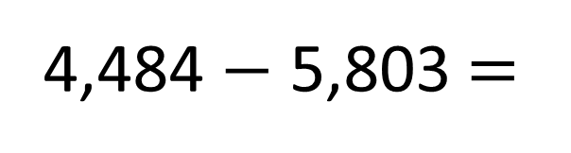

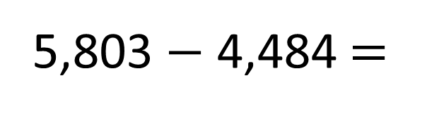
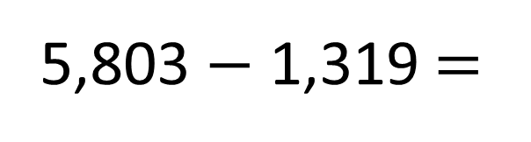

Have a think
5,803
1,319 + 4,484 =
Th | H | T | O
1 | 3 | 1 | 9
4 | 4 | 8 | 4
Th | H | T | O
5 | 8 | 0 | 3
4 | 4 | 8 | 4
1 | 3 | 1 | 9
7
9
5,803
1
1
$$+$$
1,319
4,484
$$−$$
5
8
0
3
1
1
5,803 $−$ 4,484 =
1,319
5,803 $−$ 1,319 =
1,319
4,484 $−$ 5,803 =
4,484

Slide 8
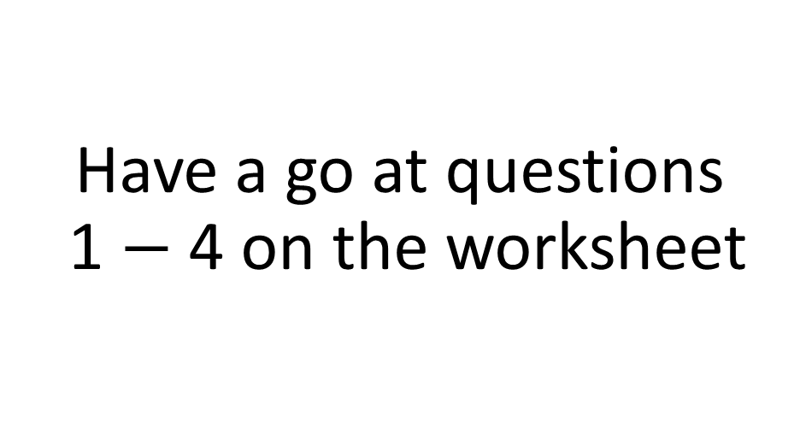
Have a go at questions 1 $−$ 4 on the worksheet

Slide 9






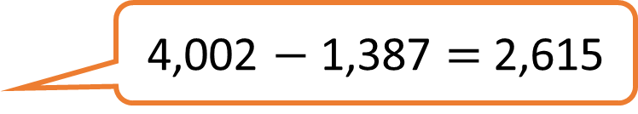
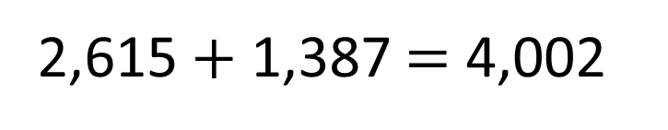

2,615 $+$ 1,387 $=$ 4,002
Have a think
1,387 $+$ 2,615 $=$ 4,002
Commutative
Inverse
4,002 $−$ 2,615 $=$ 1,387
4,002 $−$ 1,387 $=$ 2,615
Inverse
Inverse
efficient method
3,999 $−$ 1,384 $=$ 2,615

Slide 10
Have a go at the rest of the worksheet

