Slide 1


Year 4 – Summer Block 5 – Properties of Shapes
Step 2: Compare and Order Angles
© Classroom Secrets Limited 2019

Slide 2
Introduction
Label these angles as acute, right angle or obtuse.
© Classroom Secrets Limited 2019

Slide 3
Introduction
Label these angles as acute, right angle or obtuse.
Right Angle
Obtuse
Acute
Acute
Obtuse
© Classroom Secrets Limited 2019

Slide 4
Varied Fluency 1
Which angle is the largest?
B
A
C
© Classroom Secrets Limited 2019

Slide 5
Varied Fluency 1
Which angle is the largest?
B
A
C
© Classroom Secrets Limited 2019

Slide 6
Varied Fluency 2
Here are some segments with different sized angles at their points.
Put the angles in order from smallest to largest.
A
D
B
C
© Classroom Secrets Limited 2019

Slide 7
Varied Fluency 2
Here are some segments with different sized angles at their points.
Put the angles in order from smallest to largest.
A
D
B
C
A, C, D, B
© Classroom Secrets Limited 2019

Slide 8
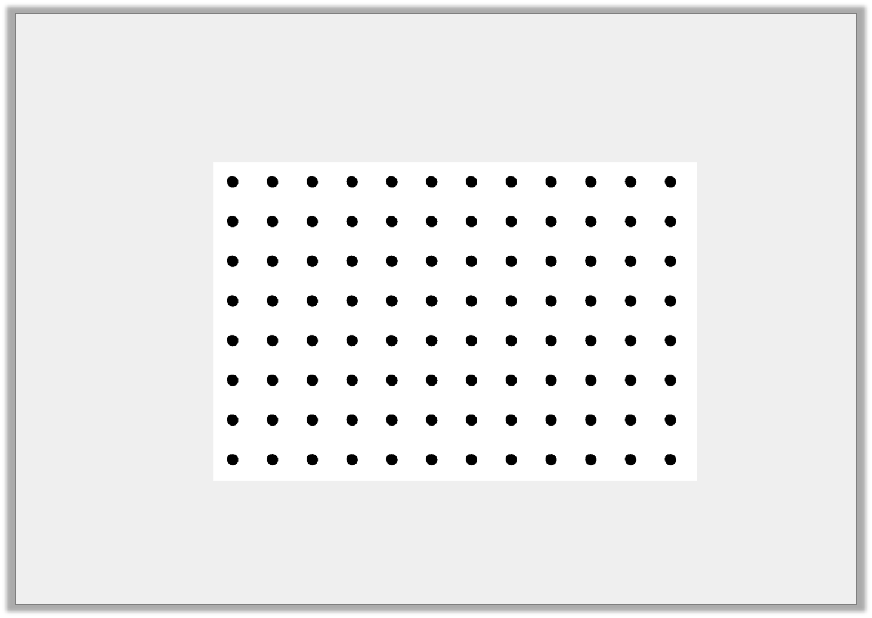
Varied Fluency 3
True or false?
Angle A is smaller than angle B. Angles B and C are the same size.
A
B
C
© Classroom Secrets Limited 2019

Slide 9
Varied Fluency 3
True or false?
Angle A is smaller than angle B. Angles B and C are the same size.
True
A
B
C
© Classroom Secrets Limited 2019

Slide 10
Problem Solving 1
Which of these shapes contains the smallest angle?
A
C
B
© Classroom Secrets Limited 2019

Slide 11
Problem Solving 1
Which of these shapes contains the smallest angle?
A
C
B
© Classroom Secrets Limited 2019

Slide 12

Reasoning 1
Kaito is discussing angles.
Is Kaito correct? Explain your answer.
I have 3 angles. One angle is obtuse, one is 90° and the other is acute. I think that the 90° angle is the smallest angle.
© Classroom Secrets Limited 2019

Slide 13
Reasoning 1
Kaito is discussing angles.
Is Kaito correct? Explain your answer.
Kaito is incorrect because...
I have 3 angles. One angle is obtuse, one is 90° and the other is acute. I think that the 90° angle is the smallest angle.
© Classroom Secrets Limited 2019

Slide 14
Reasoning 1
Kaito is discussing angles.
Is Kaito correct? Explain your answer.
Kaito is incorrect because an acute angle is smaller than 90°.
I have 3 angles. One angle is obtuse, one is 90° and the other is acute. I think that the 90° angle is the smallest angle.
© Classroom Secrets Limited 2019

Slide 15
Problem Solving 2
If you join together the end points of the matching lines below, do they make 4 angles in order from smallest to largest?
Be sure to compare the smallest side of each angle created.
1
2
3
4
© Classroom Secrets Limited 2019

Slide 16
Problem Solving 2
If you join together the end points of the matching lines below, do they make 4 angles in order from smallest to largest?
Be sure to compare the smallest side of each angle created.
Yes
1
2
3
4
© Classroom Secrets Limited 2019

