Slide 1
Year 4 Maths 19.01.2021
LO: To count forwards and backwards using fractions

Slide 2
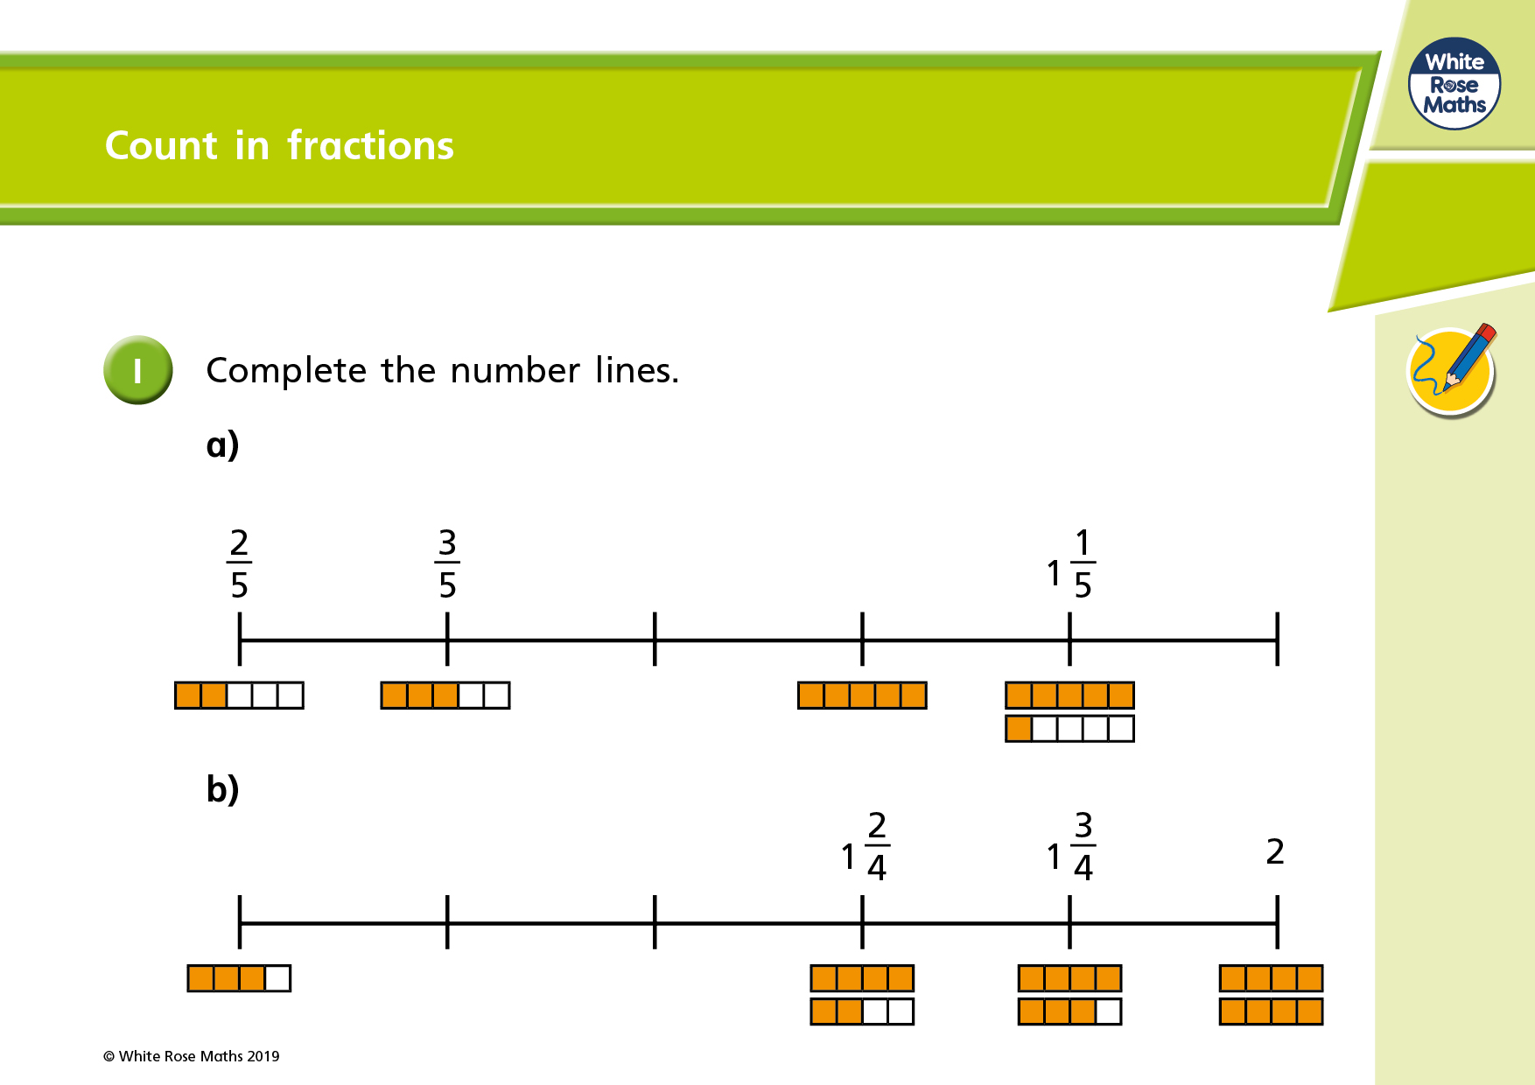

Slide 3
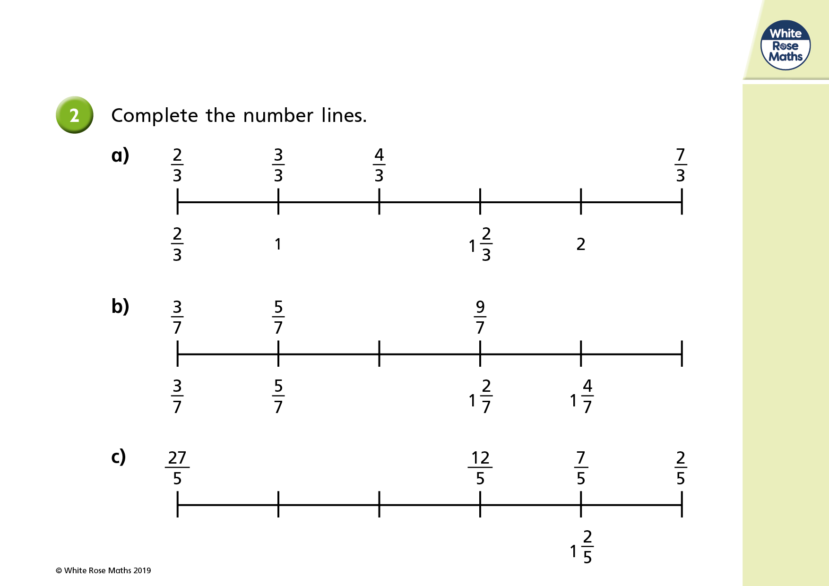

Slide 4
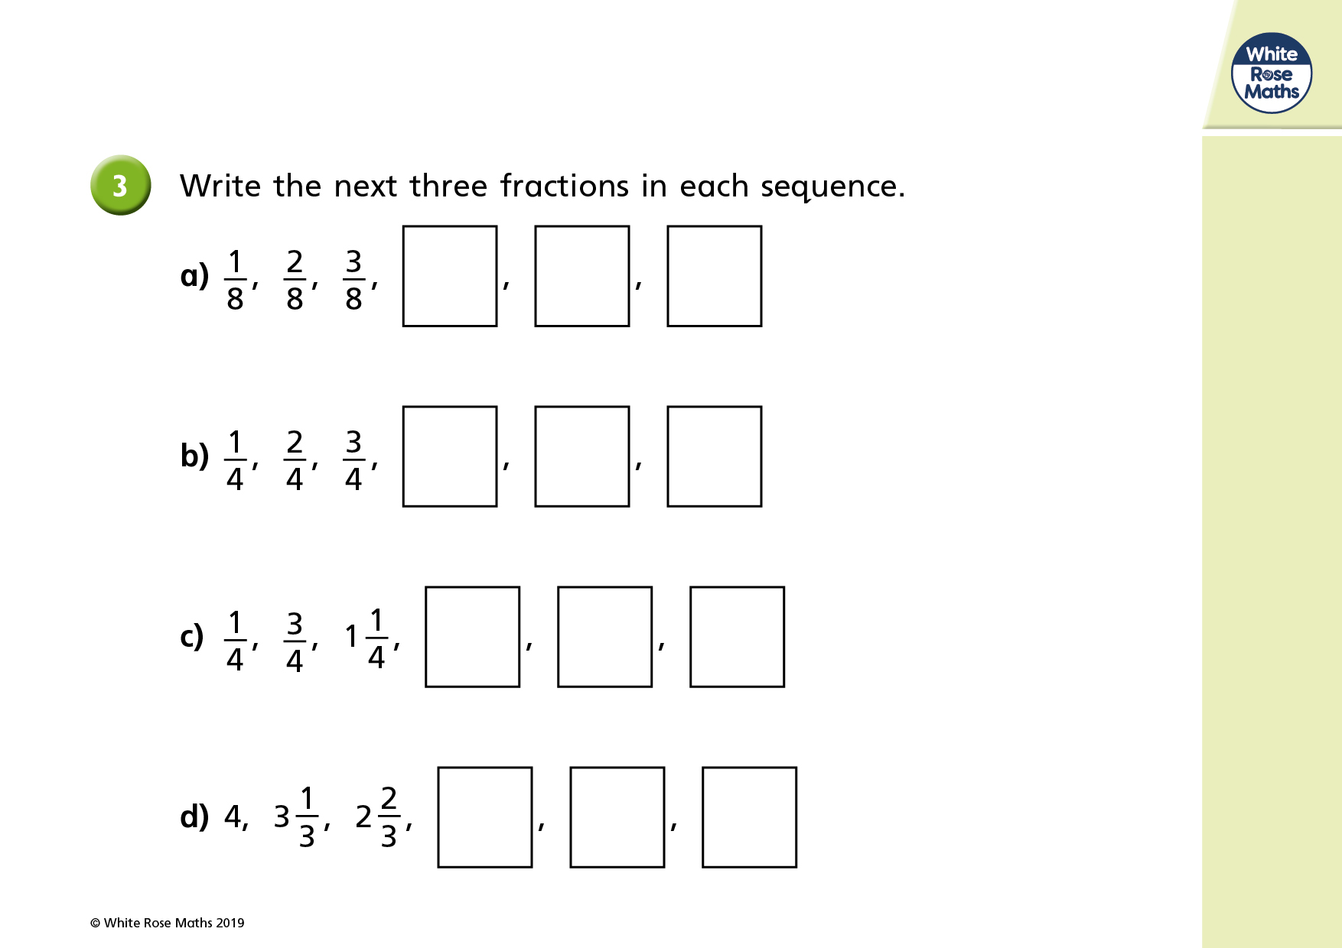

Slide 5
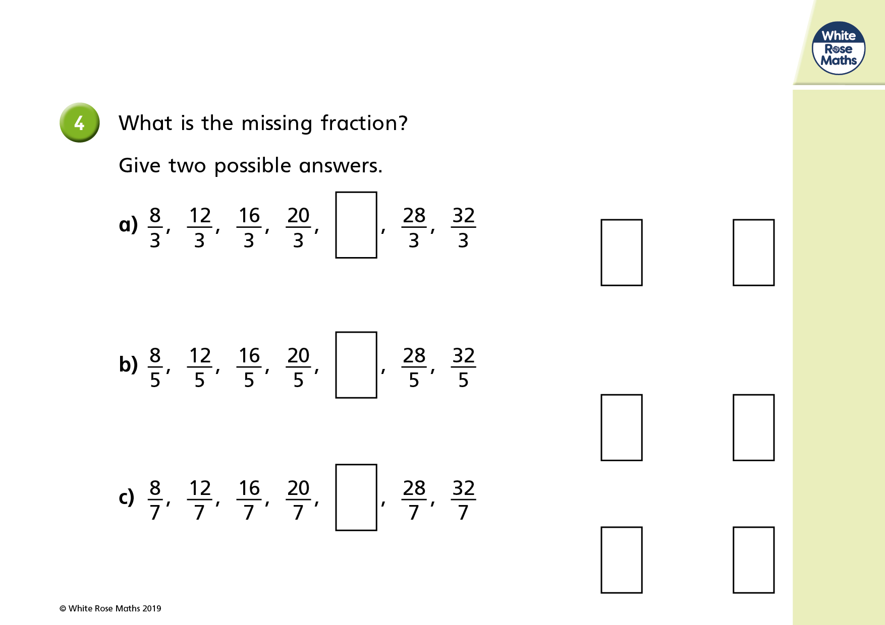

Slide 6
Please complete these next two questions in your maths book.
You will need to explain your answers (referring back to this PowerPoint)

Slide 7
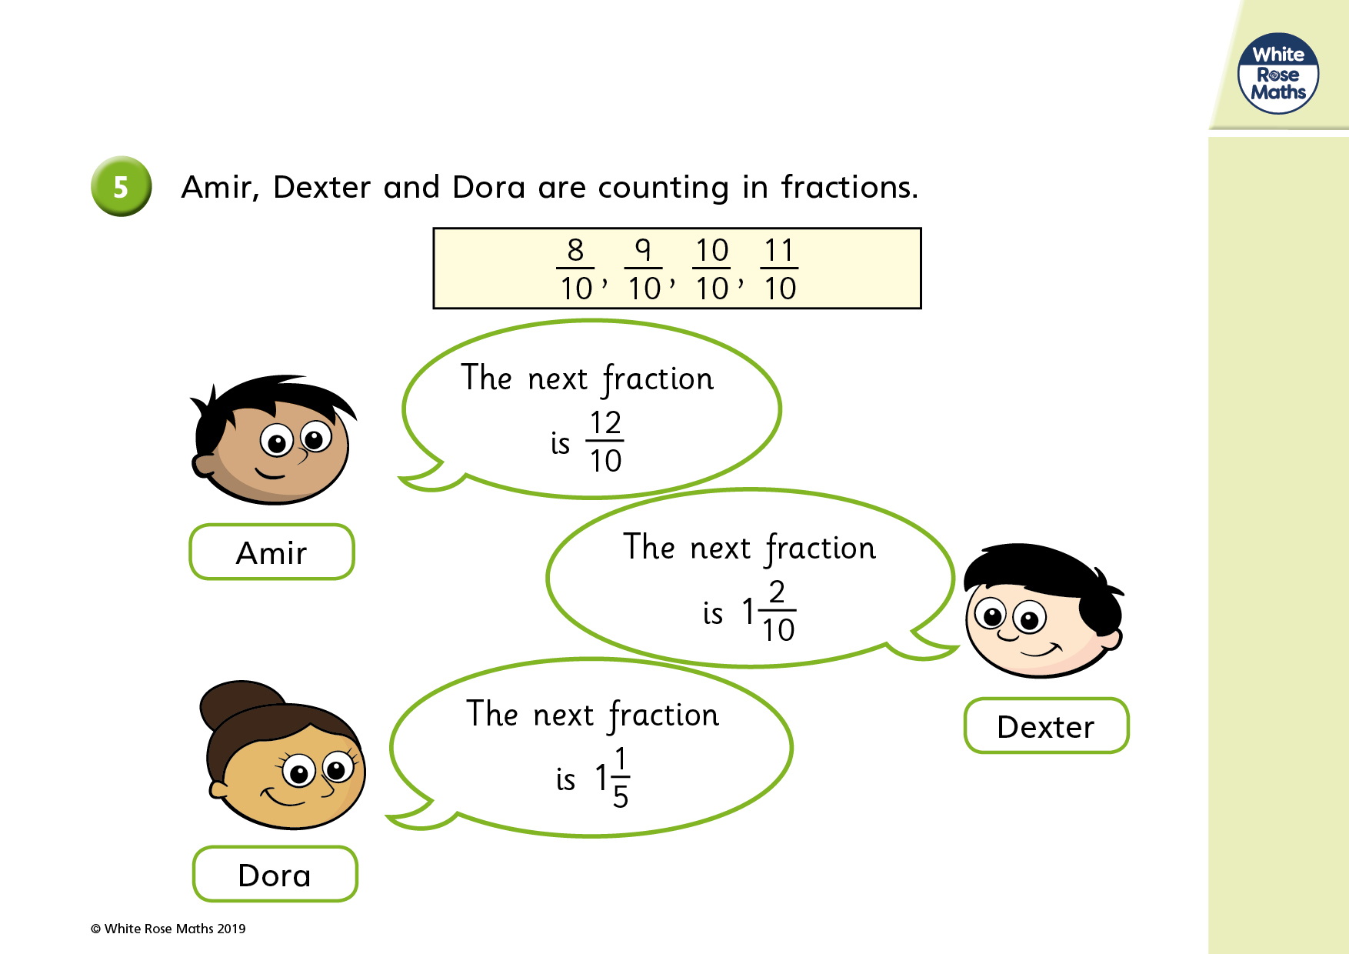

Slide 8
