Slide 1


LO: To multiply and divide by 9
© Classroom Secrets Limited 2018

Slide 2
Introduction
Highlight all the multiples of 9 in the hundred square below.
What do you notice about the highlighted numbers?
1 | 2 | 3 | 4 | 5 | 6 | 7 | 8 | 9 | 10
11 | 12 | 13 | 14 | 15 | 16 | 17 | 18 | 19 | 20
21 | 22 | 23 | 24 | 25 | 26 | 27 | 28 | 29 | 30
31 | 32 | 33 | 34 | 35 | 36 | 37 | 38 | 39 | 40
41 | 42 | 43 | 44 | 45 | 46 | 47 | 48 | 49 | 50
51 | 52 | 53 | 54 | 55 | 56 | 57 | 58 | 59 | 60
61 | 62 | 63 | 64 | 65 | 66 | 67 | 68 | 69 | 70
71 | 72 | 73 | 74 | 75 | 76 | 77 | 78 | 79 | 80
81 | 82 | 83 | 84 | 85 | 86 | 87 | 88 | 89 | 90
91 | 92 | 93 | 94 | 95 | 96 | 97 | 98 | 99 | 100
© Classroom Secrets Limited 2018

Slide 3
Introduction
Highlight all the multiples of 9 in the hundred square below.
What do you notice about the highlighted numbers?
1 | 2 | 3 | 4 | 5 | 6 | 7 | 8 | 9 | 10
11 | 12 | 13 | 14 | 15 | 16 | 17 | 18 | 19 | 20
21 | 22 | 23 | 24 | 25 | 26 | 27 | 28 | 29 | 30
31 | 32 | 33 | 34 | 35 | 36 | 37 | 38 | 39 | 40
41 | 42 | 43 | 44 | 45 | 46 | 47 | 48 | 49 | 50
51 | 52 | 53 | 54 | 55 | 56 | 57 | 58 | 59 | 60
61 | 62 | 63 | 64 | 65 | 66 | 67 | 68 | 69 | 70
71 | 72 | 73 | 74 | 75 | 76 | 77 | 78 | 79 | 80
81 | 82 | 83 | 84 | 85 | 86 | 87 | 88 | 89 | 90
91 | 92 | 93 | 94 | 95 | 96 | 97 | 98 | 99 | 100
© Classroom Secrets Limited 2018

Slide 4
Varied Fluency 1
Write a multiplication and division calculation based on the bar model.
63
7 | 7 | 7 | 7 | 7 | 7 | 7 | 7 | 7
 | ÷ |  | =
 | x |  | =
© Classroom Secrets Limited 2018

Slide 5
Varied Fluency 1
Write a multiplication and division calculation based on the bar model.
63
7 | 7 | 7 | 7 | 7 | 7 | 7 | 7 | 7
63 | ÷ | 9 | = | 7
7 | x | 9 | = | 63
© Classroom Secrets Limited 2018

Slide 6
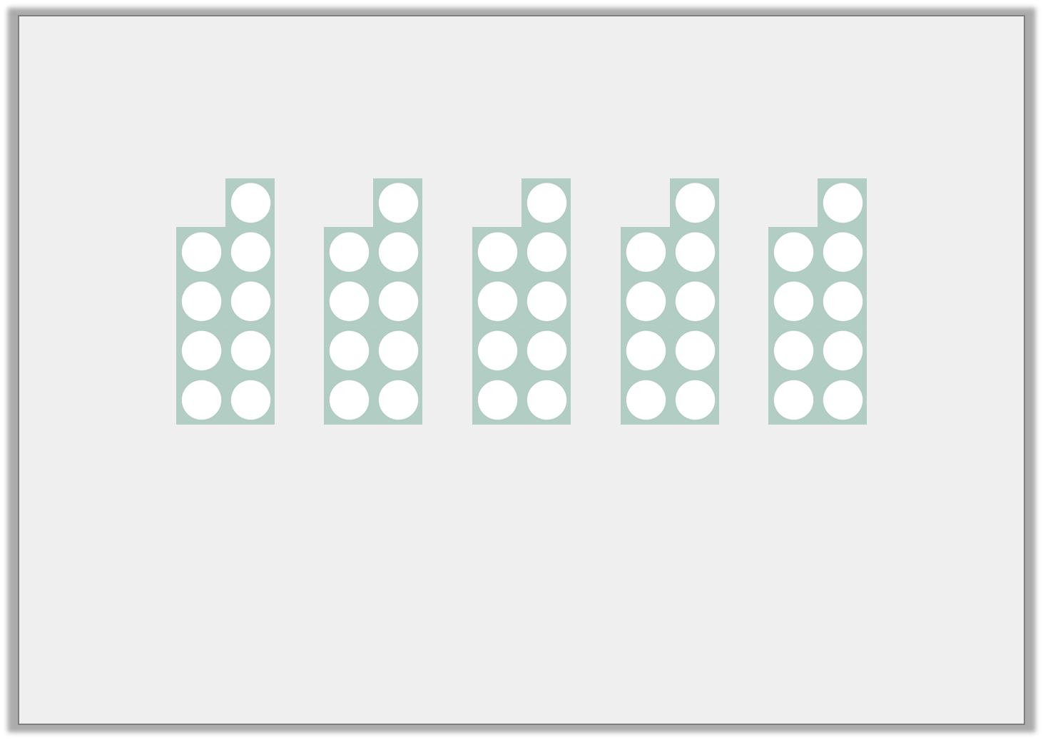
Varied Fluency 2
Using the image below, complete the number sentences.
45 | ÷ |  | =
 | ÷ | 9 | =
 | x | 9 | =
 | x |  | = | 45
© Classroom Secrets Limited 2018

Slide 7
Varied Fluency 2
Using the image below, complete the number sentences.
45 | ÷ | 5 | = | 9
45 | ÷ | 9 | = | 5
5 | x | 9 | = | 45
9 | x | 5 | = | 45
© Classroom Secrets Limited 2018

Slide 8
Varied Fluency 3
Circle the number sentences that are represented by the array.
3 | x | 9 | = | 27
27 | ÷ | 9 | = | 3
9 | x | 3 | = | 27
28 | ÷ | 8 | = | 3
© Classroom Secrets Limited 2018

Slide 9
Varied Fluency 3
Circle the number sentences that are represented by the array.
3 | x | 9 | = | 27
27 | ÷ | 9 | = | 3
9 | x | 3 | = | 27
28 | ÷ | 8 | = | 3
© Classroom Secrets Limited 2018

Slide 10
Varied Fluency 4
Use the sentences to complete the calculations.
There are six 9s.
There are 11 lots of 9.
 | x |  | =
 | x |  | =
© Classroom Secrets Limited 2018

Slide 11
Varied Fluency 4
Use the sentences to complete the calculations.
There are six 9s.
There are 11 lots of 9.
6 | x | 9 | = | 54
11 | x | 9 | = | 99
© Classroom Secrets Limited 2018

Slide 12
Problem Solving 1
Junior is making an array with counters to represent the calculation 4 x 9 = 36.
He adds some counters to show how he would calculate 6 x 9.
Find and correct his mistake.
© Classroom Secrets Limited 2018

Slide 13
Problem Solving 1
Junior is making an array with counters to represent the calculation 4 x 9 = 36.
He adds some counters to show how he would calculate 6 x 9.
Find and correct his mistake.
Junior has added 2 columns of 4 counters which represents 11 x 4. He should have added 2 more rows of 9 counters to find the correct answer of 54.
© Classroom Secrets Limited 2018

Slide 14
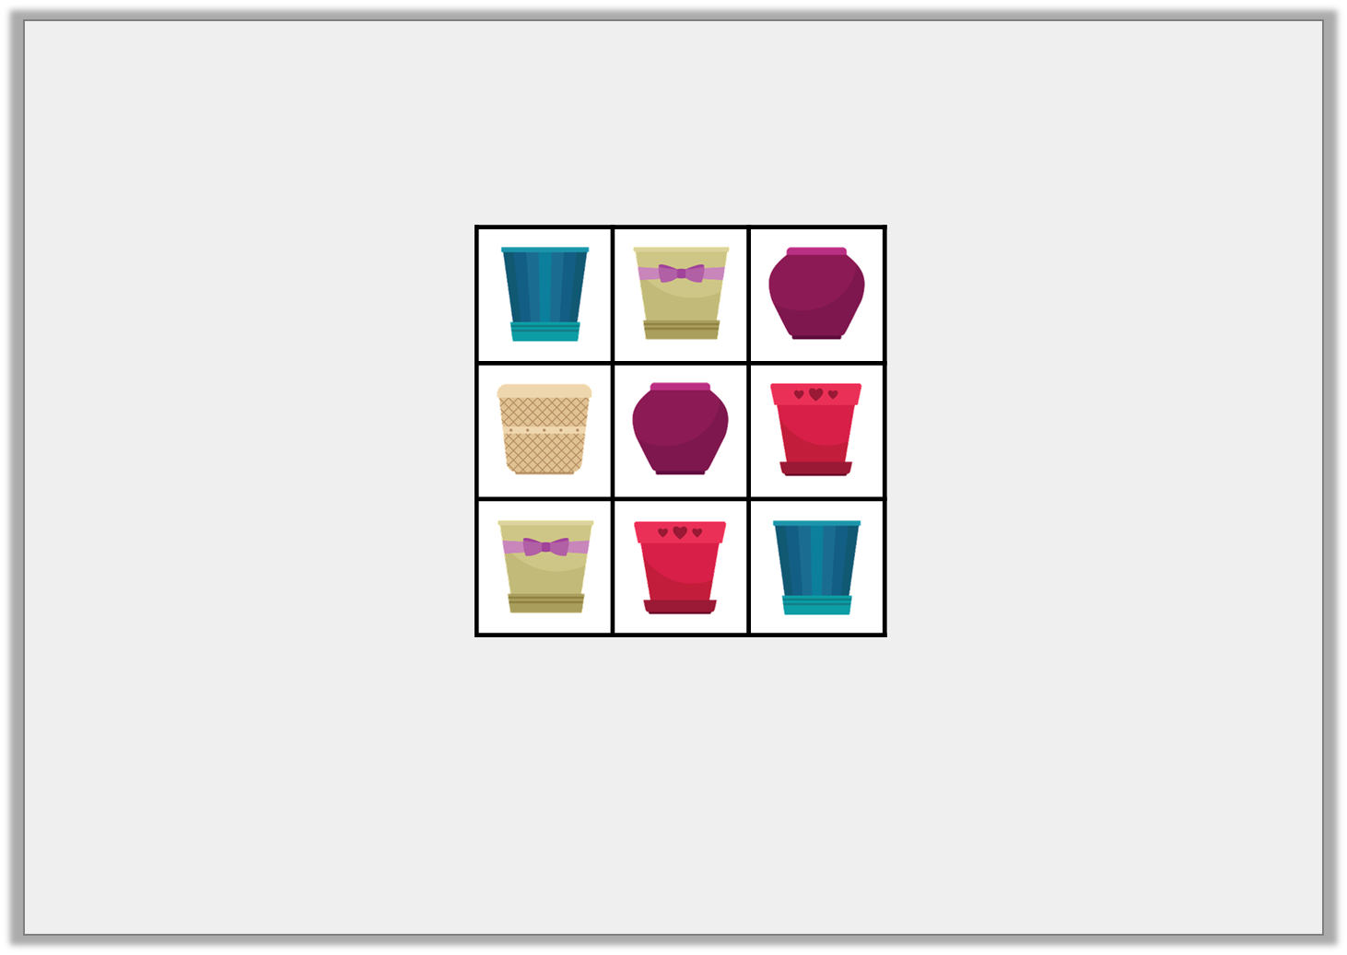
Reasoning 1
Ameerah is packing plant pots in boxes. She can put 9 pots in each box and each box is full.
Ameerah has between 20 and 40 plant pots.
How many boxes might she need?
© Classroom Secrets Limited 2018

Slide 15
Reasoning 1
Ameerah is packing plant pots in boxes. She can put 9 pots in each box and each box is full.
Ameerah has between 20 and 40 plant pots.
How many boxes might she need?
Ameerah could have 27 or 36 plant pots so…
© Classroom Secrets Limited 2018

Slide 16
Reasoning 1
Ameerah is packing plant pots in boxes. She can put 9 pots in each box and each box is full.
Ameerah has between 20 and 40 plant pots.
How many boxes might she need?
Ameerah could have 27 or 36 plant pots so she might need 3 (27 ÷ 9 = 3) or 4 (36 ÷ 9 = 4) boxes.
© Classroom Secrets Limited 2018

Slide 17

Reasoning 2
Riley and Anoop are comparing how many books they each have. There are 9 books on each shelf.
Riley says,
Is he correct? Prove it.
Anoop has more books than me because she has 7 full shelves. I have 81 books.
© Classroom Secrets Limited 2018

Slide 18
Reasoning 2
Riley and Anoop are comparing how many books they each have. There are 9 books on each shelf.
Riley says,
Is he correct? Prove it.
Riley is incorrect because…
Anoop has more books than me because she has 7 full shelves. I have 81 books.
© Classroom Secrets Limited 2018

Slide 19
Reasoning 2
Riley and Anoop are comparing how many books they each have. There are 9 books on each shelf.
Riley says,
Is he correct? Prove it.
Riley is incorrect because Anoop has 7 x 9 = 63 books. 81 is more than 63, so Riley has more.
Anoop has more books than me because she has 7 full shelves. I have 81 books.
© Classroom Secrets Limited 2018

