Slide 1


LO: To multiply and divide by 6
© Classroom Secrets Limited 2018

Slide 2
Introduction
Sort the following numbers under the correct headings on the Venn diagram.
Multiples of 3
Multiples of 6
G
45
30
12
3
66
33
15
42
© Classroom Secrets Limited 2018

Slide 3
Introduction
Sort the following numbers under the correct headings on the Venn diagram.
Multiples of 3
Multiples of 6
G
12
3
15
30
42
33
66
45
© Classroom Secrets Limited 2018

Slide 4
Varied Fluency 1
Complete the calculations to match the picture.
 | x |  | =
 | ÷ |  | =
© Classroom Secrets Limited 2018

Slide 5
Varied Fluency 1
Complete the calculations to match the picture.
7 | x | 6 | = | 42
42 | ÷ | 6 | = | 7
© Classroom Secrets Limited 2018

Slide 6
Varied Fluency 2
Tick the bar model which correctly represents the calculation below.
8 x 6
48
6 | 6 | 6 | 6 | 6 | 6 | 6
A.
B.
48
6 | 6 | 6 | 6 | 6 | 6 | 6 | 6
© Classroom Secrets Limited 2018

Slide 7
Varied Fluency 2
Tick the bar model which correctly represents the calculation below.
8 x 6
48
6 | 6 | 6 | 6 | 6 | 6 | 6
A.
B. |  | 
48
6 | 6 | 6 | 6 | 6 | 6 | 6 | 6
© Classroom Secrets Limited 2018

Slide 8
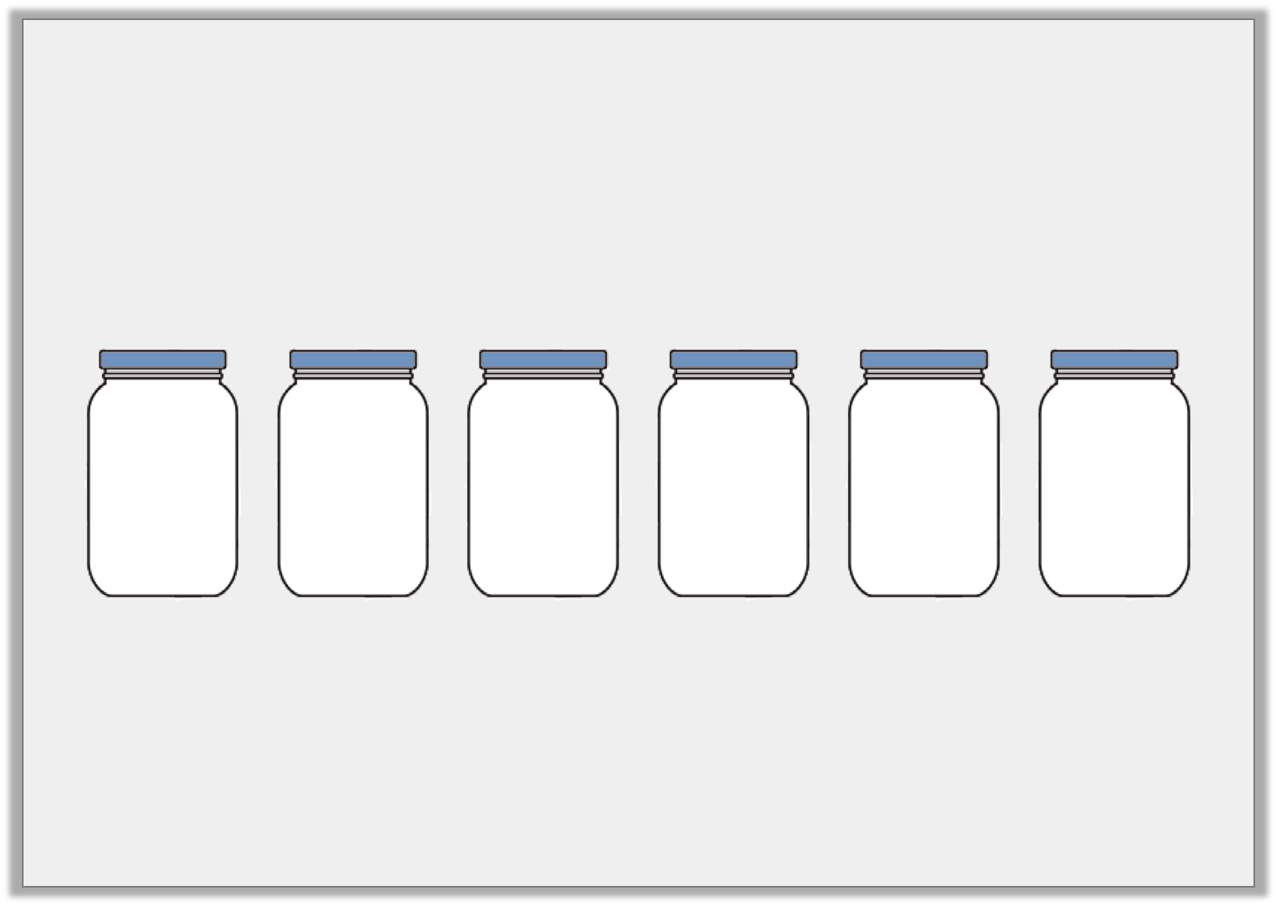
Varied Fluency 3
George has 18 coins. He shares them equally between 6 jars.
How many will be in each jar?
Draw the coins in the jars below to show this.
Write a calculation to show your answer.
© Classroom Secrets Limited 2018

Slide 9
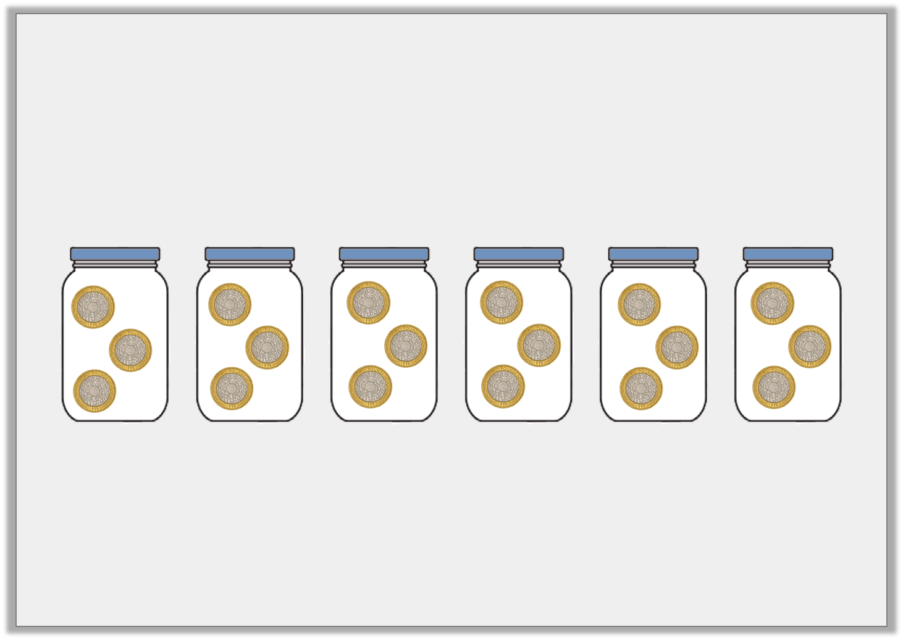
Varied Fluency 3
George has 18 coins. He shares them equally between 6 jars.
How many will be in each jar?
Draw the coins in the jars below to show this.
Write a calculation to show your answer.
18 ÷ 6 = 3
© Classroom Secrets Limited 2018

Slide 10
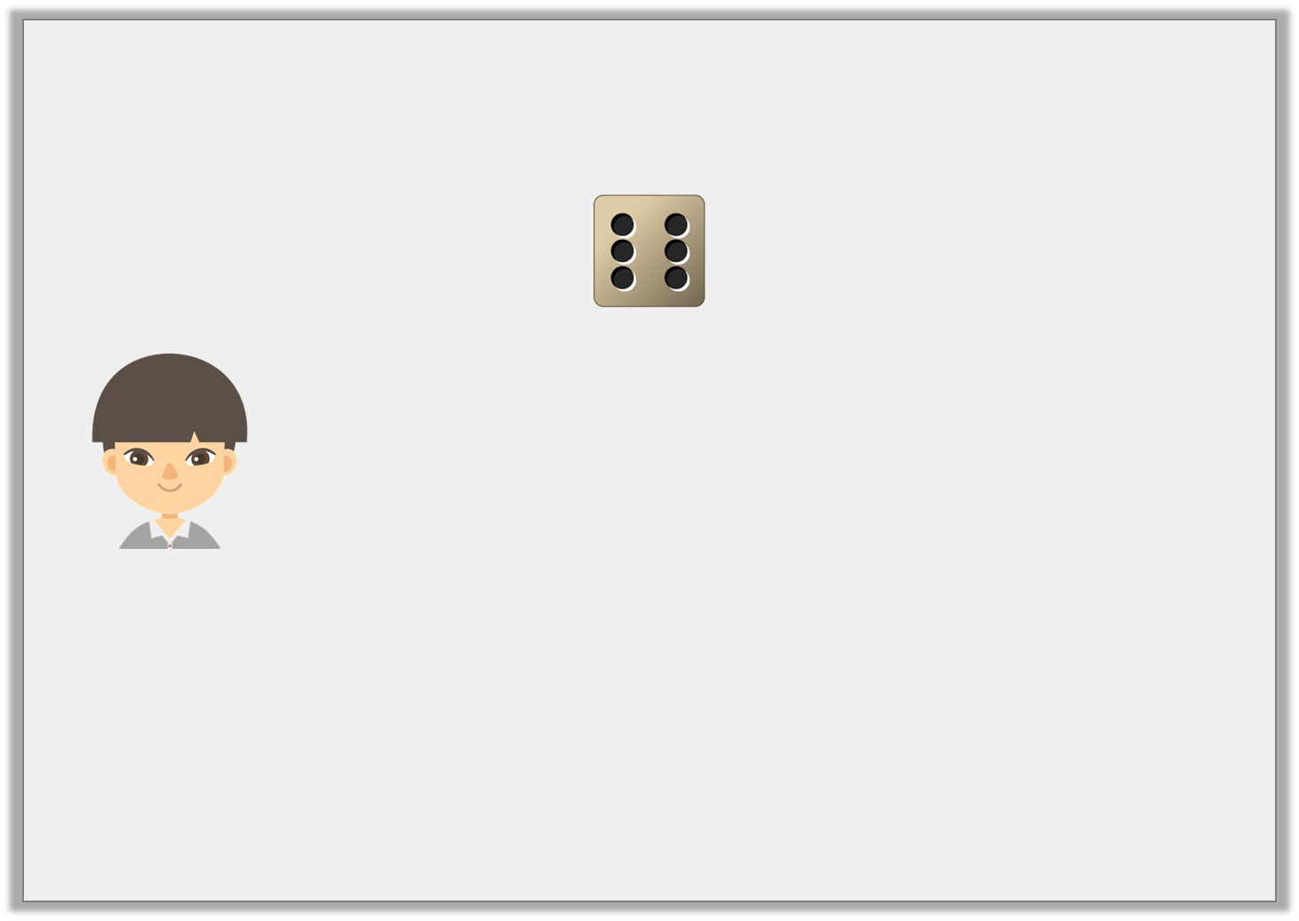
Reasoning 1
Alex rolls a dice 10 times and it lands on 6 every time.
He says,
Do you agree with Alex? Explain your answer.
I got 66 altogether.
© Classroom Secrets Limited 2018

Slide 11
Reasoning 1
Alex rolls a dice 10 times and it lands on 6 every time.
He says,
Do you agree with Alex? Explain your answer.
Alex is incorrect because…
I got 66 altogether.
© Classroom Secrets Limited 2018

Slide 12
Reasoning 1
Alex rolls a dice 10 times and it lands on 6 every time.
He says,
Do you agree with Alex? Explain your answer.
Alex is incorrect because 10 x 6 = 60.
I got 66 altogether.
© Classroom Secrets Limited 2018

Slide 13

Reasoning 2
Lottie is trying to solve the calculation below.
30 ÷ 6
She says,
What has Lottie done wrong? Draw a bar model to show your answer.
I think the answer is 6.
30
6 | 6 | 6 | 6 | 6 | 6
© Classroom Secrets Limited 2018

Slide 14
Reasoning 2
Lottie is trying to solve the calculation below.
30 ÷ 6
She says,
What has Lottie done wrong? Draw a bar model to show your answer.
Lottie has got the wrong answer because…
I think the answer is 6.
30
6 | 6 | 6 | 6 | 6 | 6
© Classroom Secrets Limited 2018

Slide 15
Reasoning 2
Lottie is trying to solve the calculation below.
30 ÷ 6
She says,
What has Lottie done wrong? Draw a bar model to show your answer.
Lottie has got the wrong answer because 30 ÷ 6 = 5
I think the answer is 6.
30
6 | 6 | 6 | 6 | 6 | 6
30
5 | 5 | 5 | 5 | 5 | 5
© Classroom Secrets Limited 2018

Slide 16
Problem Solving 1
Using the cards below, create as many number sentences as you can.
x
42
=
7
10
6
60
÷
© Classroom Secrets Limited 2018

Slide 17
Problem Solving 1
Using the cards below, create as many number sentences as you can.
Various answers, for example: 10 x 6 = 60; 42 ÷ 6 = 7
x
42
=
7
10
6
60
÷
© Classroom Secrets Limited 2018

