Slide 1
Year 4 Maths 10.02.2021
LO: To compare and classify 2D shapes

Slide 2
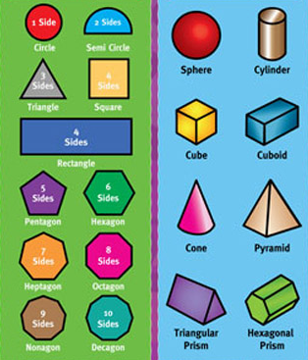
Starter
What is the difference between a 2D and a 3D shape?

Slide 3
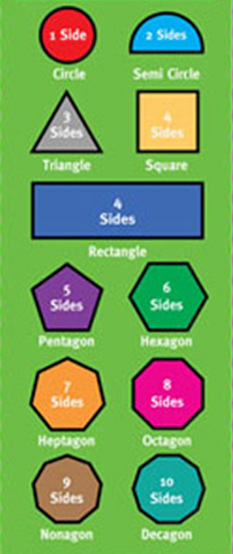
2D shapes
These shapes have 2 dimensions
They are called flat shapes
They are drawings that can’t be picked up

Slide 4

3D shapes
These shapes have 3 dimensions
They are called solid shapes
They can be picked up
These can be shown as drawings, using a 3D image

Slide 5
What is a polygon?
From the shapes below, which ones are polygons?

Slide 6
What is a polygon?
From the shapes below, which ones are polygons?
✓
✓
✓
✓
✓
✓
✓

Slide 7


Names of 2D shapes
List the names of 2D shapes from 3 sides to 10 sides.
How many do you know?

Slide 8
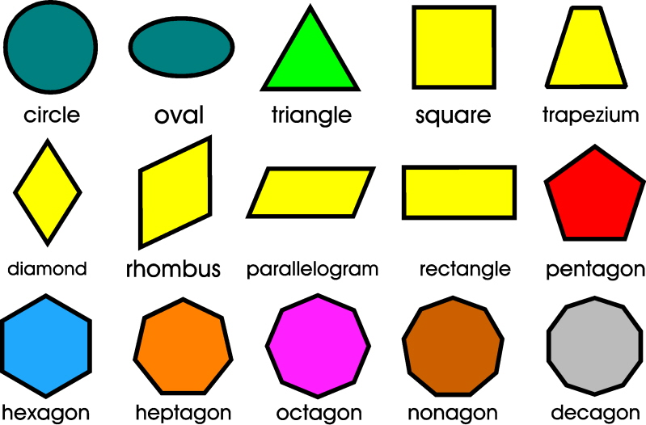

Slide 9
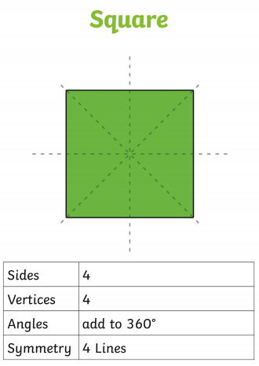

Slide 17
Polygon

Slide 18
Not a polygon
Polygon

Slide 19
Not a polygon
Polygon
Right angles

Slide 20
Not a polygon
Polygon
Right angles
No right angles

Slide 21
Not a polygon
Polygon
Right angles
No right angles

