Slide 1
Year 4 Maths 02.02.2021
LO: To understand and convert time using different units of measure

Slide 2
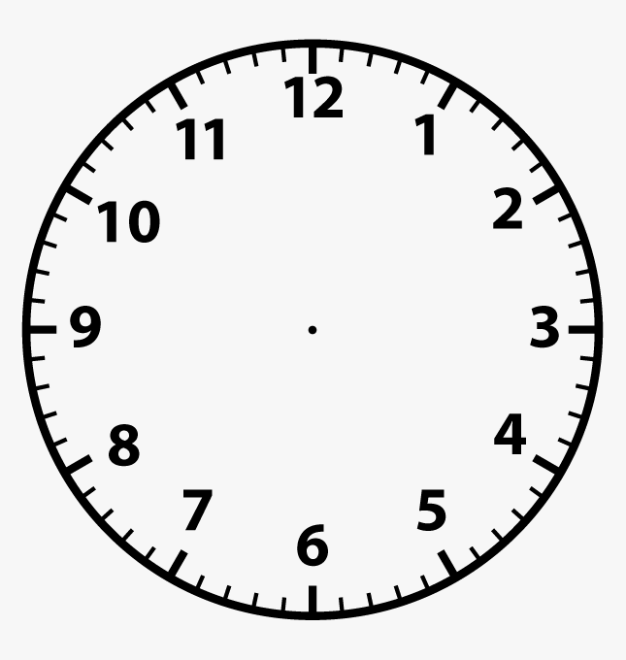
Starter
How many seconds are in a minute?
How many minutes in an hour?
How many hours in a day?

Slide 3
Starter
How many seconds are in a minute?
60 seconds = 1 minute
How many minutes in an hour?
How many hours in a day?

Slide 4
Starter
How many seconds are in a minute?
60 seconds = 1 minute
How many minutes in an hour?
60 minutes = 1 hour
How many hours in a day?

Slide 5
Starter
How many seconds are in a minute?
60 seconds = 1 minute
How many minutes in an hour?
60 minutes = 1 hour
How many hours in a day?
24 hours = 1 day

Slide 6
Question Time
How many minutes are in two hours?
How many seconds are in three minutes?
How many hours in four days?

Slide 7
Question Time
How many minutes are in two hours?
1 hr = 60 mins
There are 120 minutes in two hours
How many seconds are in three minutes?
How many hours in four days?

Slide 8
Question Time
How many minutes are in two hours?
1 hr = 60 mins
There are 120 minutes in two hours
How many seconds are in three minutes?
60 secs = 1 min
There are 180 seconds in three minutes
How many hours in four days?

Slide 9
Question Time
How many minutes are in two hours?
1 hr = 60 mins
There are 120 minutes in two hours
How many seconds are in three minutes?
60 secs = 1 min
There are 180 seconds in three minutes
How many hours in four days?
24 hrs = 1 day
There are 96 hours in four days

Slide 10
Analogue clocks
What time is shown on the clock?
What time will it be after another 15 minutes?

Slide 11
Analogue clocks
What time is shown on the clock?
9:10
What time will it be after another 15 minutes?

Slide 12
Analogue clocks
What time is shown on the clock?
9:10
What time will it be after another 15 minutes?
9:25

Slide 13
Analogue clocks
What time is shown on the clock?
What time will it be after another 35 minutes?

Slide 14
Analogue clocks
What time is shown on the clock?
10:35
What time will it be after another 35 minutes?

Slide 15
Analogue clocks
What time is shown on the clock?
10:35
What time will it be after another 35 minutes?
11:10

Slide 17
Extension Task

