Slide 1
Year 4 Maths 01.02.2021
LO: To read and write time on an analogue and digital clock

Slide 2
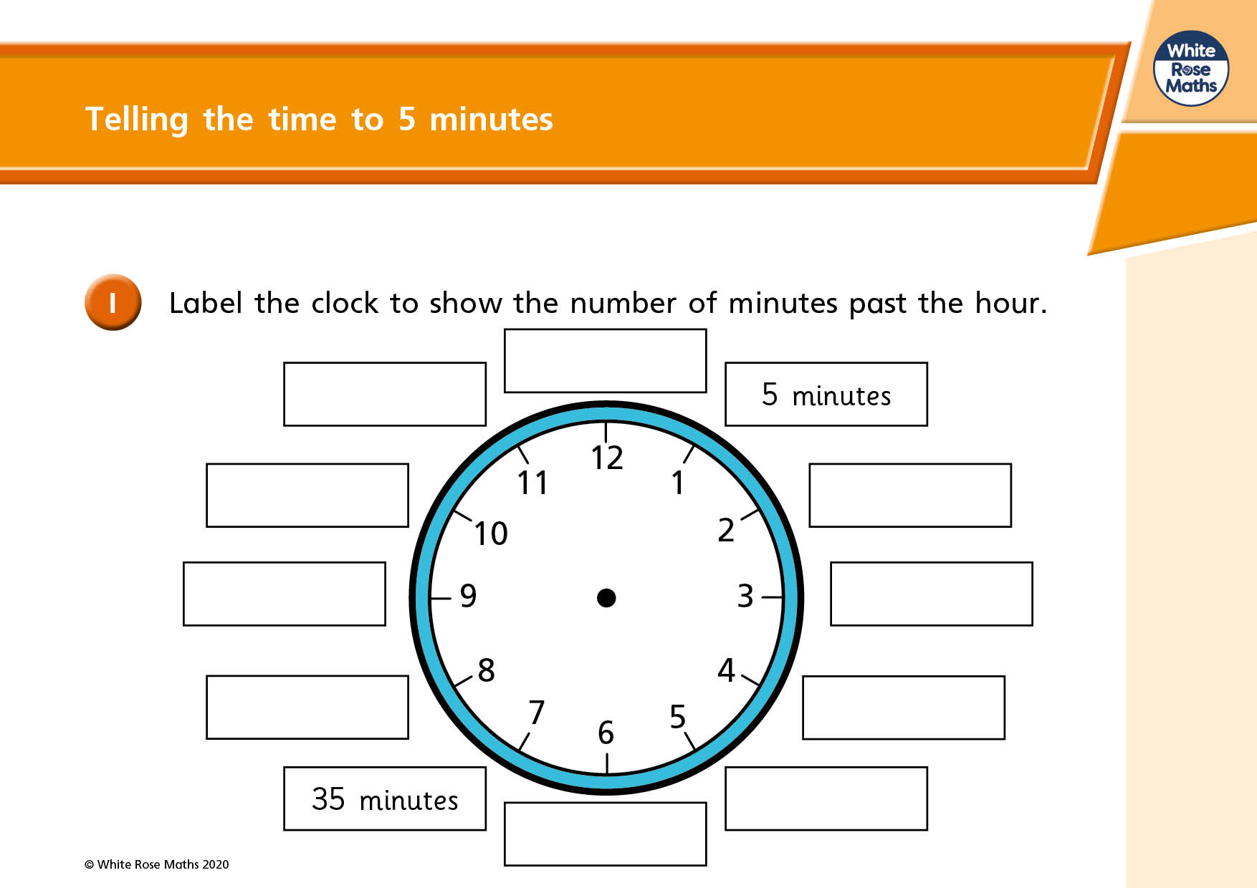


Slide 3
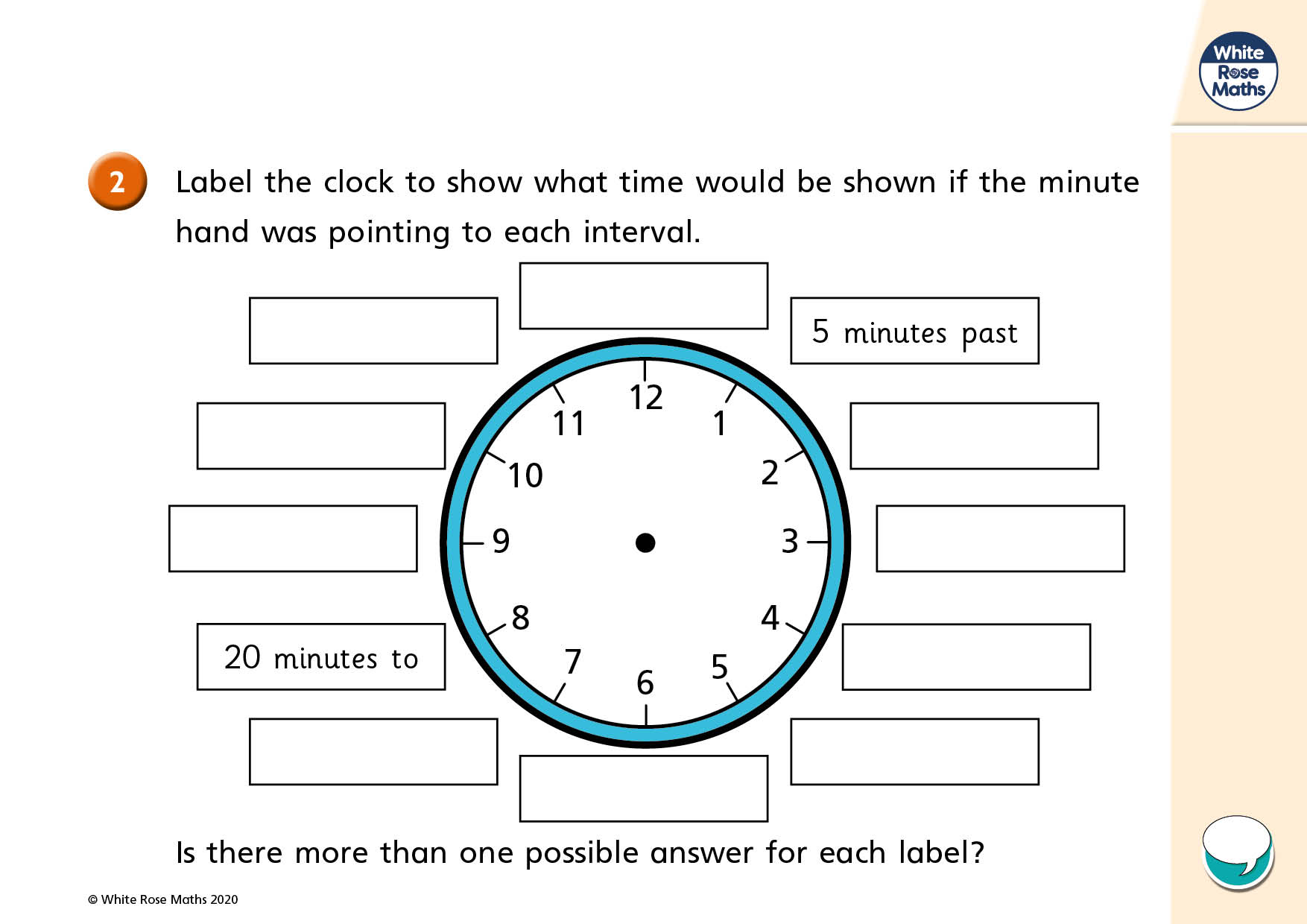

Slide 4

Using an analogue and digital clock

Slide 5
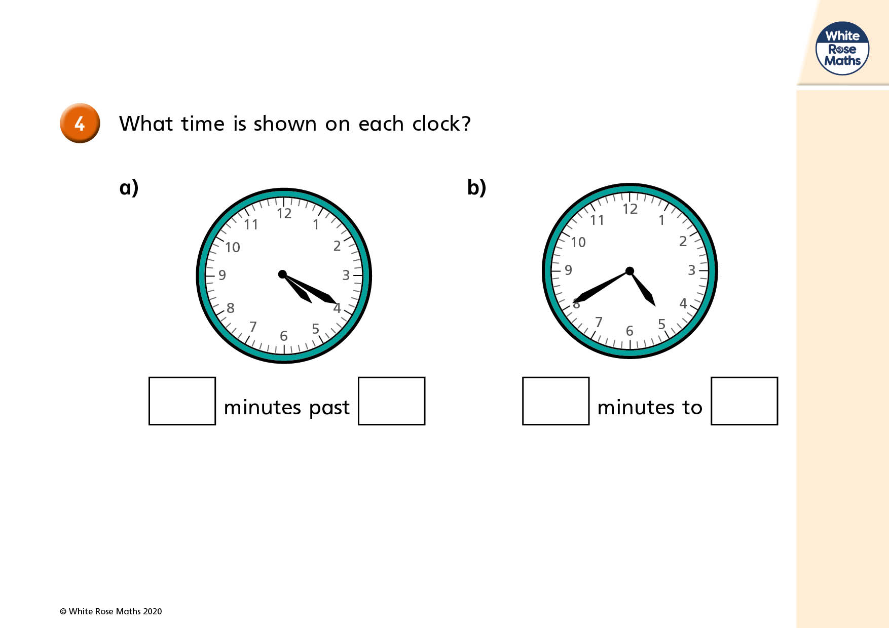

Slide 6
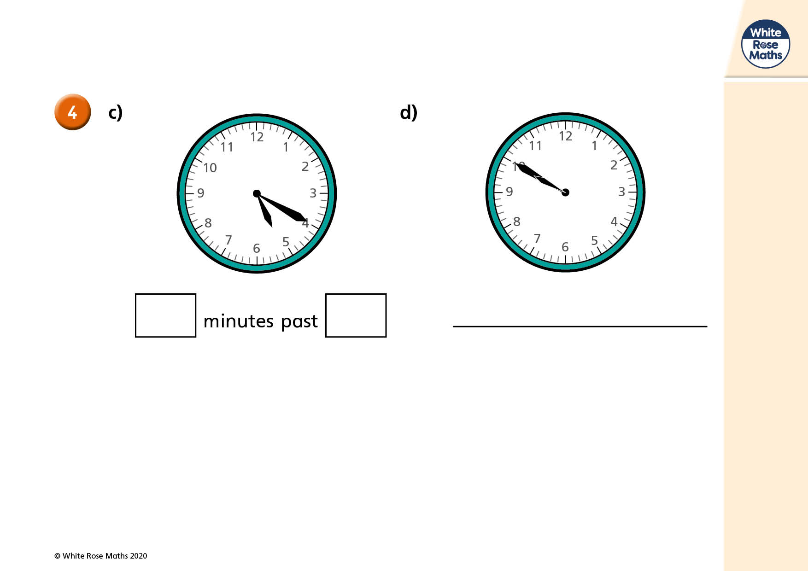

Slide 7
