Slide 1
English 03.03.21
Explanation Texts 3rd March, 2021

Slide 2
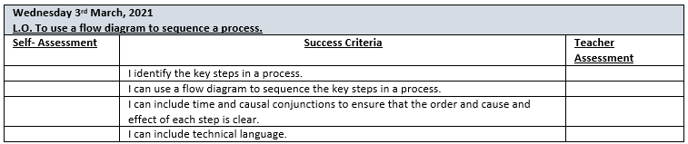

Slide 3
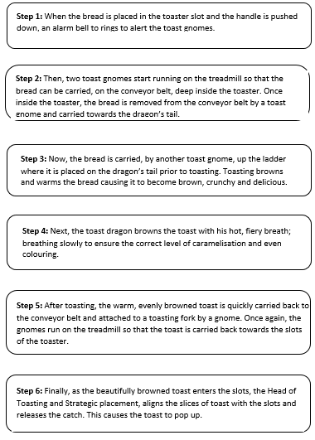
Time conjunctions
Notice that steps begin with time conjunctions not imperative verbs.
Explanation texts explain how or why something happens – they do not tell us how to do it.
Causal conjunctions

Slide 4
Explanation text
tells how or why a process
happens (or how something works).
This is sequential and deals
with cause and effect.

Slide 5
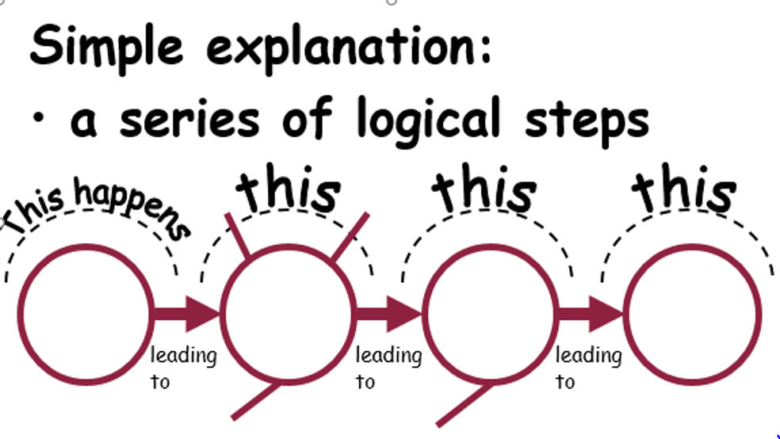
Time and causal conjunctions make clear the order of events and cause and effect.

Slide 6
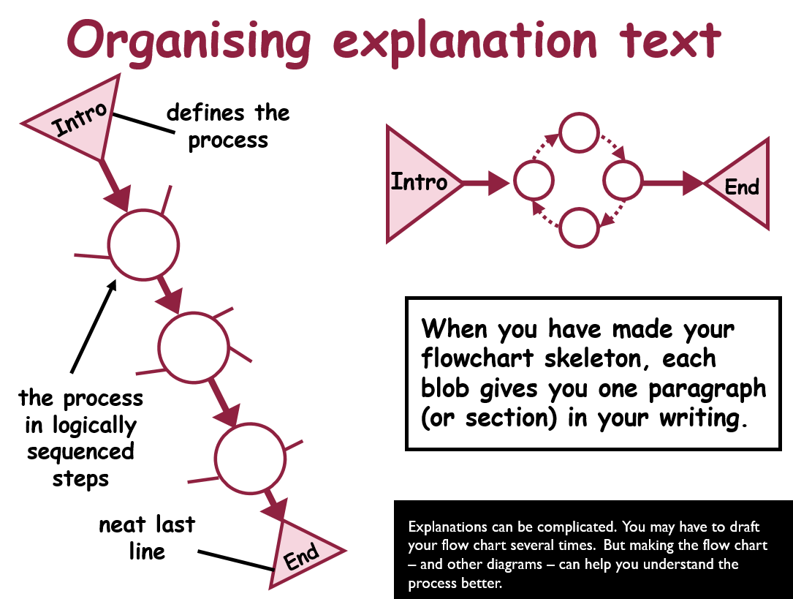
Flow charts can be used to sequence the process.

Slide 7
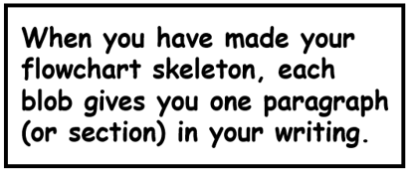
Intro
End

Slide 8
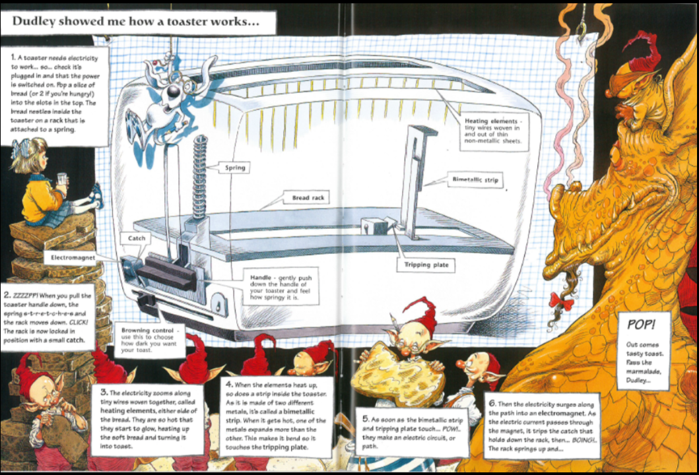
This is how a toaster really works.
Notice numbered steps.
Technical language.

Slide 9
Intro
Begin by placing the bread to be toasted into the slots. Pull down the handle so that the bread slips into the slots.
End

Slide 10
Independent Work:
Year 4: Pupils to identify and record the key steps of the process and complete the flow diagram provided. Try to include time conjunctions.
Year 5: As above but pupils also to include an initial step for their flow diagram explaining what their flow diagram is about and a final statement. Time conjunctions are included to make the order clear.
Y6: As for Y5 but pupils must also include a ‘topic’ sentence that explains what is happening at each stage of their flow diagram. Time and causal conjunctions are used to make the order and cause and effect clear.
Extension: Try to include technical language.

Slide 11
Plenary:
Using just your flow diagram, can you orally explain to someone at home, how a toaster works?
You can, if you wish, share in our Zoom session or upload onto Tapestry.

