Slide 1
English 02.03.21
Explanation Texts 2nd March, 2021

Slide 2
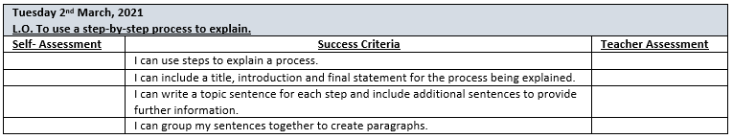

Slide 3
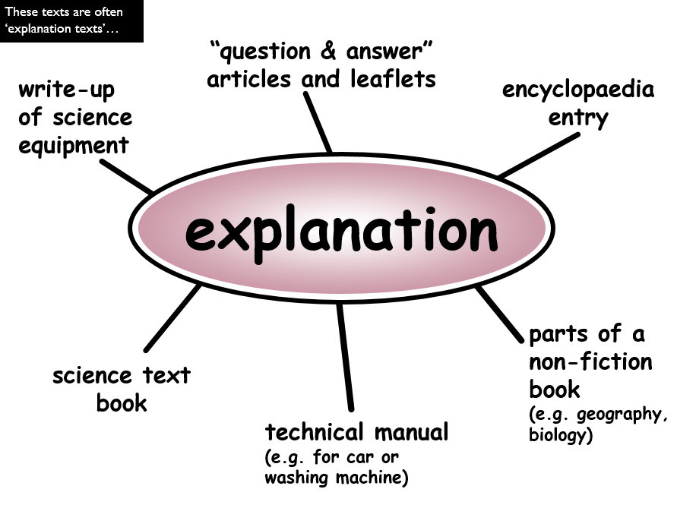

Slide 4
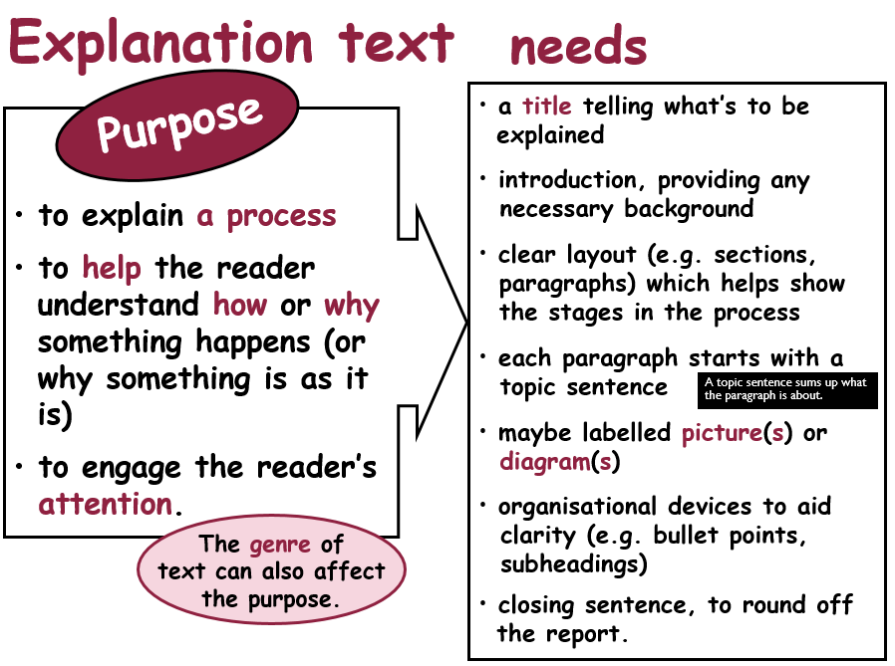

Slide 5
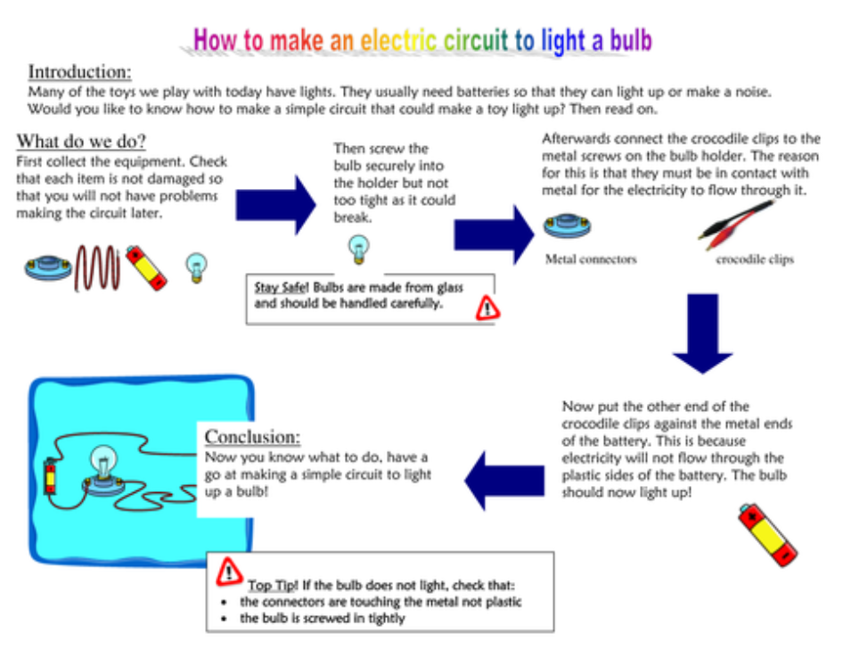

Slide 6
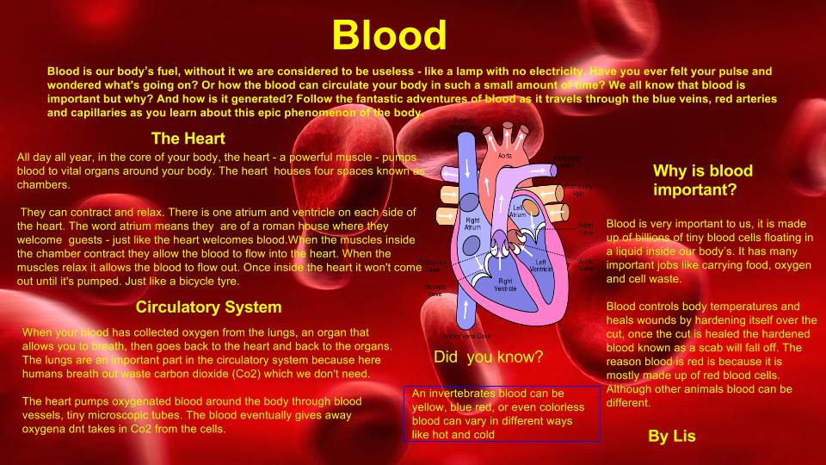

Slide 7
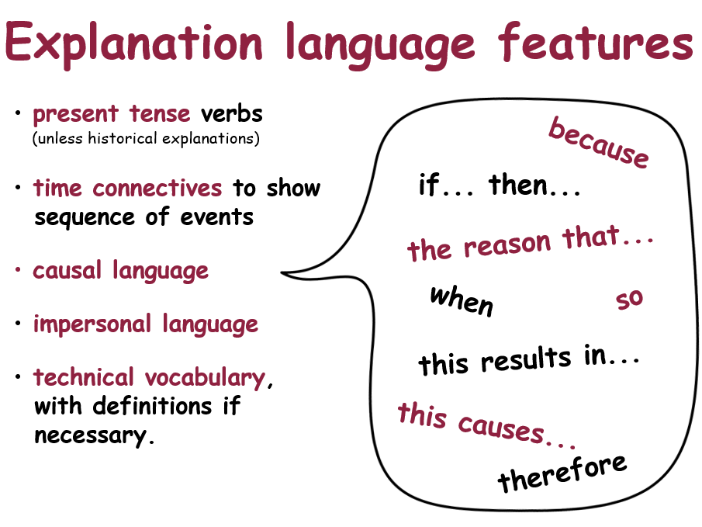

Slide 8
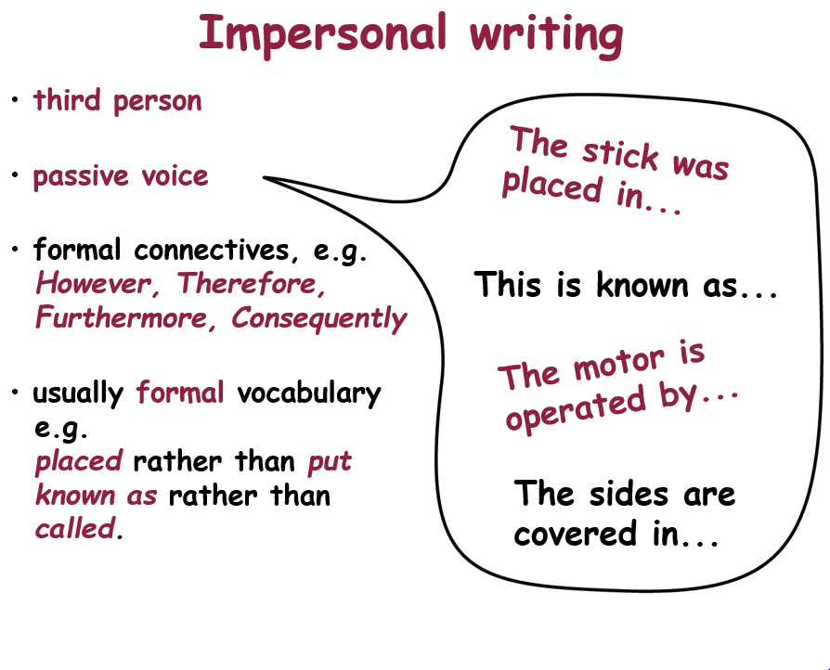

Slide 9
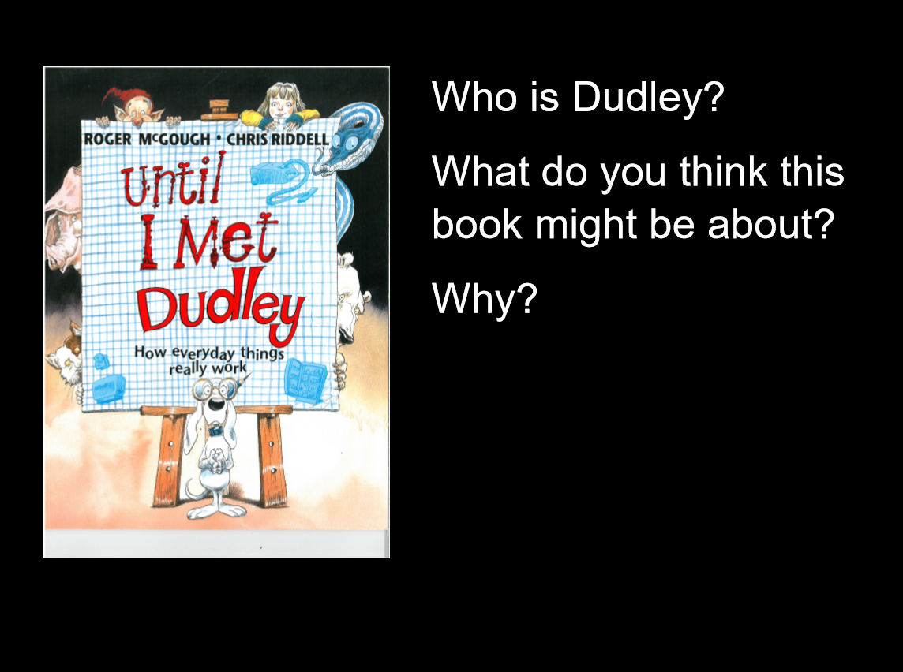

Slide 10
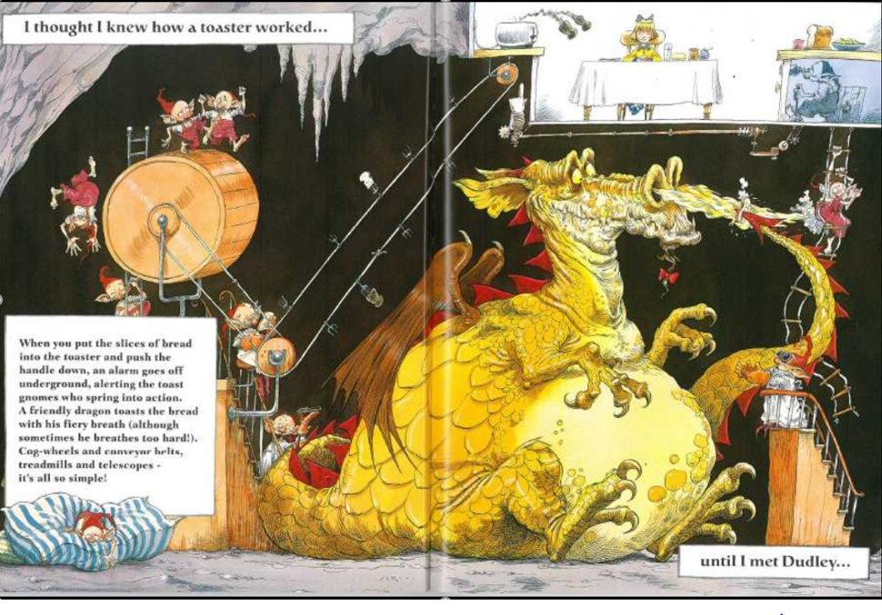
Explain how toast is made using a step-by-step process.
Step 1: …..

Slide 11
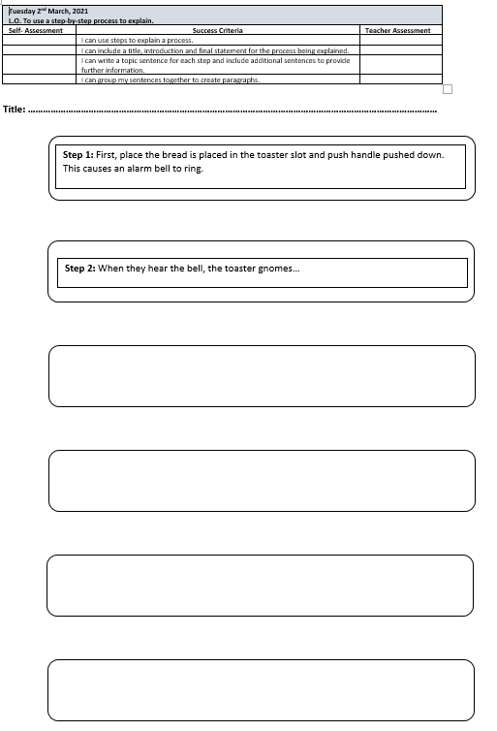
Independent work:
Year 4: Pupils to identify the key steps in the process shown in the picture.
Year 5: As above but pupils also to include an initial introduction to explain what the process is about and a final statement to finish off. Additional information in note form.
Year 6: As for Y5 but pupils must also include a ‘topic’ sentence that explains what is happening at each stage of the process with any additional details added as sentences. Working in their book.
Extension: Use the appropriate type of conjunction to link your steps together. What type of conjunction will we need?

Slide 12
Plenary:
We will review the step-by-step process at the beginning of tomorrow’s lesson. Please make sure you have your book or sheet with you.

