Slide 1


Money
Y4 Money (decimals)
Four Operations
© Classroom Secrets Limited 2018

Slide 2
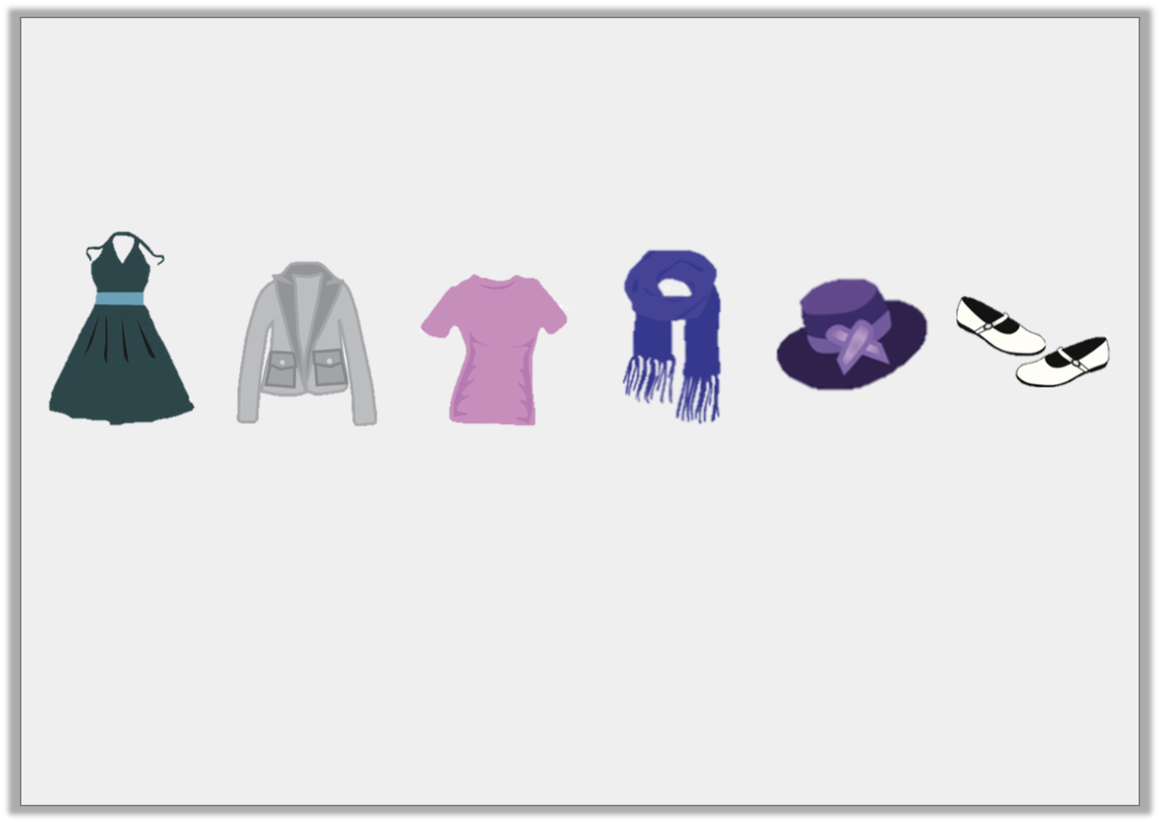
Introduction
Lana is shopping.
She has about £20 to spend.
Estimate what she could purchase.
Dress
£11.45
Jacket
£5.75
Shirt
£7.30
Scarf
£8.55
Hat
£4.95
Shoes
£6.80
© Classroom Secrets Limited 2018

Slide 3
Introduction
Lana is shopping.
She has about £20 to spend.
Estimate what she could purchase.
Dress
£11.45
Jacket
£5.75
Shirt
£7.30
Scarf
£8.55
Hat
£4.95
Shoes
£6.80
There are several possible combinations that, when estimated, will cost £20. For example, she could purchase:
the dress and the scarf (£11 + £9 = £20)
the jacket, shirt and shoes (£6 + £7 + £7 = £20)
the hat, jacket and scarf (£5 + £6 + £9 = £20)
© Classroom Secrets Limited 2018

Slide 4
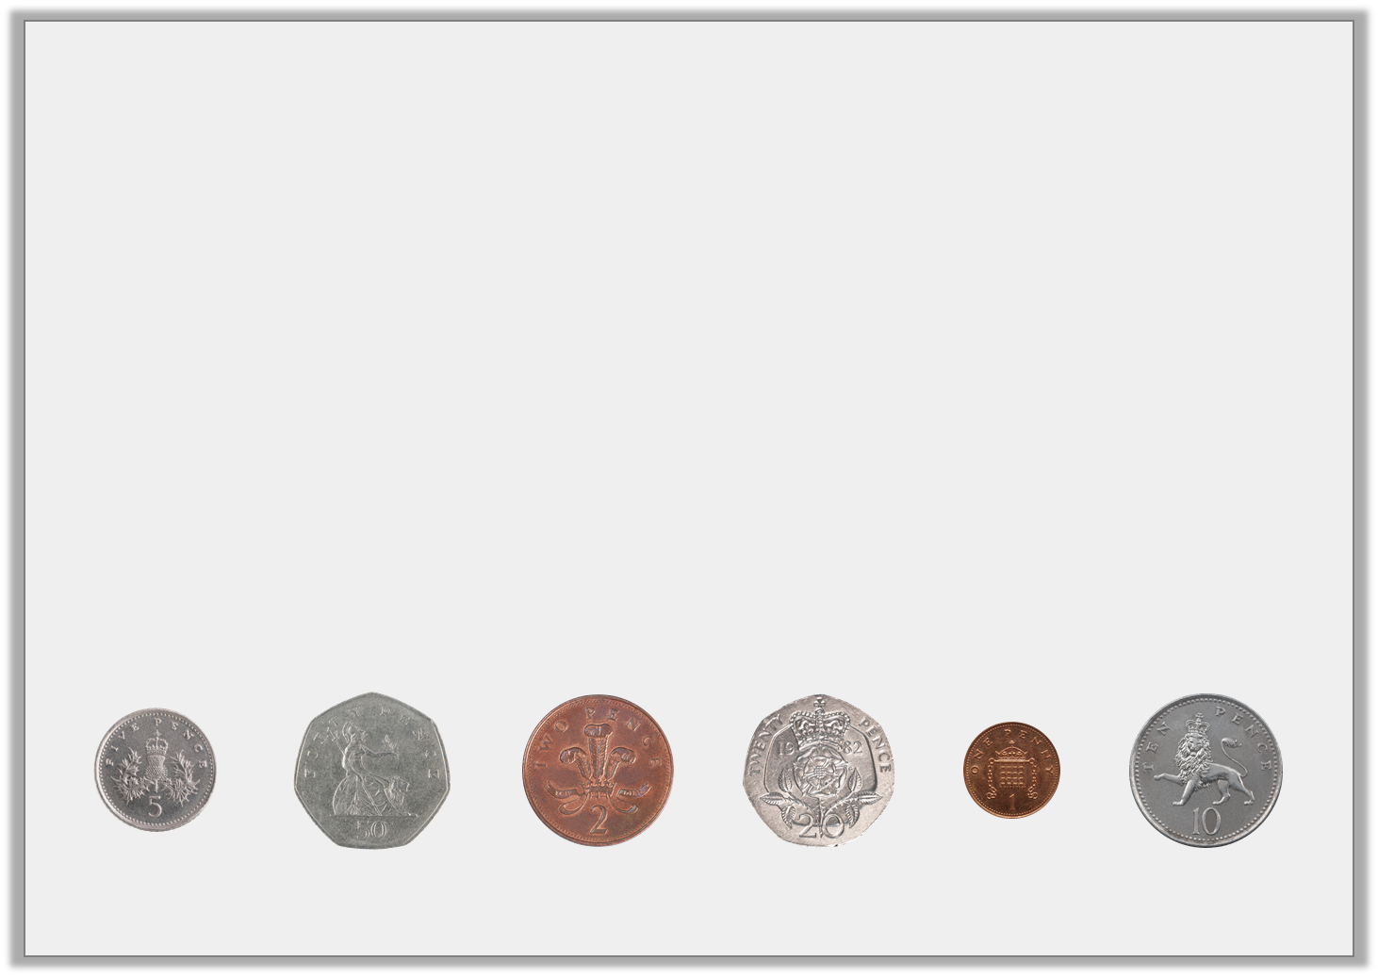
Varied Fluency 1
Which coins would complete this bar model?
You can use coins more than once.
£1.60
© Classroom Secrets Limited 2018

Slide 5
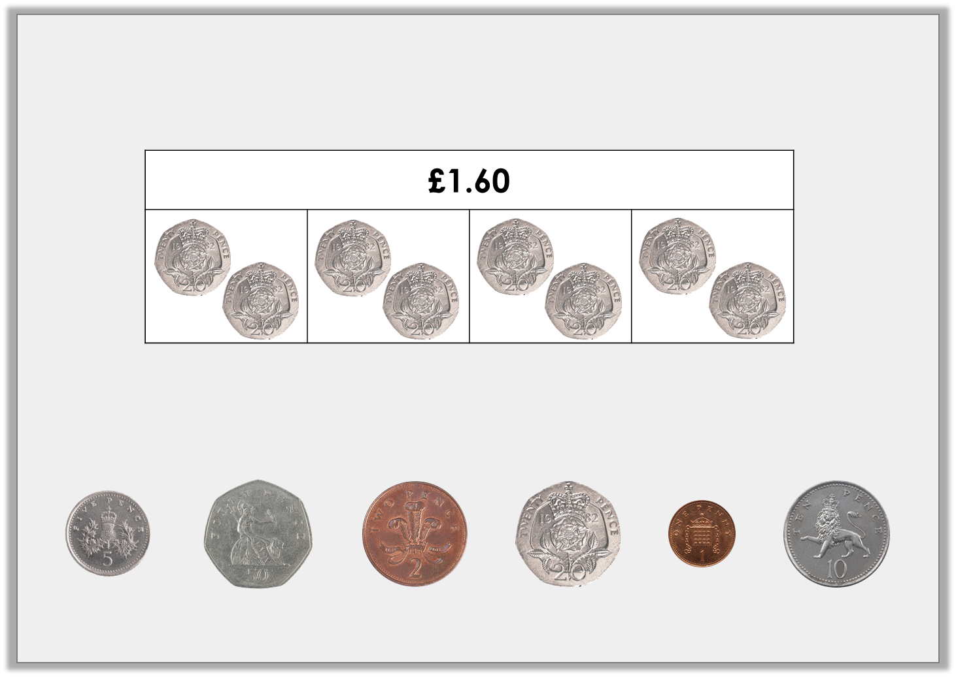
Varied Fluency 1
Which coins would complete this bar model?
You can use coins more than once.
Possible answer
© Classroom Secrets Limited 2018

Slide 6
Varied Fluency 2
Complete the bar model for the problem.
Bobby goes to the shopping centre. He spends £12.50 on a new pair of shorts and £10.80 on a t-shirt.
How much money does he spend altogether?
© Classroom Secrets Limited 2018

Slide 7
Varied Fluency 2
Complete the bar model for the problem.
Bobby goes to the shopping centre. He spends £12.50 on a new pair of shorts and £10.80 on a t-shirt.
How much money does he spend altogether?
£23.30
£12.50
£10.80
£12.50 + £10.80 = £23.30
© Classroom Secrets Limited 2018

Slide 8
Varied Fluency 3
Calculate the missing numbers:
6 | x |  | = | £1.80
 | x | 7 | = | £1.40
© Classroom Secrets Limited 2018

Slide 9
Varied Fluency 3
Calculate the missing numbers:
6 | x | £0.30 | = | £1.80
£0.20 | x | 7 | = | £1.40
© Classroom Secrets Limited 2018

Slide 10
Varied Fluency 4
The table below shows ticket prices for the theatre.
How much would it cost for two adults and two children to visit the theatre during the afternoon?
 | Afternoon | Evening
Adult | £16.25 | £20.50
Child | £8.75 | £9.50
© Classroom Secrets Limited 2018

Slide 11
Varied Fluency 4
The table below shows ticket prices for the theatre.
How much would it cost for two adults and two children to visit the theatre during the afternoon?
 | Afternoon | Evening
Adult | £16.25 | £20.50
Child | £8.75 | £9.50
£16.25 x 2 = £32.50
£8.75 x 2 = £17.50
£32.50 + £17.50 = £50
© Classroom Secrets Limited 2018

Slide 12

Reasoning 1
Tabitha loves to buy cookies for her friends.
She plans to buy 30 cookies to share with her friends, so she decides to buy her cookies in packs of 5. Do you agree with her decision? Explain your answer.
25p per cookie
5 for £1.50
10 for £2.20
© Classroom Secrets Limited 2018

Slide 13
Reasoning 1
Tabitha loves to buy cookies for her friends.
She plans to buy 30 cookies to share with her friends, so she decides to buy her cookies in packs of 5. Do you agree with her decision? Explain your answer.
No because….
25p per cookie
5 for £1.50
10 for £2.20
© Classroom Secrets Limited 2018

Slide 14
Reasoning 1
Tabitha loves to buy cookies for her friends.
She plans to buy 30 cookies to share with her friends, so she decides to buy her cookies in packs of 5. Do you agree with her decision? Explain your answer.
No because she should buy them in packs of 10. 3 x £2.20 = £6.60. Buying in packs of 5 would cost £9 and buying individually would cost £7.50.
25p per cookie
5 for £1.50
10 for £2.20
© Classroom Secrets Limited 2018

Slide 15
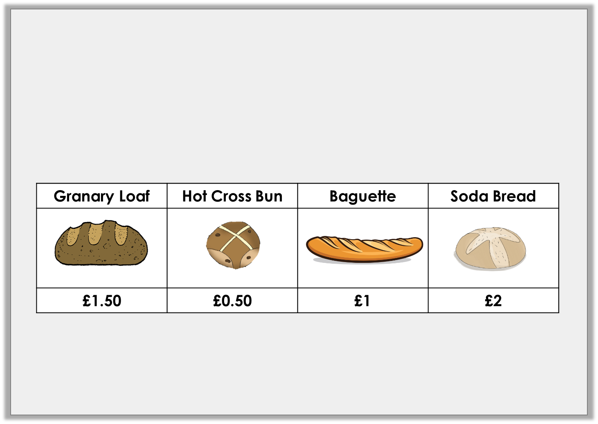
Problem Solving 1
At the bakery, Hernant spent £4 altogether.
What could she have bought?
Find more than one possibility.
© Classroom Secrets Limited 2018

Slide 16
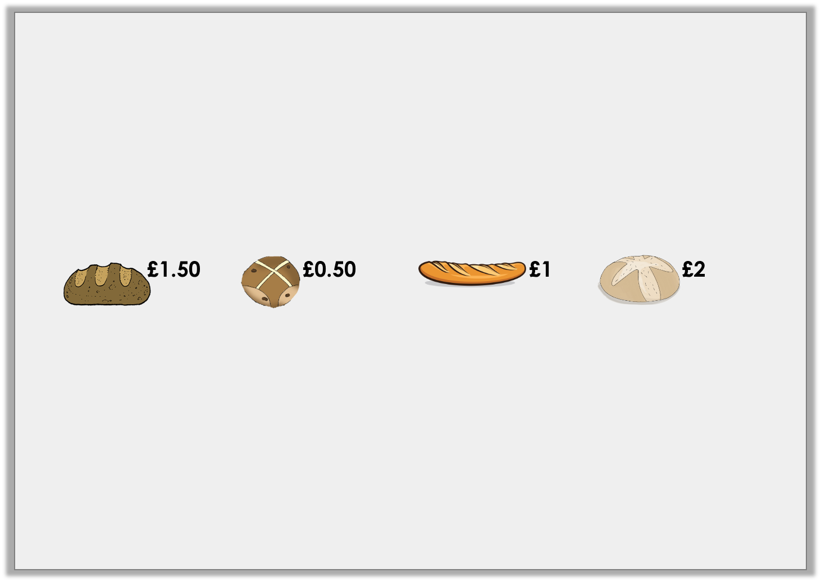
Problem Solving 1
At the bakery, Hernant spent £4 altogether.
What could she have bought?
Find more than one possibility.
Various possible answers, including:
Option | Granary loaf | Hot Cross Bun | Baguette | Soda Bread | Total
1 | 0 | 0 | 0 | 2 | £4
2 | 0 | 0 | 2 | 1 | £4
3 | 0 | 4 | 0 | 1 | £4
© Classroom Secrets Limited 2018

Slide 17

Problem Solving 2
Carice buys three sunflowers and two tulips.
She pays with £10.
How much change will she receive?
Sunflower | Tulip
£1.50 | £2.50
© Classroom Secrets Limited 2018

Slide 18
Problem Solving 2
Carice buys three sunflowers and two tulips.
She pays with £10.
How much change will she receive?
50p
Sunflower | Tulip
£1.50 | £2.50
© Classroom Secrets Limited 2018

