Slide 1


Measurement: Money
Y4 Ordering Money
© Classroom Secrets Limited 2019

Slide 2
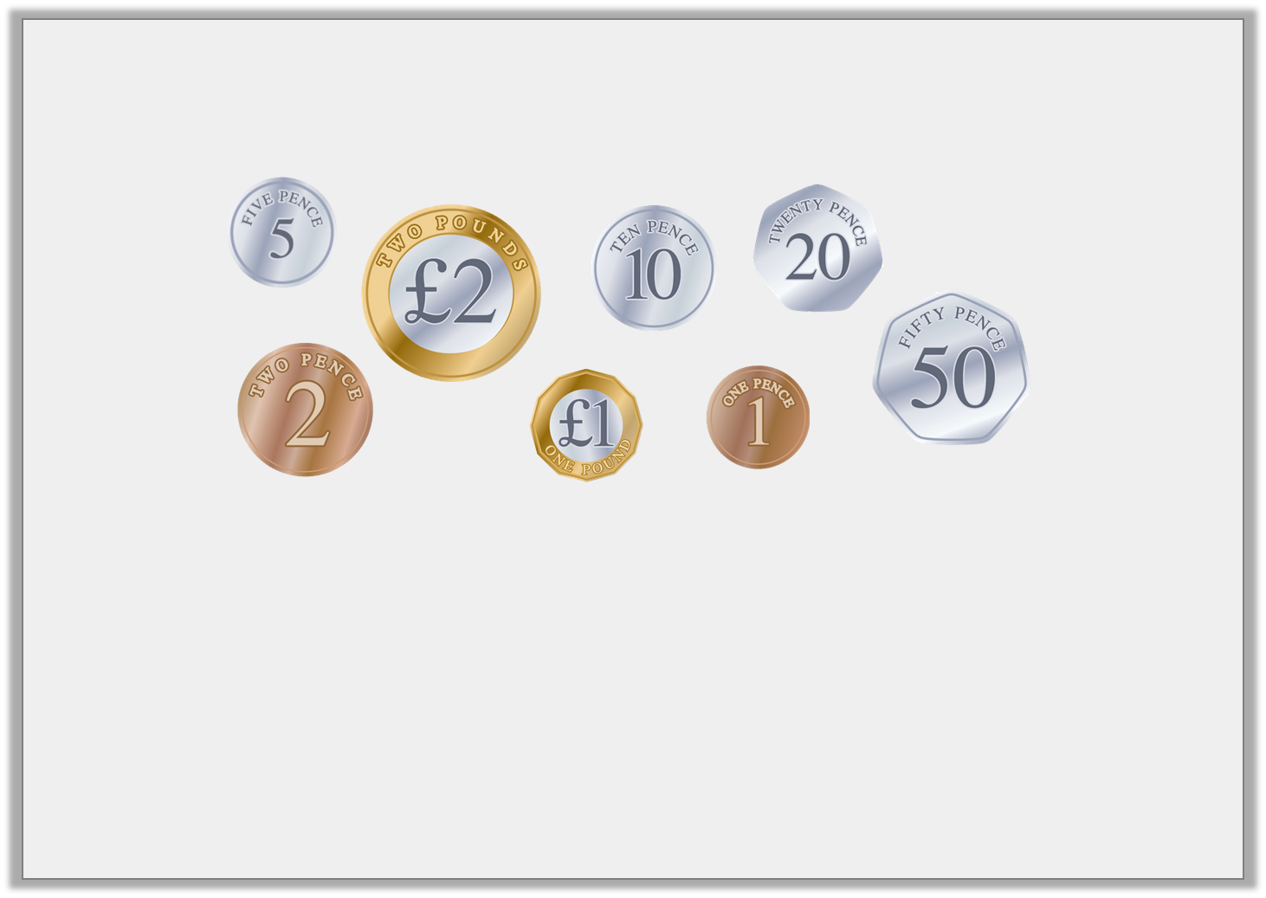
Introduction
Order these coins from lowest to highest value.
How many 10p coins are in £1?
How many 50p coins are in £1?
How many 20p coins are in £1?
How many 5p coins are in £1?
© Classroom Secrets Limited 2019

Slide 3
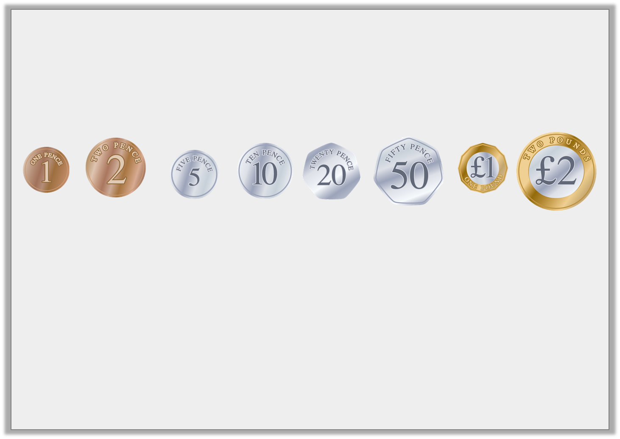
Introduction
Order these coins from lowest to highest value.
How many 10p coins are in £1? 10
How many 50p coins are in £1? 2
How many 20p coins are in £1? 5
How many 5p coins are in £1? 20
© Classroom Secrets Limited 2019

Slide 4
Varied Fluency 1
Order these amounts from smallest to largest.
6,932p |  | 2,135p
4,863p |  | 3,921p
© Classroom Secrets Limited 2019

Slide 5
Varied Fluency 1
Order these amounts from smallest to largest.
2,135p, 3,921p, 4,863p, 6,932p
6,932p |  | 2,135p
4,863p |  | 3,921p
© Classroom Secrets Limited 2019

Slide 6
Varied Fluency 2
Circle the amount that would complete this sequence
£13.45 |  | £14.54 |  | £17.22
£16.99
£17.20
£18.01
© Classroom Secrets Limited 2019

Slide 7
Varied Fluency 2
Circle the amount that would complete this sequence
£13.45 |  | £14.54 |  | £17.22
£16.99
£17.20
£18.01
© Classroom Secrets Limited 2019

Slide 8
Varied Fluency 3
Use >, < and = to compare these amounts.
2,456p |  | 1,452p
£18.97 |  | 1,679p
3,543p |  | £32.67
£45.10 |  | 4,510p
© Classroom Secrets Limited 2019

Slide 9
Varied Fluency 3
Use >, < and = to compare these amounts.
2,456p | > | 1,452p
£18.97 | > | 1,679p
3,543p | > | £32.67
£45.10 | = | 4,510p
© Classroom Secrets Limited 2019

Slide 10
Varied Fluency 4
True or false? The statement below is correct.
1,526 | < | £12.56
© Classroom Secrets Limited 2019

Slide 11
Varied Fluency 4
True or false? The statement below is correct.
False, 1,526p is the same as £15.26 and £15.26 is greater than £12.56.
1,526 | < | £12.56
© Classroom Secrets Limited 2019

Slide 12
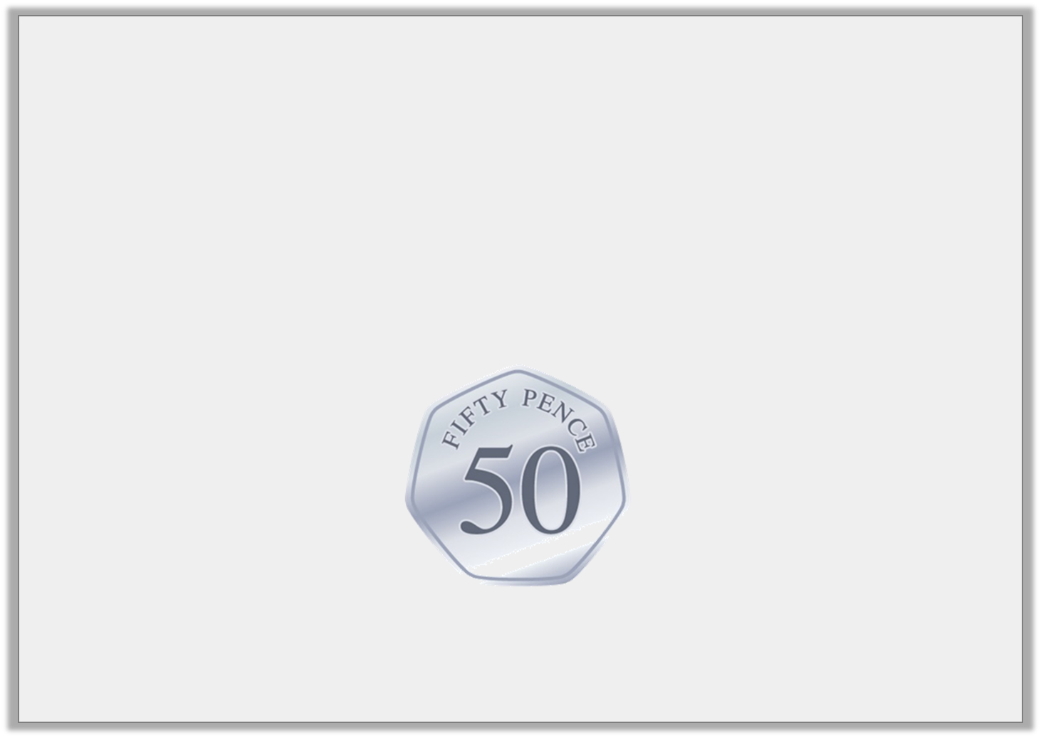
Problem Solving 1
Holly has been saving 50p coins.
She has more than £36.50 but less than £39.00.
How much could Holly have?
© Classroom Secrets Limited 2019

Slide 13
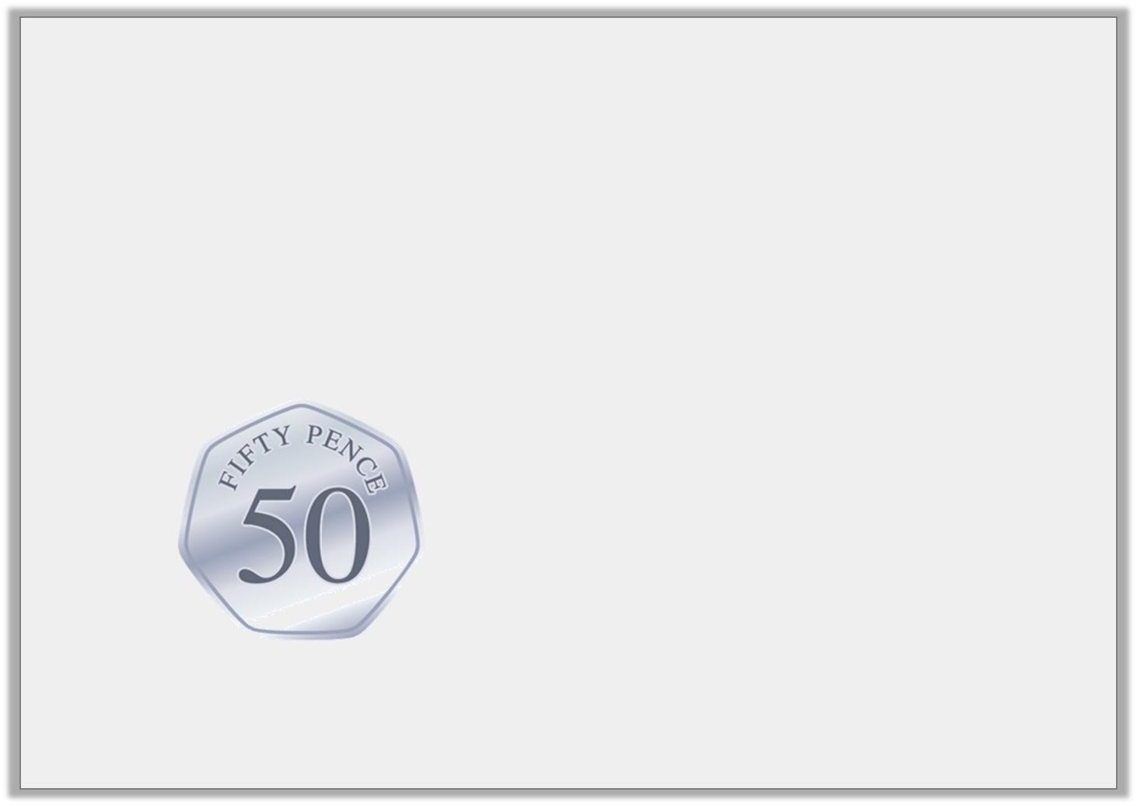
Problem Solving 1
Holly has been saving 50p coins.
She has more than £36.50 but less than £39.00.
How much could Holly have?
£37.00, £37.50, £38.00 or £38.50
© Classroom Secrets Limited 2019

Slide 14
Problem Solving 2
How many ways can you make this statement true? Use the digit cards below.
6
3
5
1
£5.61 >
3
© Classroom Secrets Limited 2019

Slide 15
Problem Solving 2
How many ways can you make this statement true? Use the digit cards below.
12: £3.13, £3.15, £3.16, £3.31, £3.35, £3.36, £3.51, £3.53, £3.56, £3.61, £3.63, £3.65
6
3
5
1
£5.61 >
3
© Classroom Secrets Limited 2019

Slide 16

Reasoning 1
Who has the most money? Explain why.
I have two 50p coins.
I have six 20p coins.
Lee
Milo
© Classroom Secrets Limited 2019

Slide 17
Reasoning 1
Who has the most money? Explain why.
Milo has the most because…
I have two 50p coins.
I have six 20p coins.
Lee
Milo
© Classroom Secrets Limited 2019

Slide 18
Reasoning 1
Who has the most money? Explain why.
Milo has the most because 6 x 20p = 120p
whereas 2 x 50p = 100p.
I have two 50p coins.
I have six 20p coins.
Lee
Milo
© Classroom Secrets Limited 2019

