Slide 1
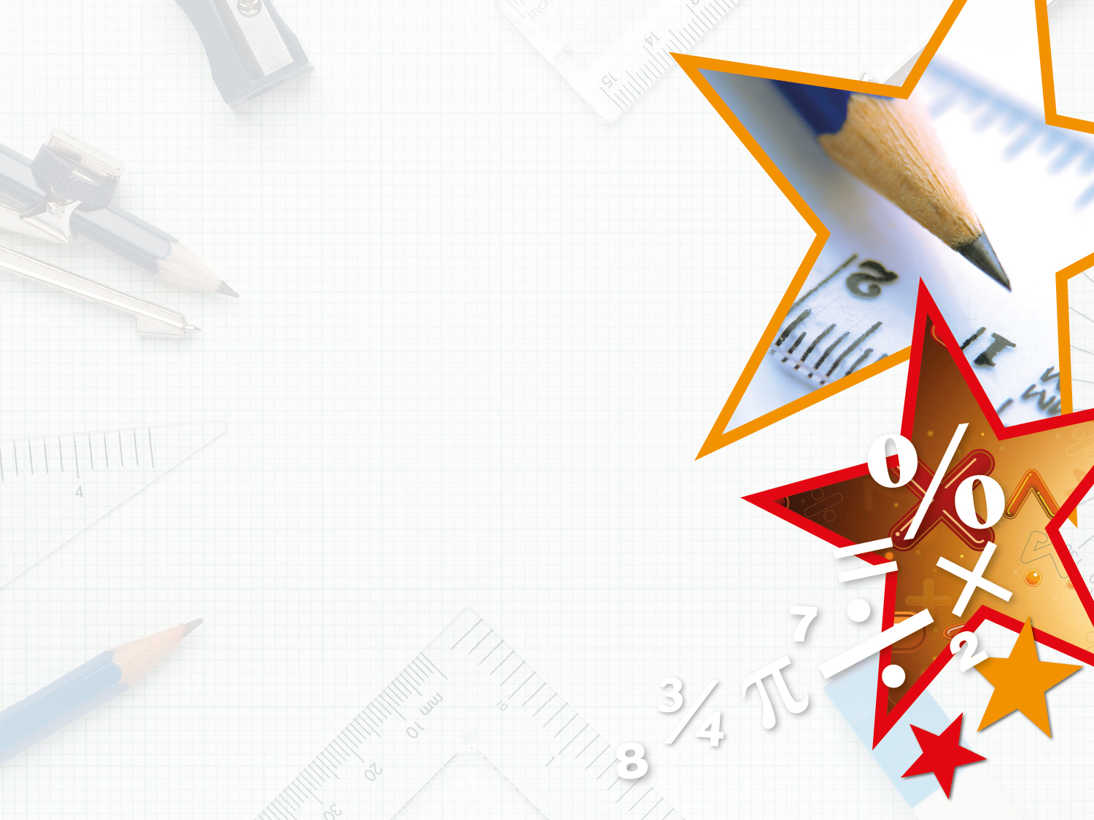

Year 4 – Spring Block 3 – Fractions
Step 10: Calculate Quantities
© Classroom Secrets Limited 2019

Slide 2

Introduction
Omar has 24 flowers.
Find of Omar’s flowers.
Find of Omar’s flowers.
Find of Omar’s flowers.
1
2
4
6
3
8
© Classroom Secrets Limited 2019

Slide 3
Introduction
Omar has 24 flowers.
Find of Omar’s flowers. 12
Find of Omar’s flowers. 16
Find of Omar’s flowers. 9
1
2
4
6
3
8
© Classroom Secrets Limited 2019

Slide 4
Varied Fluency 1
Marco is finding fractions of an amount. He knows that of his number is 6.
Complete the bar model to find the whole.
1
7
© Classroom Secrets Limited 2019

Slide 5
Varied Fluency 1
Marco is finding fractions of an amount. He knows that of his number is 6.
Complete the bar model to find the whole.
1
7
42
© Classroom Secrets Limited 2019

Slide 6
Varied Fluency 2
of a number is 20.
Complete the bar model to find the whole.
4
9
© Classroom Secrets Limited 2019

Slide 7
Varied Fluency 2
of a number is 20.
Complete the bar model to find the whole.
4
9
45
© Classroom Secrets Limited 2019

Slide 8
Varied Fluency 3
Lorna knows of a number is 12.
Use this information and the bar model above to complete the sentence below:
4
11
12
4 | of |  | =
11
© Classroom Secrets Limited 2019

Slide 9
Varied Fluency 3
Lorna knows of a number is 12.
Use this information and the bar model above to complete the sentence below:
4
11
33
3 | 3 | 3 | 3 | 3 | 3 | 3 | 3 | 3 | 3 | 3
12
4 | of |  | =
11
33 |  | 12
© Classroom Secrets Limited 2019

Slide 10
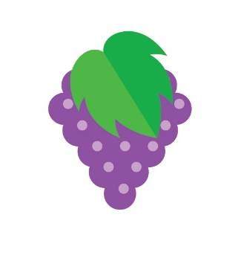
Varied Fluency 4
Locclan has a packet of grapes.
He has eaten of the packet.
He has eaten 15 grapes.
How many grapes were in the packet before Locclan started eating them?
5
12
© Classroom Secrets Limited 2019

Slide 11
Varied Fluency 4
Locclan has a packet of grapes.
He has eaten of the packet.
He has eaten 15 grapes.
How many grapes were in the packet before Locclan started eating them?
15 ÷ 5 = 3 and 3 x 12 = 36
There were 36 grapes in the packet.
5
12
© Classroom Secrets Limited 2019

Slide 12
Reasoning 1
Marley completes the following calculation in his book but he has made a mistake.
Find the mistake that he has made.
Draw a bar model to prove your answer.
If is 21, then the whole is 63.
3
7
© Classroom Secrets Limited 2019

Slide 13
Reasoning 1
Marley completes the following calculation in his book but he has made a mistake.
Find the mistake that he has made.
Draw a bar model to prove your answer.
Marley is incorrect because…
If is 21, then the whole is 63.
3
7
© Classroom Secrets Limited 2019

Slide 14
Reasoning 1
Marley completes the following calculation in his book but he has made a mistake.
Find the mistake that he has made.
Draw a bar model to prove your answer.
Marley is incorrect because he has not divided to find , he has multiplied 21 by the numerator. He should have divided by 3 and multiplied by 7 which gives a whole of 49 (21 ÷ 3 x 7 = 49)
If is 21, then the whole is 63.
3
7
1
7
49
7 | 7 | 7 | 7 | 7 | 7 | 7
© Classroom Secrets Limited 2019

Slide 15

Reasoning 2
Elodie is calculating a whole number from a fraction.
She says,
Is she correct? Explain how you know.
I know of a number is
14. To find the whole I can multiply 14 by 12 because that’s the denominator.
7
12
© Classroom Secrets Limited 2019

Slide 16
Reasoning 2
Elodie is calculating a whole number from a fraction.
She says,
Is she correct? Explain how you know.
Elodie is incorrect because …
I know of a number is
14. To find the whole I can multiply 14 by 12 because that’s the denominator.
7
12
© Classroom Secrets Limited 2019

Slide 17
Reasoning 2
Elodie is calculating a whole number from a fraction.
She says,
Is she correct? Explain how you know.
Elodie is incorrect because before she can multiply by the denominator, she must divide by the numerator (14 ÷ 7 = 2 and
2 x 12 = 24).
I know of a number is
14. To find the whole I can multiply 14 by 12 because that’s the denominator.
7
12
© Classroom Secrets Limited 2019

Slide 18
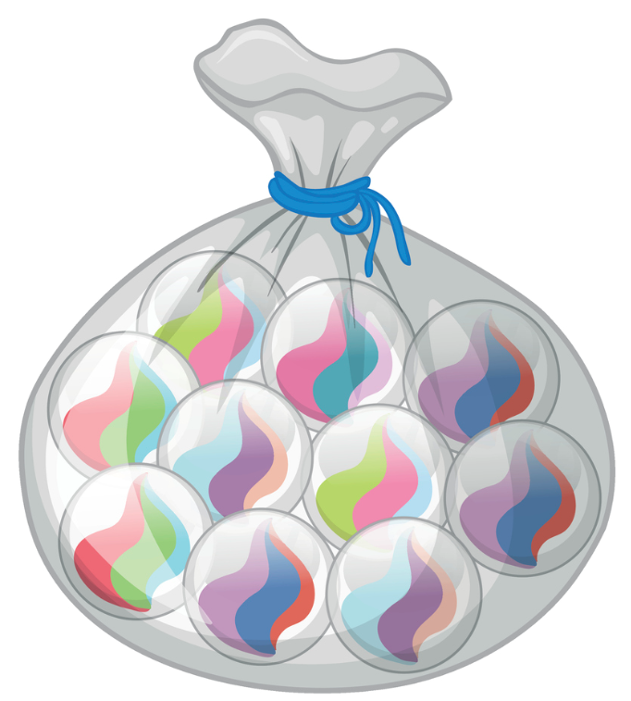
Problem Solving 1
Gina and Melvin are each collecting marbles in a bag.
of Gina’s bag is 16 marbles.
of Melvin’s bag is 12 marbles.
Who has the most marbles in their bag?
4
10
2
7
© Classroom Secrets Limited 2019

Slide 19
Problem Solving 1
Gina and Melvin are each collecting marbles in a bag.
of Gina’s bag is 16 marbles.
of Melvin’s bag is 12 marbles.
Who has the most marbles in their bag?
Gina has 40 marbles (16 ÷ 4 = 4 and 4 x 10 = 40) and Melvin has 42 marbles (12 ÷ 2 = 6 and 6 x 7 = 42). Melvin has the most marbles in his bag.
4
10
2
7
© Classroom Secrets Limited 2019

