Slide 1
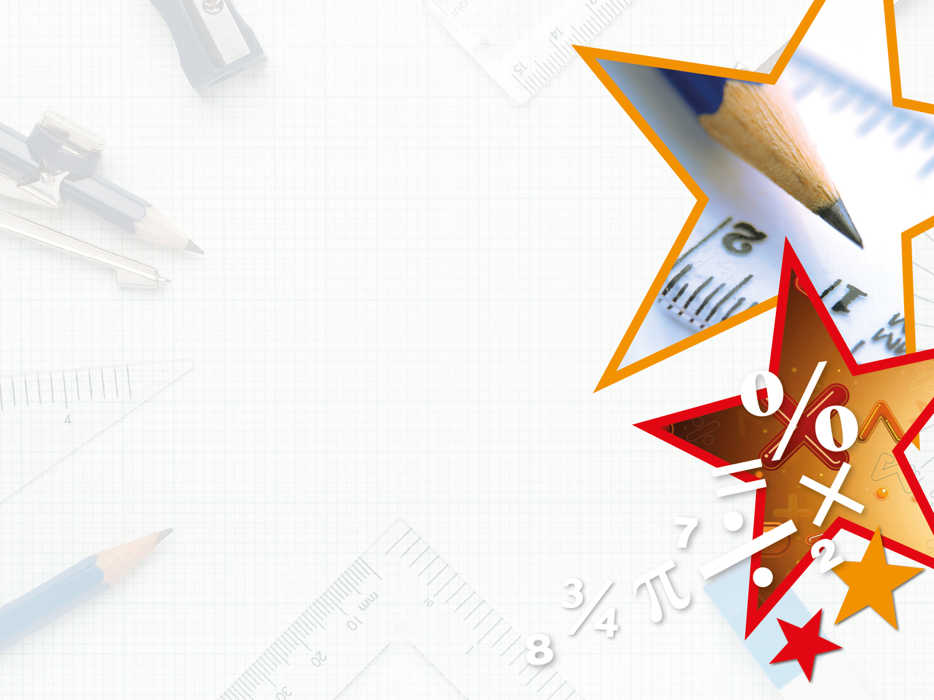

Year 4 – Spring Block 4 – Decimals
Hundredths As Decimals
© Classroom Secrets Limited 2019

Slide 2
Introduction
Circle the numbers greater than one.
99
100
0.5
9
8
0.16
2
10
3
2
1.03
© Classroom Secrets Limited 2019

Slide 3
Introduction
Circle the numbers greater than one.
99
100
0.5
9
8
0.16
2
10
3
2
1.03
© Classroom Secrets Limited 2019

Slide 4
Varied Fluency 1
Match the equivalent values.
0.06 |  |  | 0.71
 | 71 |  | 0.03
 | 100
three hundredths |  |  | forty hundredths
 | 40 |  |  | 6
 | 100 |  |  | 100
© Classroom Secrets Limited 2019

Slide 5
Varied Fluency 1
Match the equivalent values.
0.06 |  |  | 0.71
 | 71 |  | 0.03
 | 100
three hundredths |  |  | forty hundredths
 | 40 |  |  | 6
 | 100 |  |  | 100
© Classroom Secrets Limited 2019

Slide 6
Varied Fluency 2
True or false?
0.85 is equivalent to eighty five hundredths.
© Classroom Secrets Limited 2019

Slide 7
Varied Fluency 2
True or false?
0.85 is equivalent to eighty five hundredths.
True
© Classroom Secrets Limited 2019

Slide 8
Varied Fluency 3
Convert the hundredths to decimals.
72
100
5
100
64
100
=
=
=
© Classroom Secrets Limited 2019

Slide 9
Varied Fluency 3
Convert the hundredths to decimals.
72
100
5
100
64
100
=
0.72
0.05
0.64
=
=
© Classroom Secrets Limited 2019

Slide 10
Varied Fluency 4
What numbers go in the boxes below?
A
B
0.4 |  |  |  |  | 0.45 |  |  |  |  | 0.5
© Classroom Secrets Limited 2019

Slide 11
Varied Fluency 4
What numbers go in the boxes below?
0.44
0.48
0.4 |  |  |  |  | 0.45 |  |  |  |  | 0.5
© Classroom Secrets Limited 2019

Slide 12
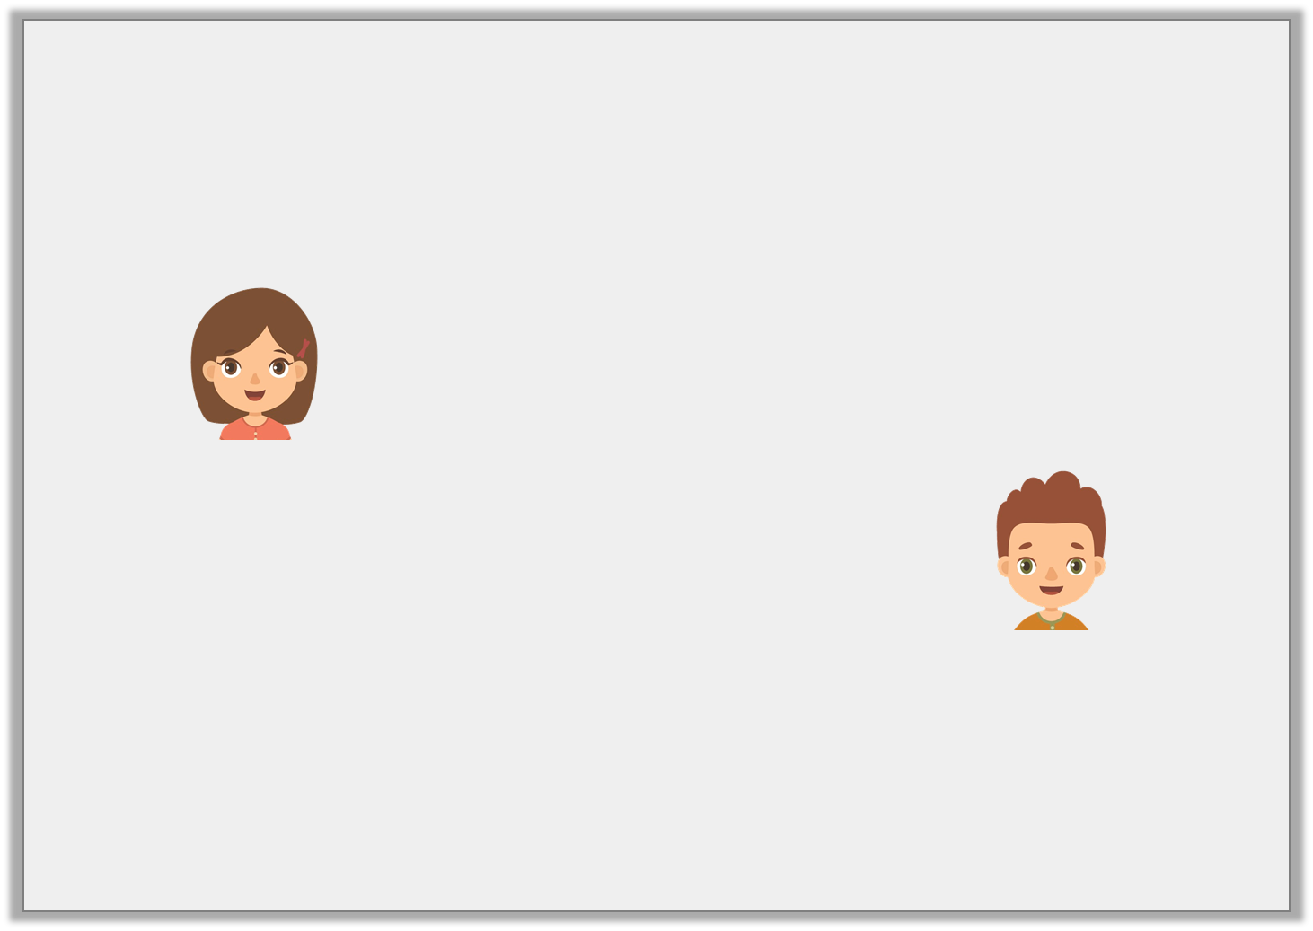
Reasoning 1
Who is correct?
Explain your answer.
5 | = | 0.05
100
This decimal is correct as it shows 50 hundredths.
Helen
This decimal is correct because it shows 5 hundredths.
Carl
© Classroom Secrets Limited 2019

Slide 13
Reasoning 1
Who is correct?
Explain your answer.
Carl is correct because...
5 | = | 0.05
100
This decimal is correct as it shows 50 hundredths.
Helen
This decimal is correct because it shows 5 hundredths.
Carl
© Classroom Secrets Limited 2019

Slide 14
Reasoning 1
Who is correct?
Explain your answer.
Carl is correct because the decimal has 5 hundredths and zero tenths. 50 hundredths would be 0.5 as a decimal.
5 | = | 0.05
100
This decimal is correct as it shows 50 hundredths.
Helen
This decimal is correct because it shows 5 hundredths.
Carl
© Classroom Secrets Limited 2019

Slide 15
Problem Solving 1
Use the digit cards to make three decimals less than one.
Write the equivalent fraction for each decimal you create.
4
6
0
0
© Classroom Secrets Limited 2019

Slide 16
Problem Solving 1
Use the digit cards to make three decimals less than one.
Write the equivalent fraction for each decimal you create.
Various answers, for example: 0.06 =
0.64 = , 0.40 =
4
6
0
0
6
100
64
100
40
100
© Classroom Secrets Limited 2019

Slide 17
Reasoning 2
Is this statement correct?
Explain your answer.
0.22 | > | 0.02
© Classroom Secrets Limited 2019

Slide 18
Reasoning 2
Is this statement correct?
Explain your answer.
Yes, the statement is correct because…
0.22 | > | 0.02
© Classroom Secrets Limited 2019

Slide 19
Reasoning 2
Is this statement correct?
Explain your answer.
Yes, the statement is correct because twenty two hundredths are greater than 2 hundredths.
0.22 | > | 0.02
© Classroom Secrets Limited 2019

