Slide 1
Division
14.01.21
Lesson 4

Slide 2
Learning objectives
LO: To consolidation my understanding of dividing by 3, 4 and 8.

Slide 3

What have we learnt so far?
Multiplication is the inverse operation to division
Division does not follow commutative law
There are three different ways to solve multiplication
There are different ways to ask division questions, but we are always sharing

Slide 4
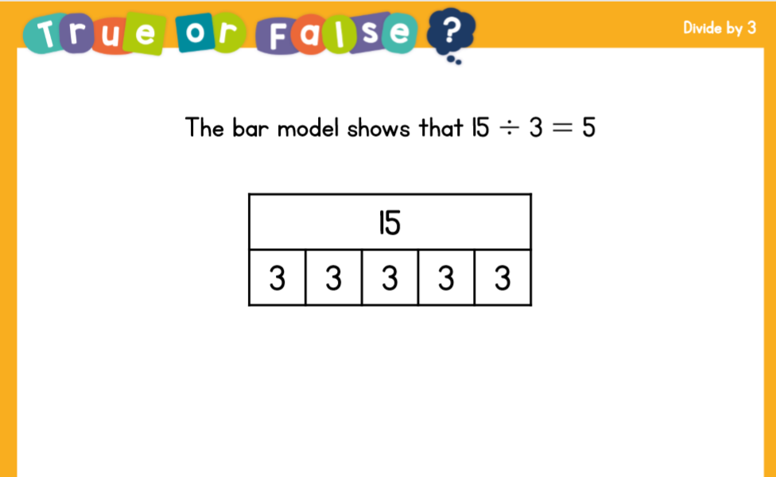

Slide 5
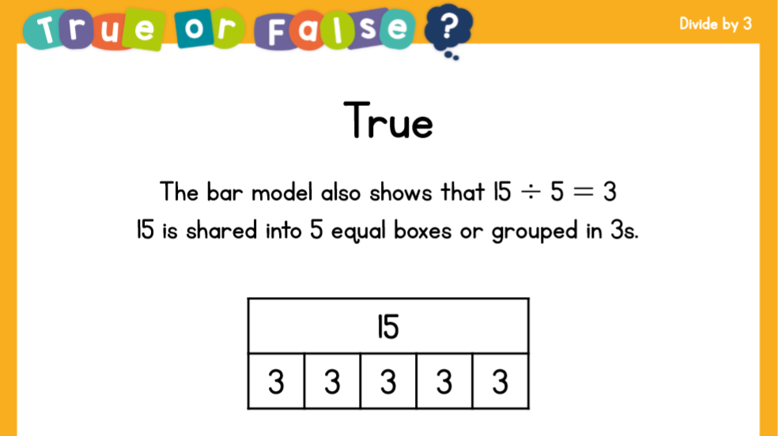

Slide 6
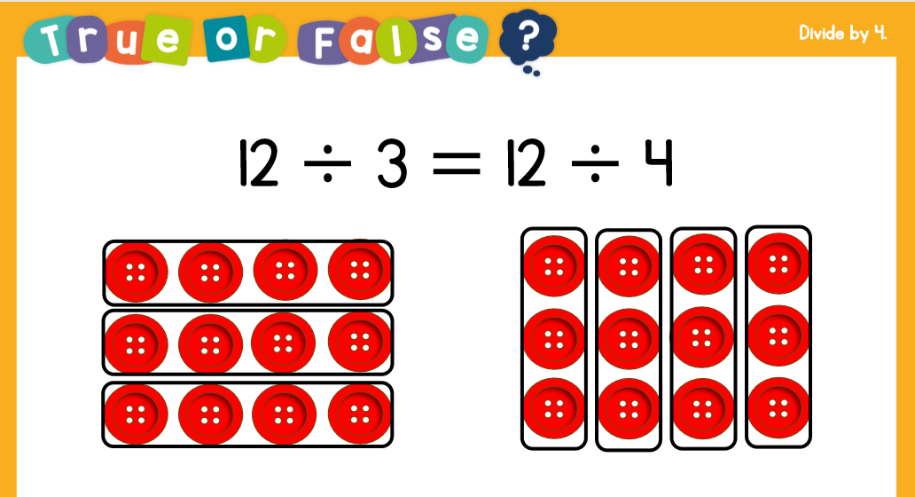

Slide 7
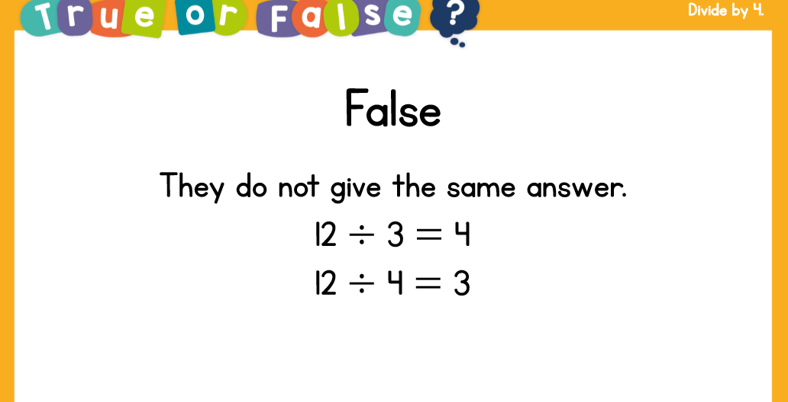

Slide 8
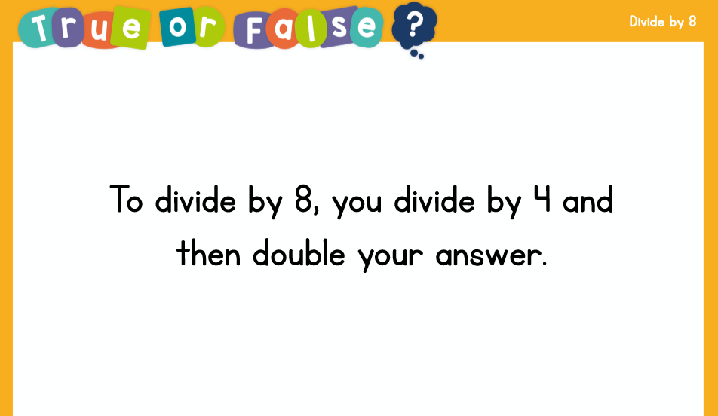

Slide 9
