Slide 1

Progressive Tenses
LO: To be able to use the present and past tenses correctly and consistently, including the progressive form.

Slide 2
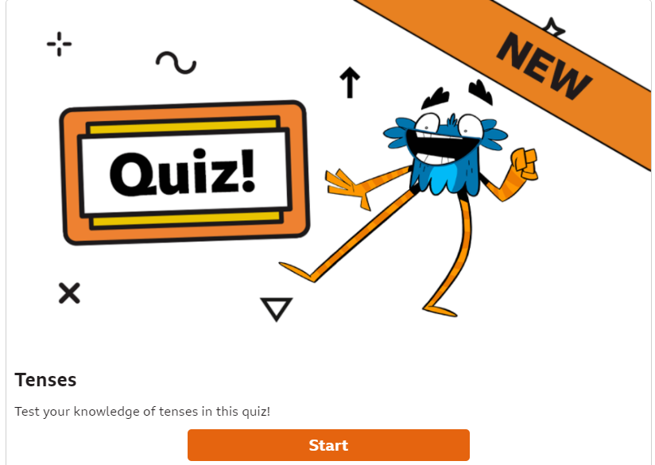
Starter:
To check our understanding of simple past, present and future tense, have a go at this quiz. https://www.bbc.co.uk/bitesize/articles/z4fq96f

Slide 3
In English, we use the progressive tense to talk about experiences and events that happened or continue to happen for a period of time.
We can use past progressive tense and present progressive tense.
When you think of the progressive tense
think of the word ‘progressing’. Any
progressive verbs will end in ‘-ing’.
Then use either ‘was’ or ‘were’ for past
or ‘is’ or ‘are’ for present, depending on
whether the noun is singular or plural.

Slide 4
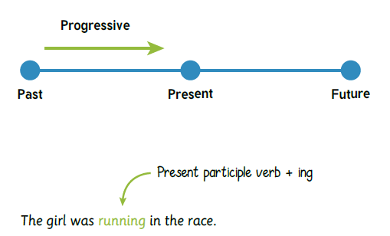
Past progressive tenses
The past progressive tense is
formed using ‘was’ or ‘were’ +
present participle verb and adding the –ing suffix.
Remember the best way to remember is to think of the
word ‘progressing’ and think ‘–ing’!

Slide 5
Past progressive tenses
Let’s play a game! Look at the following sentences and decide what the past
progressive verb could be. The first one has been completed for you.
The Romans were watching the gladiators.
Jamie Oliver _________________ the meal.
The boy ________________ rugby.
The athletes ________________ in the Olympics.

Slide 6
Past progressive tenses
Let’s play a game! Look at the following sentences
and decide what the past progressive verb could be.
The Romans were watching the gladiators.
Jamie Oliver was cooking the meal.
The boy was playing rugby.
The athletes were competing in the Olympics.

Slide 7
Present progressive tenses
The present progressive tense is formed using ‘am’ ‘is’ or
‘are’ + present participle verb and adding the –ing suffix.
The present progressive tense is used to show 3 things:
Actions that are happening now. | Actions that are temporary. | Definite future plans.
Their mother is cooking in the kitchen. | The girls are staying here for a few nights. | Tomorrow, I am going to climb the mountain.

Slide 8
Present progressive tenses
Let’s play a game! Look at the following sentences and decide what the
present progressive verb could be. The first one has been completed for you.
The politicians are debating on television.
Taylor swift _________________ at the festival.
The girl ________________ her tea.
The doctors ________________ brain surgery.

Slide 9
Let’s play a game! Look at the following sentences and decide what the
present progressive verb could be. The first one has been completed for you.
The politicians are debating on television.
Taylor swift is singing at the festival.
The girl is eating her tea.
The doctors are performing brain surgery.

Slide 10
